Slide 1
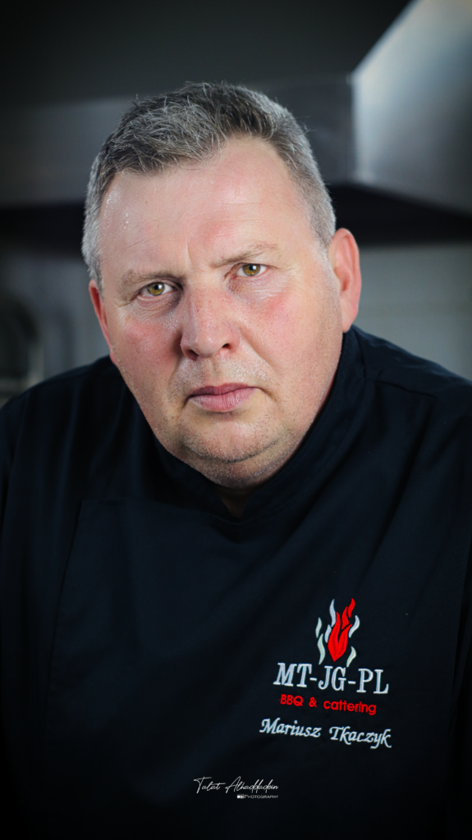
My name is Mariusz Tkaczyk.
The culinary art is my field of education, interests, hobbies and a great passion that fills my life. I have a huge experience gained through professional work and participation in many culinary competitions in the country and abroad.

Slide 2
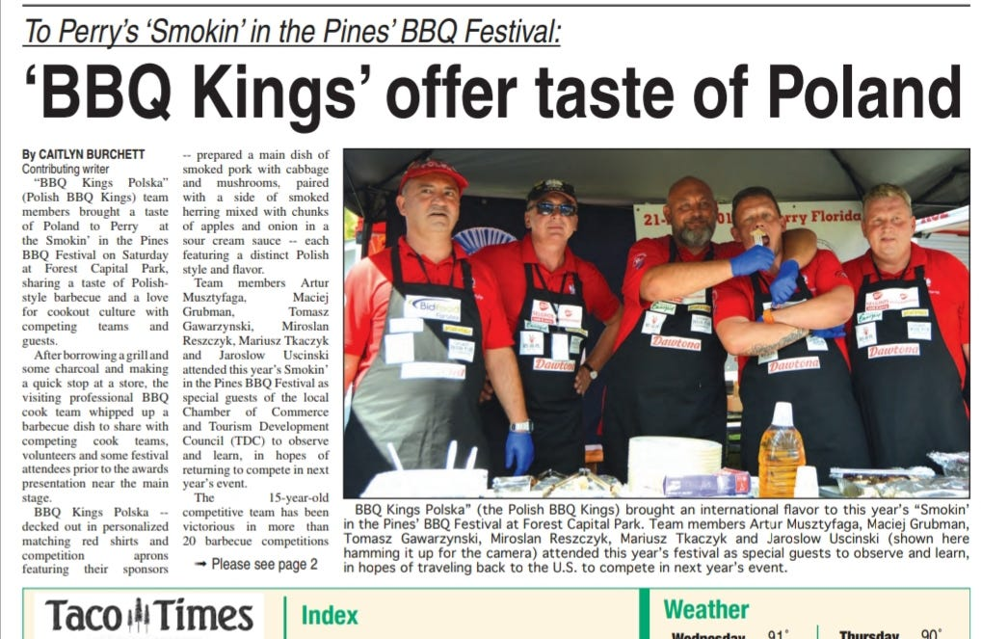

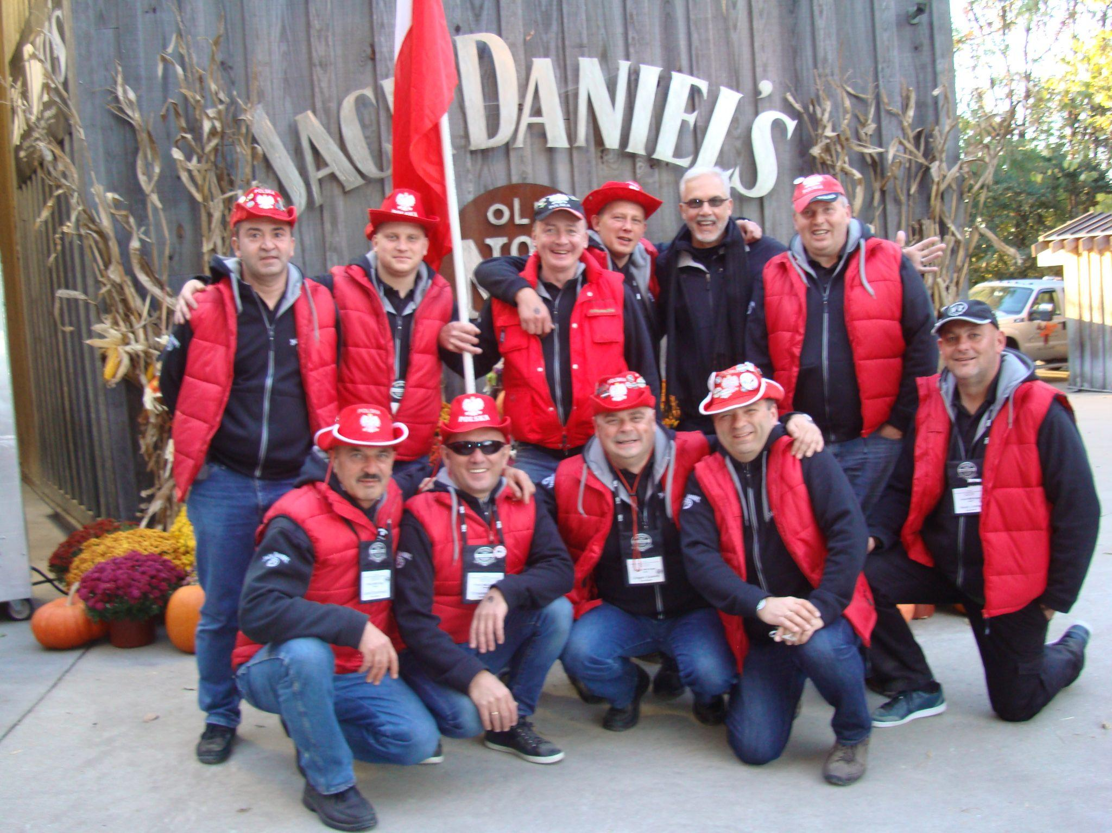
My specialty is BBQ. I have won the championship many times. I am a member of the Polish BBQ team.

Slide 3
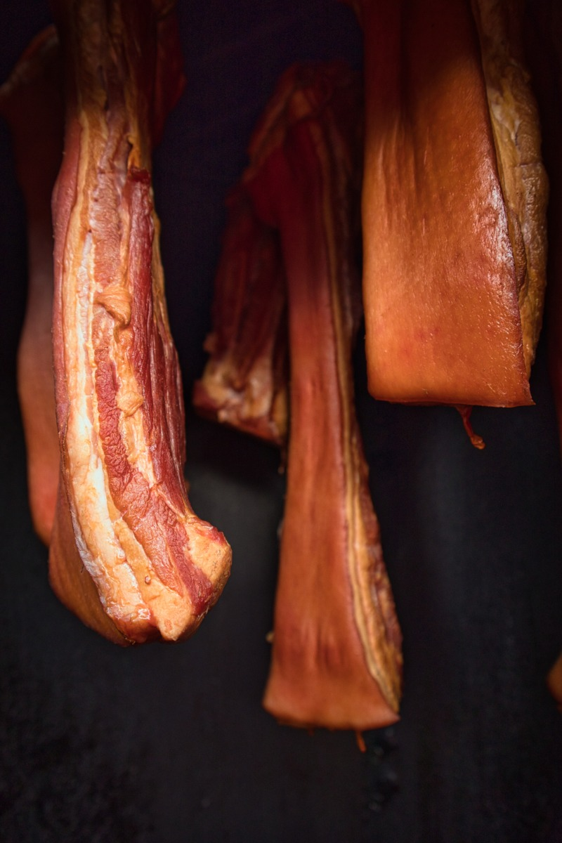

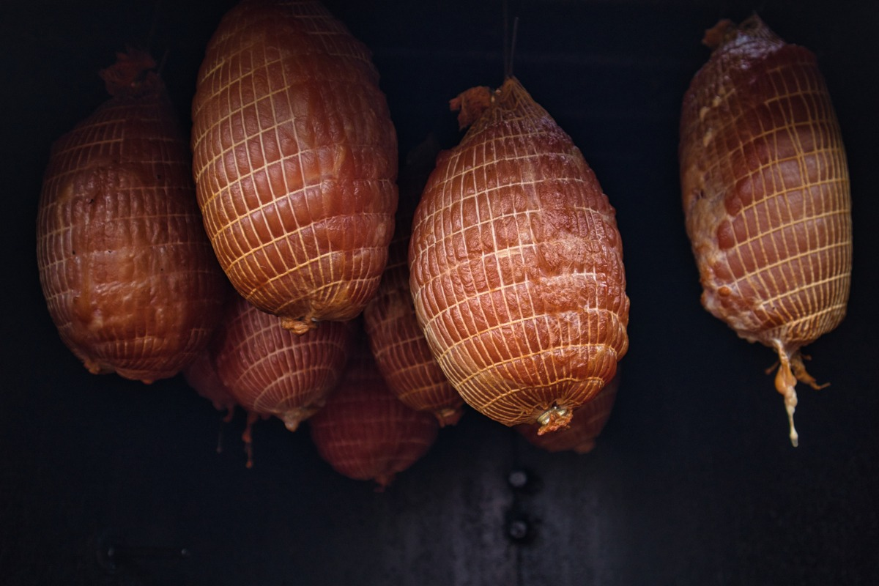
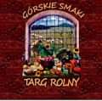
Kulinaria Mariusz Tkaczyk
Currently, I am involved in my own buisness. I prepare the local, traditional, high quality products mainly based on meat and fish. I am also present on our local market – ever Saturday we have an event Targ Rolny – Górskie Smaki. All local manufacturer are presenting their best products there.

Slide 4
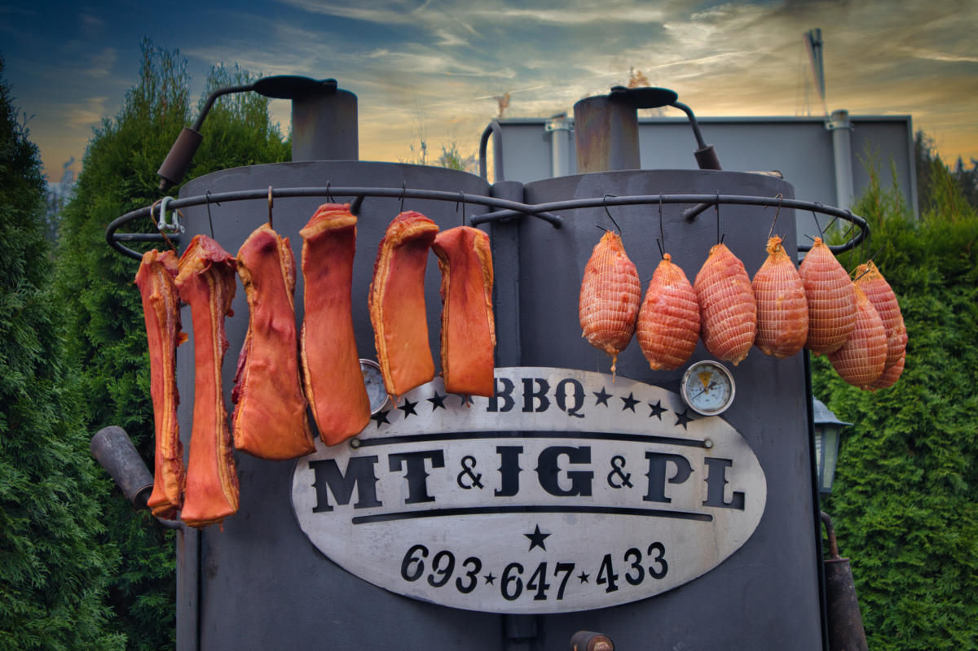
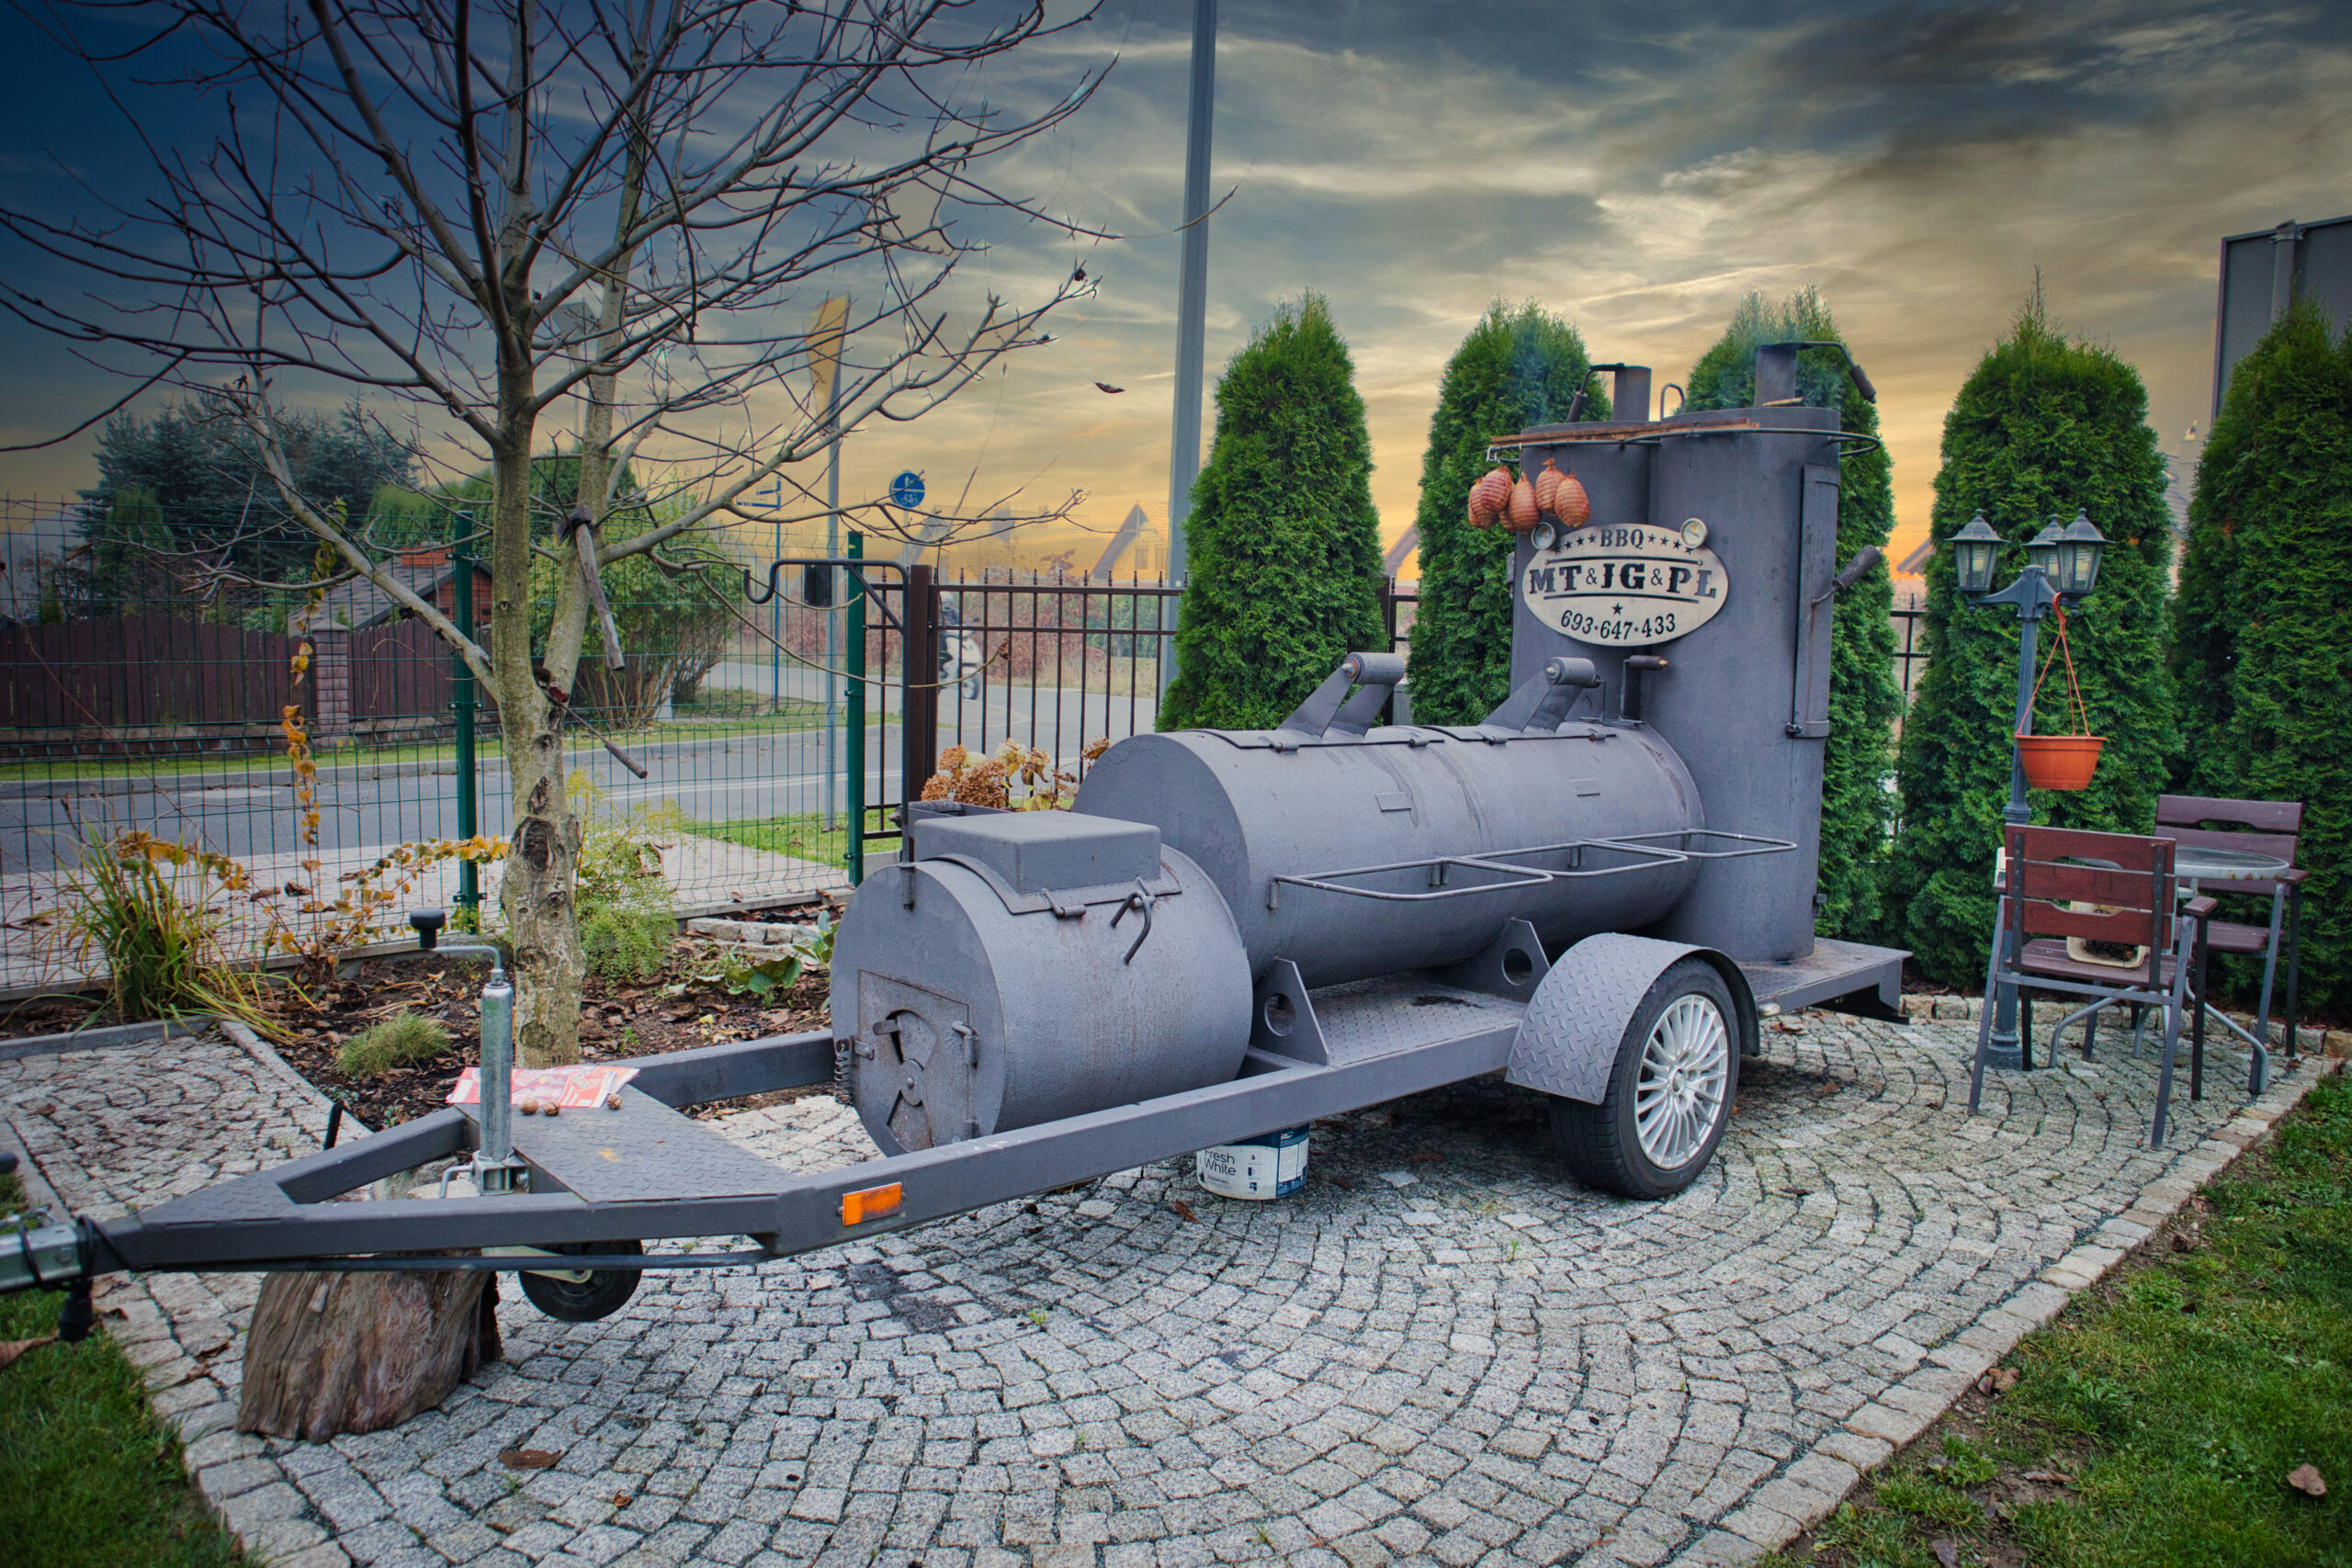
I also offer professional trainings and catering service with my unique smoking equpiment
Trainings
Catering

