Slide 1


How a Bank Can Support
International Business in Difficult Times
Club of Commercial Counsellors at the Polish Chamber of Commerce
Warsaw, 02.03.2023

Slide 2
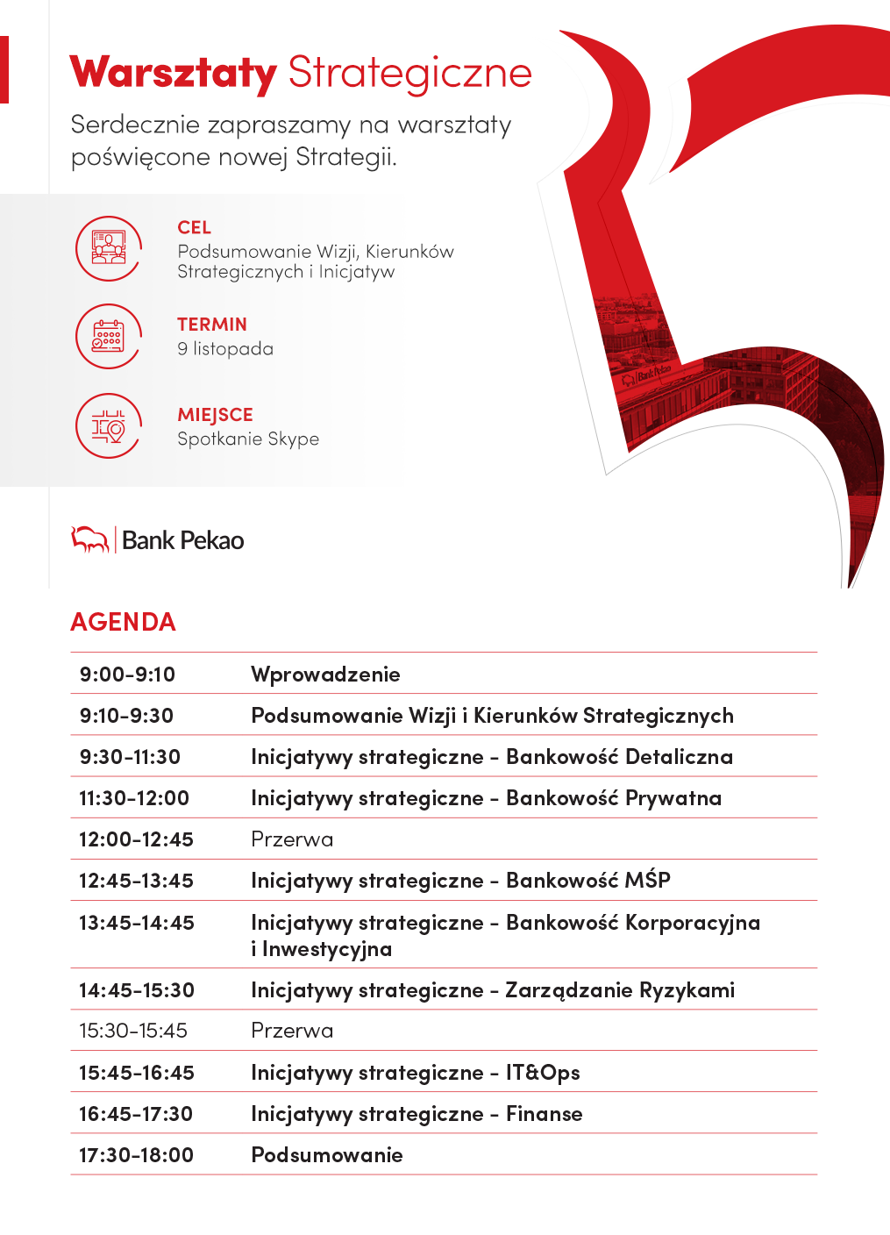
Macroeconomic overview Part I

Slide 3
Poland’s second Golden Age
Source: Maddison

Slide 4
The last 30 years – no longer recession-free
Source: World Bank, Eurostat

Slide 5

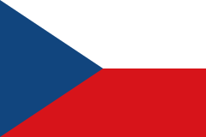








Despite the pandemic turmoil, Polish exports remained in a strong upward trend, maintaining strong geographic and product diversification
Export of goods from Poland, bn euros
Geographical and product structure of Polish exports
bn euros
CAGR
Top 10 partners, 2022
Main product categories, 2022
CAGR
CAGR
2004-19
2019-22
’10-’19
’19-’22
’10-’19
’19-’22
+10%
+13%
+9%
+13%
Machinery, appliances
+7%
+13%
+8%
+16%
Food, agriculture
+10%
+14%
+6%
+12%
Transport equipment
+6%
+5%
+10%
+12%
+7%
+6%
Metals, articles thereof
+6%
+15%
+8%
+15%
Chemical products
+9%
+16%
+5%
+14%
Plastics, rubber
+9%
+13%
+13%
+15%
Textiles
+10%
+15%
+7%
+17%
Mineral products
0%
+36%
% GDP
29
32
33
40
43
45
53
+6%
+25%
Paper, pulp
+7%
+12%
% global trade
+7%
+11%
Other
+11%
+11%
0,8
1,0
1,1
1,1
1,3
1,4
1,5¹
The dynamics of the value of Polish exports after 2019 accelerated compared to the previous decade, despite the pandemic turmoil, which was strongly supported by price trends prevailing in Europe. The Poland’s exports to the GDP ratio is also systematically growing, as well as its share in global trade.
Exports to the EU-27 countries remained the main driving force, though within the Community the geographical diversity was still relatively strong (regardless of the leading role of Germany). Sales outside the EU also maintained a strong growth rate - in particular, after the outbreak of war in Ukraine, Poland became the gateway to this country for EU support.
Polish exports also remain highly diversified in terms of products, with all key categories (except vehicles) growing faster in 2019-22 period than in the previous decade (the impact of price effects, the most visible in the categories of raw materials, and especially energy).
1) As of 2021 - the most up-to-date data available
Source: Statistics Poland, International Trade Centre

Slide 6






The portfolio of foreign direct investments in Poland grows systematically. The trend accelerated after 2015, and the outbreak of the pandemic slowed it down only temporarily.
Foreign direct investment in Poland inward position
Geographical and product structure of FDIs
bn euros
CAGR
bn euros
Top 10 investors, 2022
FDI inward position by economic activity, 2022
2010-15
2015-21
CAGR
CAGR
’10-’15
’15-’21
’10-’15
’15-’21
+1%
+6%
+2%
+7%
Manufacturing
+2%
+5%
+4%
+8%
Trade¹
+1%
+5%
+11%
+5%
Financial activities²
-4%
+2%
-1%
+2%
Real estate activities
+6%
+10%
+11%
+12%
Professional activities³
+4%
+10%
+14%
+2%
ICT activities
+4%
+8%
+4%
+7%
Construction
+3%
+6%
+7%
-1%
Electricity, gas supply
+3%
+3%
+7%
+7%
Transportation, storage
+2%
+8%
-7%
+7%
Other
+4%
+11%
After a period of stagnation in the first half of the previous decade, after 2015 the value of the FDI portfolio in Poland returned to a fairly solid growth path. In 2021, our country accounted for 29% of the entire FDI portfolio in the EU countries of the CEE ⁴, and starting from 2015, Poland attracted 39% of the entire inflow of these investments to the region.
In the 2015-21 period, the value of investments from countries playing a key role in the entire FDI portfolio (Netherlands, Germany, Luxembourg) showed high dynamics, but it also grew rapidly in the case of some smaller players (Austria, Belgium, Switzerland) as well as international companies based in Cyprus.
The largest share of the FDI portfolio in Poland still belongs to the highly developed and pro-export manufacturing. However, in the years 2015-21, strong dynamics were reported in modern, dynamically developing branches of the economy (ICT - especially in the area of ​​IT services - and professional, scientific and technical activities) as well as in real estate activities, transport and logistics, and in a group of branches (most of all service activities) that have played a minor role in the portfolio so far.
1) Both wholesale and retail 2) Including insurance activities 3) Including scientific and technical activities 4) Taking into account Poland, Czechia, Slovakia, Lithuania, Latvia, Estonia, Hungary, Romania, Bulgaria, Slovenia, Croatia Source: NBP, UNCTAD

Slide 7
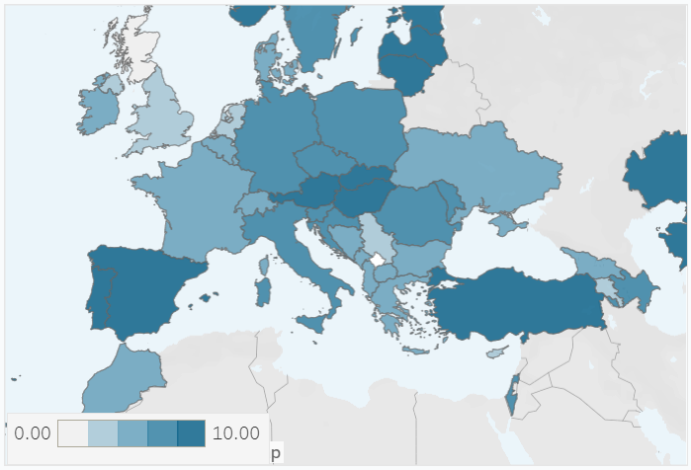
Challenges that lie ahead
Challenge | Demographic decline | Negative NIIP | Energy transition | Underdeveloped financial markets | Justice system
Illustration
Silver lining | Immigration | Steady improvement | The EU mandates it | Treat it as an opportunity | Many laggards, Poland can lead
Deployment of ICT systems
Source: UN Population Projections, NBP, Eurostat, Macrobond, Stooq, COE

Slide 8
Outlook for 2023-24: let’s remain optimistic
Area | indicator |  | 2021 | 2022 | 2023 | 2024
Economic growth | GDP (% yoy) |  | 6,8 | 4,9 | 0,8 | 3,2
 | Household consumption (% yoy) |  | 6,2 | 3,0 | -0,4 | 2,9
 | Investment (% yoy) |  | 2,0 | 4,9 | 3,5 | 6,2
Prices and monetary policy | CPI (% yoy, annual average) |  | 5,1 | 14,4 | 12,2 | 6,2
 | CPI (% yoy, end of period) |  | 8,6 | 16,6 | 7,2 | 5,5
 | Core CPI (% yoy) |  | 4,1 | 9,1 | 10,2 | 4,8
 | NBP reference rate (%, end of period) |  | 1,75 | 6,75 | 6,50 | 4,00
Labor market | Unemployment rate (%, end of period) |  | 5,4 | 5,2 | 5,5 | 5,8
 | Corporate employment (% yoy) |  | 0,5 | 2,4 | 1,0 | 0,0
 | Corporate wages (% yoy) |  | 8,6 | 12,9 | 10,7 | 6,7
Public finance | Fiscal balance (ESA2010, % GDP) |  | -1,8 | -3,5 | -3,7 | -2,8
 | Public debt (ESA2010, % GDP) |  | 53,4 | 48,1 | 50,9 | 49,0
Balance of payments & FX | Current acount balance (% GDP) |  | -1,4 | -3,2 | -1,1 | 0,3
 | EUR/PLN (end of period) |  | 4,60 | 4,69 | 4,74 | 4,78
 | USD/PLN (end of period) |  | 4,06 | 4,40 | 4,27 | 4,23
Source: GUS, NBP, Refinitiv Pekao Research

Slide 9
How institutions can support entrepreneurs in their international activities - our experience and capabilities Part II

Slide 10


A network of cooperating institutions and organizations supporting international expansion can help to consolidate the competitive position of enterprises
Various competences to support international expansion are located In public institutions as well as business or trade organizations, such as:
Ministry of Foreign Affairs, Ministry of Development and Technology
Embassies
The Polish Chamber of Commerce
Public Agencies supporting export and foreign expansion
Export Credit Insurance Corporation
State-owned entities providing capital instruments
The Banking sector
Cooperation between institutions brings measurable benefits for entrepreneurs.
On 31 January 2023, an agreement was signed between the Polish Chamber of Commerce (KIG) and Bank Pekao SA
The Parties express their intention to undertake joint actions for the development of exports from Poland and accelerate the international economic expansion of entrepreneurs, by providing them with substantive care, expert knowledge and access to comprehensive financial solutions, as well as by facilitating contacts with potential contractors.

Slide 11




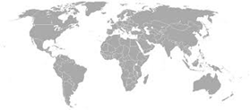
Cooperation with KIG: by associating businesses, combining the know-how of institutions and financing tools, we will support entrepreneurs in their international activities
What tasks can we carry out together?
Networking: building business cooperation between Polish and foreign companies and institutional support
Organization of workshops and trainings for enterprises and institutional partners
Coordinated market and product expertise: presentation of product solutions, support programs and tools, and best practices
Access to international banking and export finance specialists, export insurance specialists and foreign markets
Providing industry and market reports, macroeconomic analyses
How can we help entrepreneurs together?
We associate businesses: building business cooperation between Polish and foreign companies
We generate demand for export and international expansion - promotion of entrepreneurs on foreign markets
We become partners in structuring foreign ventures – close cooperation with enterprises from the earliest stages of contract planning
We strengthen the competitiveness of entrepreneurs – expanding the exporter's offer with financing opportunities and market know-how

Slide 12

Bank Pekao Competence Centre for international business ventures and commercial operations of enterprises
INTERNATIONAL EXPANSION
A UNIQUE RANGE OF PRODUCTS
TRADE FINANCING
SERVICES FOR INTERNATIONAL CUSTOMERS
Expertise and support for foreign expansion of Polish companies
Comprehensive export finance offer
Financing foreign acquisitions
Solutions with the support of export credit agencies
Settlement of commercial transactions
Hedging against transaction risk in most countries of the world
Trade financing
Financing investments related to international expansion
Modern tools
Specialized teams of product experts
Best Trade Finance Provider – 2023
Support for international companies operating in Poland and entering the Polish market
First Point of Contact for international representatives of corporate clients.
Experienced team of experts coordinating business meetings, talks & development of an offer tailored to the needs of an international company
COMPETENCE CENTRE

Slide 13
Our experience - examples of transactions
Part III

Slide 14

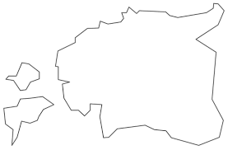






Case 1: Spanish capital group manufactures means of transport in Poland and exports them to Estonia
Delivery of vehicles manufactured in Poland
Financed by Bank Pekao via purchase of receivables from the delivery contract
BENEFITS for Exporter / Borrower:
The Exporter: subsidiary of a Spanish capital group located in Poland
Won the tender for delivery of vehicles
Profited from accelerated payment terms and improved liquidity thanks to bank financing
Banks’s flexible approach to collateral
Transferred risk of non-payment to the Bank
Long term cooperation, repeated export finance transactions
BENEFITS for Importer:
The Importer: municipal company located in Estonia
Purchased modern high-quality transport fleet
Comfort of bank partner supporting the contractor
Reliability
Conformity with tender rules and requirements

Slide 15
Case 1: Spanish capital group manufactures means of transport in Poland and exports them to Estonia
Purpose of financing
3
Financing of invoices issued by the Exporter
Supplier / Exporter
Buyer
1
Transaction process
4
2
5
Characteristics
Contract
Financing agreement with the Bank
Dispatch of goods / Invoice
Accelerated payment of funds by the Bank to the Exporter
Payment by the Buyer
The supplier (exporter) provides trade credit to a foreign contractor (importer) on the basis of an export contract
The Bank provides financing to the Exporter by discounting invoices
Bank

Slide 16
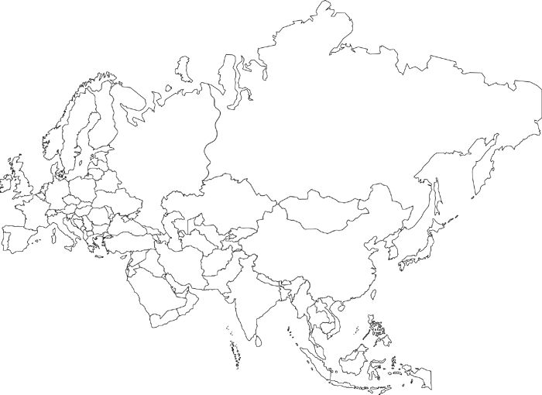






Case 2: Asian and European manufacturers deliver to a clothing company based in Poland
Delivery of clothing manufactured in Asia & Europe
Suppliers financed by Bank Pekao via Open Platform for Financing
BENEFITS for Importer:
The Importer: Clothing company located in Poland
Benefits from convenient payment terms
Manages and controls the financing program via electronic platform
Technical support 24/7
Professional service & point of contact
Access to the database
BENEFITS for Exporters / Borrowers:
Exporters: SME companies based in Bangladesh, China, Germany, Hungary, India, Turkey
Invoice paid earlier on non-recourse basis
Cash-flow optimization & balance sheet improvement
Access to financing without the need of the Bank financial analysis
Free of charge access 24/7 on-line to the Open Platform for Financing
International service desk & point of contact

Slide 17
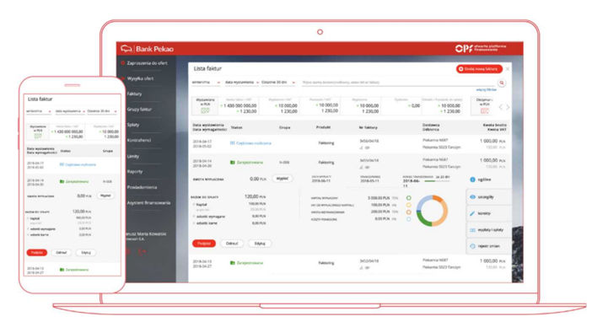
Case 2: Asian and European manufacturers deliver to a clothing company based in Poland
Purpose of financing
Financing of invoices issued by Suppliers
1
Supplier / Exporter
Buyer
2
Characteristics
Transaction process
Launching the Financing Program requires an assessment only of the Buyer's creditworthiness.
Upon invitation form the Buyer, the Supplier can join the on-line Open Platform for Financing
The Bank finances invoices entered into the system by the Buyer.
The Supplier bears the cost of financing invoices for the period from the date of financing to the invoice payment date. The Bank does not assess the Supplier's creditworthiness.
The Supplier receives 100% of the invoice amount less financing costs.
4
3
5
Contract / Order
Dispatch of goods / Invoice
3. Invoice confirmation
Payment of funds by the Bank to the Supplier
Payment by the Buyer
Bank

Slide 18
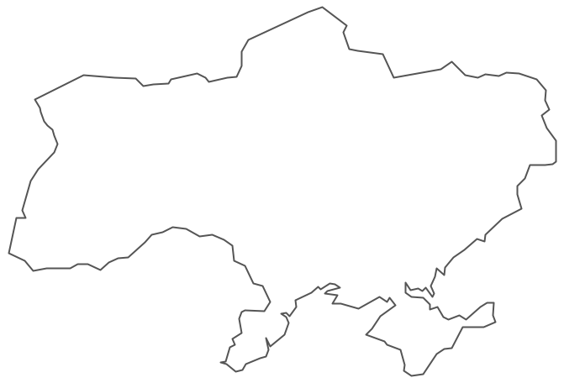
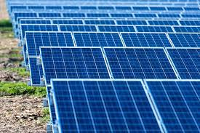

Case 3: A company from Ukraine signs a contract with a general contractor & supplier from Poland and obtains an investment loan
Construction & supply of equipment from Poland
Financed by Bank Pekao via investment loan for the Ukrainian company
with insurance from export credit agency
BENEFITS for Exporter:
The Exporter: company based in Poland acting as general contractor and supplier of equipment
Protection against the risk of non-payment
Increased exporter’s competitiveness
BENEFITS for Importer / Borrower:
The Importer: company based in Ukraine, investing in a photovoltaic farm
Obtained financing of the investment project
Long-term financing
Favourable cost of financing compared to the conditions on the importer’s home market

Slide 19
Case 3: A company from Ukraine signs a contract with a general contractor & supplier from Poland and obtains an investment loan
4
1
Purpose of financing
Exporter
Buyer
Long-term financing of an investment in which the Polish party acts as a contractor (or subcontractor)
Transaction process
2
Export contract
Loan agreement directly with the buyer
3. Establishing a security package
4. Payment of funds made directly to the Exporter's account
Bank
Characteristics
Financing of the export contract
Tailor-made security package, including those offered by insurers
Up to 85% of the export contract
3
Insurer

Slide 20
THANK YOU
Magdalena Szczepańska
Piotr Stolarczyk
Head of International Clients Office
International Banking & Trade Finance Department
Magdalena.Szczepanska@pekao.com.pl
Head of International Banking & Trade Finance Department
Piotr.Stolarczyk@pekao.com.pl

