Slide 1


Epidemic prevention and management Lessons from Taiwan to Poland
Marcin Jaskula
CEO

Slide 2

How it all started…
The World Health Organization (WHO) was first alerted to a novel coronavirus outbreak by Chinese authorities on the 31 December 2019.
In the following weeks, an increasing number of cases and deaths were reported outside China (the epicentre), prompting WHO to declare COVID-19 a Public Health Emergency of International Concern (PHEIC) on 30 January 2020 and a pandemic on 12 March 2020.

Slide 3
What is the situation now (as of Nov 18 2020)

Slide 4
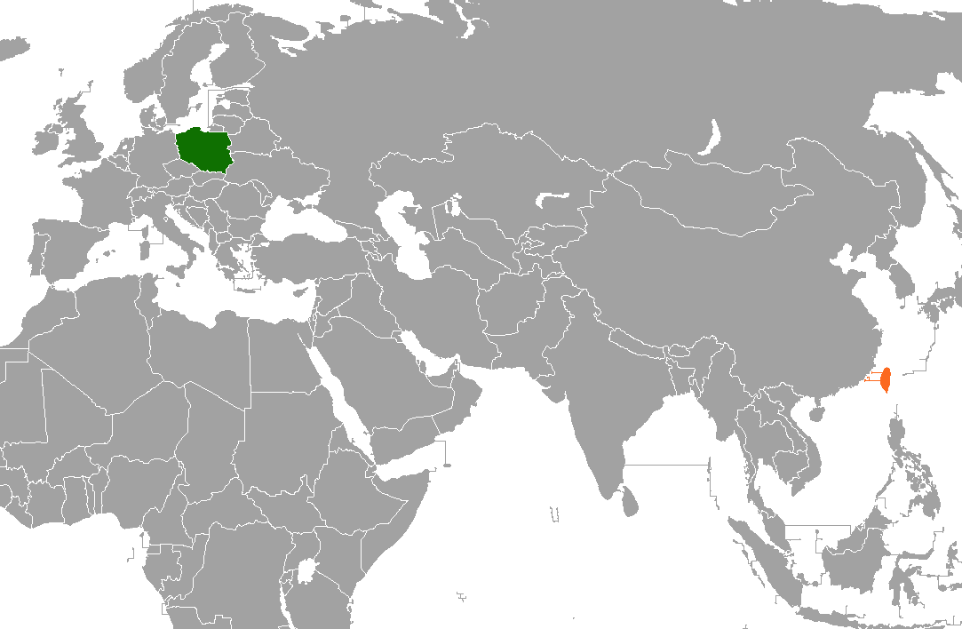
Why Taiwan has done so much better then Poland?
The secret of Taiwan’s success lies in the painful memories of the 2003 outbreak of the Severe Acute Respiratory Syndrome, known as SARS.
Also caused by a type of coronavirus, the disease was a direct predecessor of COVID-19.
Even the name of the current coronavirus that has wreaked havoc across the globe -- SARS-CoV-2 -- is derived from SARS-CoV, the coronavirus identified in 2003 as the cause of SARS.

Slide 5
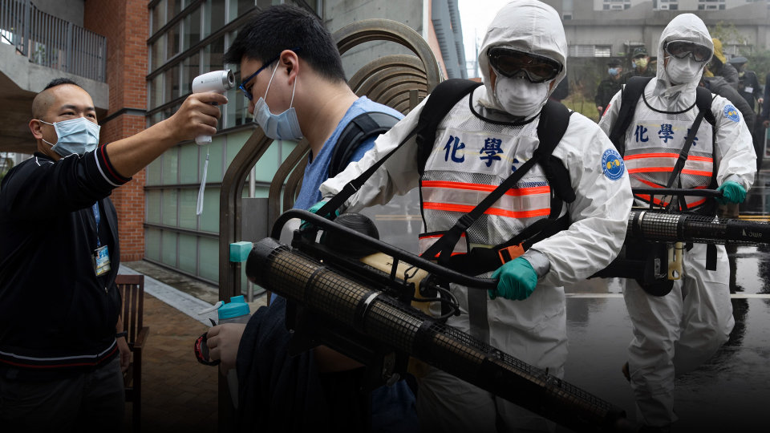
2003 SARS outbreak in Taiwan
The SARS epidemic, which affected 26 countries and resulted in more than 8,000 cases and nearly 800 deaths worldwide, hit Taiwan.
Taiwan had the highest mortality rate in the world in the SARS outbreak. In just one hospital in Taipei, there were 154 cases and 31 deaths.

Slide 6
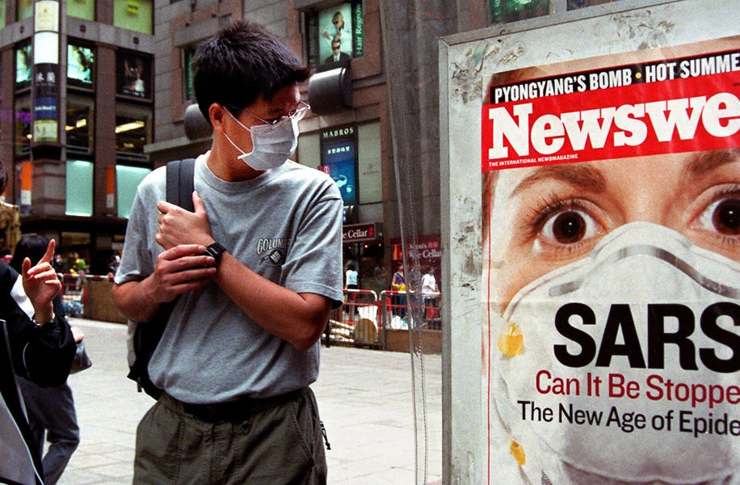
Lessons Taiwan drew from 2003
Well-trained and experienced public health officials were quick to recognize the crisis and launched an emergency public health response to contain the emerging outbreak
They established a National Health Command Center as the hub for number of smaller centers charged with responding to epidemics, biological pathogens, bioterrorism and medical emergencies.
Taiwan expanded their surveillance net to include anyone who had traveled to Wuhan in the previous two weeks. By Jan. 20, the government activated the Central Epidemic Command Center and charged it with coordinating all government efforts to combat the growing health crisis.
In an effort to contain the epidemic, Taiwan employed the most powerful tools at its disposal – big data and analytics.

Slide 7

Masks and medical care
Wearing masks and putting emphasis on medical care were the two crucial keys to Taiwan's success in preventing COVID-19 spread
In Poland it was generally believed that only infected patients need to wear a mask and that wearing a mask implies an admission of disease.
In Taiwan, on the other hand, it is common for people to wear masks to prevent COVID-19 and Taiwanese commonly do so during winter and many even during summer (pre-COVID)

Slide 8

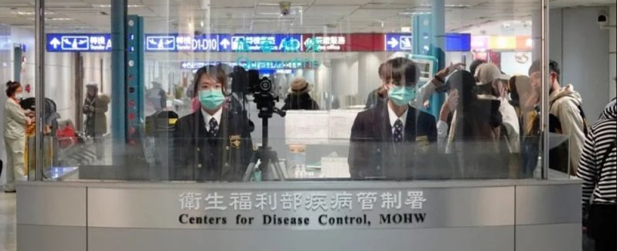
Lessons for Poland. Key stategies to implement immediately
1. Operational Structure
2. Legislation
3. Prevention Strategies
Surveilance and lab diagnostics
Border control
Control of community transmittion
Medical system response and prepardness
Health education and fighting missinformation

Slide 9


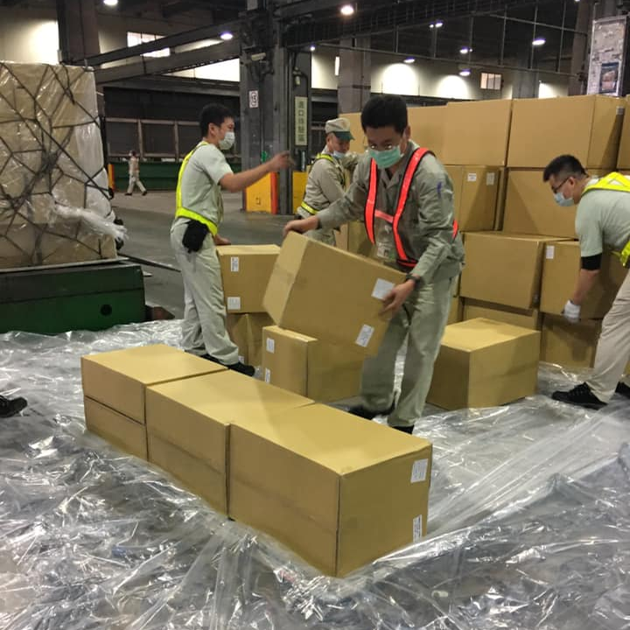
Working with Taiwan – a solid and trustworthy international partner
PPE shipments from Taiwan to Poland ( April/May 2020)
CRITICAL TIMING

Slide 10

Thank you for your attention
Marcin Jaskula 马尔钦
e: marcin.jaskula@nomibiotech.eu
t: +886965483994

