Slide 1
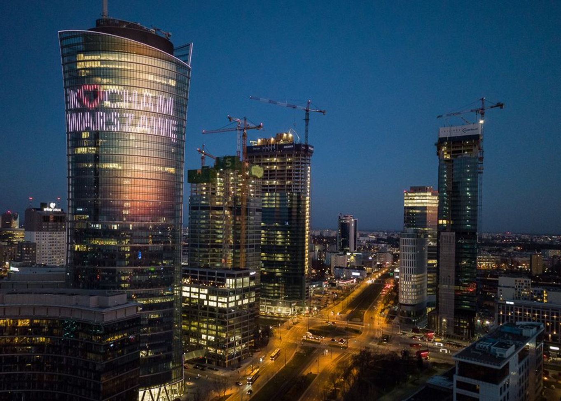
Investment Climate and Business Opportunities in Poland
Poland - Turkey economic cooperation

Slide 2
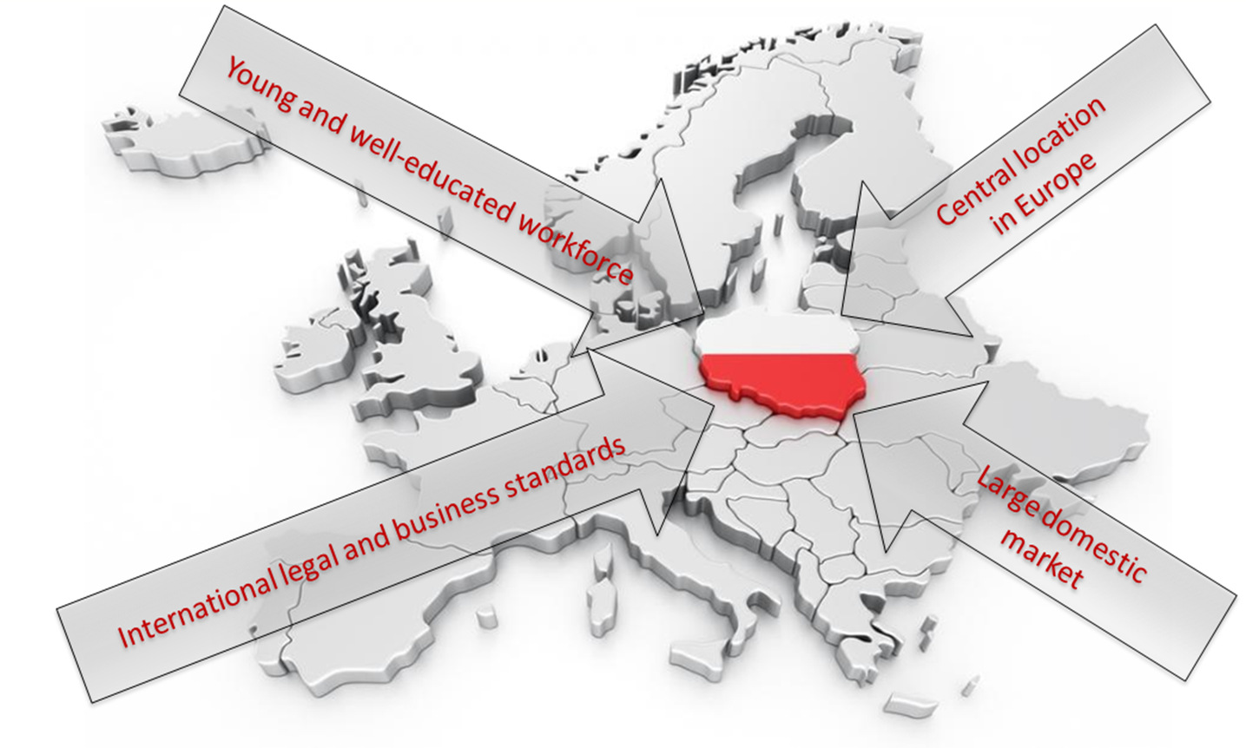
Poland – central location in Europe

Slide 3
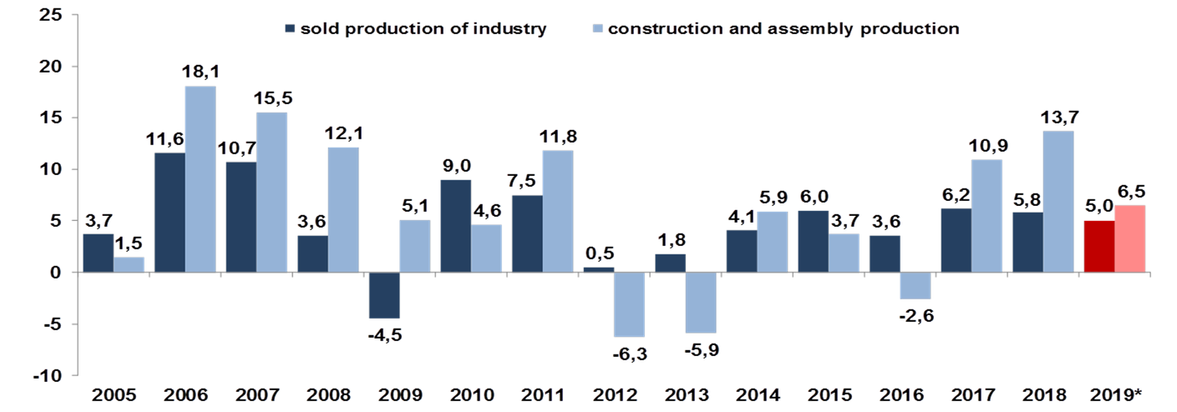
Polish Economy – main information
Sold production of industry, construction and assemby production (%, YoY)
GDP Growth
?
4,0

Slide 4

Polish economy more resistant to virus than others?
The Polish economy is set to be the least affected in the EU by the Covid-19 pandemic.
In forecast prepared by experts GDP is currently expected to decline by 2,4% against 3.5 % previously.
The Commission added that Poland should bounce back in 2021 with GDP growth predicted to increase by 4 %.

Slide 5
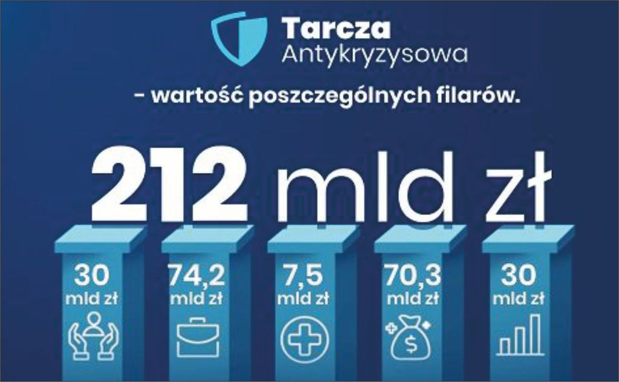
Anti-crisis measures for business - Anti-crisis Shield
Anti-crisis Shield it is the package of solutions with aim to protect Polish economy and Polish citizens from the crisis. The Shield bases on 5 pillars:
Protection of workplaces and employee safety,
Financing of entrepreneurs,
Health protection,
Strengthening the financial system,
Public investments.
The shield will stabilize Polish economy and give it an investment impulse.
The support paid to companies and employees from the Anti-Crisis Shield has already exceeded 130 billion PLN.

Slide 6


Anti-crisis measures for business
A new temporary recovery instrument Next Generation EU with financial firepower of €750 billion as well as targeted reinforcements to the long-term EU budget for 2021-2027 will bring the total financial firepower of the EU budget to €1.85 trillion
National allocations (Poland): €63.8 billion, of which €37.7 would be grants and €26.1 billion would be loans
The situation in the economy shows that the determination of Polish entrepreneurs, with government and UE support, allowed to maintain the potential of Polish entities, and this allows to look with optimism into the near future

Slide 7
Investment incentives
TAX BREAKS
CASH SUPPORT
State aid
rules
CIT exemptions in Special Economic Zones (SEZ)
Real estate tax (RET) exemptions
CIT relief for R&D
Government grants for innovative projects
Grants co-financed by EU funds for R&D activities

Slide 8
Support for foreign investments
Estonian corporate tax
the possibility of deferring the payment of CIT until dividends are paid
Draft act
on the status
of a strategic investor
simplified path of administrative proceedings for entrepreneurs with the status of a strategic investor
Changes in the Polish Investment Zone
including: lowering quantitative thresholds for small and medium-sized enterprises (98% discount in relation to the base amount
Draft act
on strategic investment parks
a mechanism enabling the purchaser of private land for the purpose of creating investment parks
Program
supporting investments of significant importance to the Polish economy for 2011-2030
simplified criteria for access to the program
by the SMES
Draft act
on support for the
trade receivables insurance market
implementation of the mechanism of reinsurance by the State Treasury of commercial insurances

Slide 9

Poland - Turkey economic cooperation
The State of Turkey is Poland's main trading partner in the Middle East.
The Polish-Turkish economic ties are developing well but the commodity trade potential between Poland and Turkey remains underutilised.

Slide 10
Poland-Turkey trade relations
(mln EUR)
Trade turnover between Poland and Turkey in 2019 reached EUR 5,9 billion a 8% fall from 2018.
Polish export to Turkey reached EUR 1,9 billion and import from Turkey was at EUR 3,9 billion – reflecting a major trade imbalance.
Key sectors of Polish export: mechanical and electrical devices, vehicles, chemical industry products.
Key sectors of Polish import: vehicles, textiles, mechanical and electrical devices.

Slide 11



Prospective sectors for cooperation
Power engineering
Pharmaceuticals & Cosmetics
Agri-food products

Slide 12
Thank you for your attention!
Aleksander Siemaszko
Deputy Director
Department for Trade and International Cooperation
e-mail: Aleksander.Siemaszko@mr.gov.pl
tel.: 22 411 92 70

