Slide 1


Wroclaw Centre for Technology Transfer offer and achievements
Agnieszka Turynska, PhD
Anna Szczypka
11.12.2019

Slide 2
Wroclaw Centre for Technology Transfer
Wroclaw Centre for Technology Transfer (WCTT) is the oldest technology transfer centre in Poland founded in 1995 as the unit of Wroclaw University of Science and Technology. The main WCTT’s activities are focused around:
Commercialization
Research cooperation
Research cooperation promotion – Horizon 2020
Innovations
Active support for innovative business activities, internalization
Knowledge transfer and commercialization of WUST scientific results

Slide 3
Wroclaw Centre for Technology Transfer Overall achievements (1995-2018)
over 1000 trainings and conferences organized
129 agreements for international technology transfer and commercial agreements assigned
46 thousand people trained
support for submitting more than 640 applications for
about 34 thousand consultations carried out

Slide 4
Wroclaw Centre for Technology Transfer
Commercialization achievements 2014-2019
research results reviewed (scouting)
About 1000
Over 300
scientific results initially assessed
in-depth analysis prepared
160
140
technology offers introduced to business
inventions commercialized
59

Slide 5
Science to business transfer
Polish Association of Centers for Technology Transfer
65 000 researchers
Integration
14 000 patents
Knowledge exchange
66 academic institutions
Cooperation
PACTT is a voluntary association of Polish universities’ TTOs responsible for the protection, management and commercialization of university Intellectual Property (IP). PACTT’s members are agricultural, medical, economic, technical universities as well as Polish Academy of Sciences.
PACTT was started in 2015 by 6 TTOs and at the moment associates over 60 Polish research units.

Slide 6

Science to business transfer ASTP Proton
PACTT is a member of ASTP Proton - the leading knowledge tr ansfer association established in 2000.
ASTP brings together over 850 members from 41 countries through whole Europe.
ASTP mission is to build and develop an effective network between the European TTOs.
PACTT Poland

Slide 7
B2B international cooperation
Enterprise Europe Network
WCTT is a member of Enterprise Europe Network (EEN) – network co-financed and coordinated by the European Comission. The network helps businesses innovate and grow on an international scale. It is the world’s largest support network for small and medium-sized enterprises (SMEs) with international ambitions.
international agreements
individual B2B meetings
training and conferences
company missions
European partnership

Slide 8

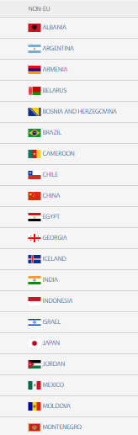
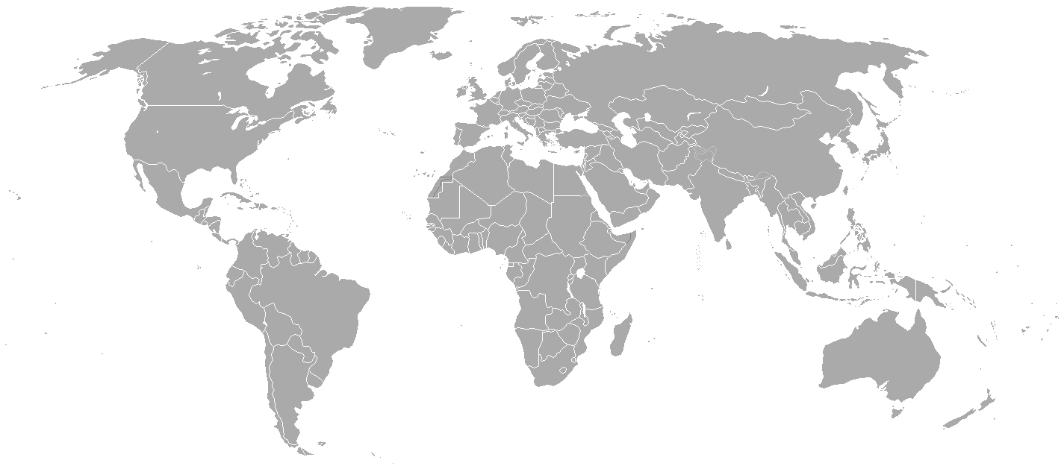
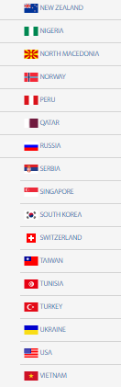
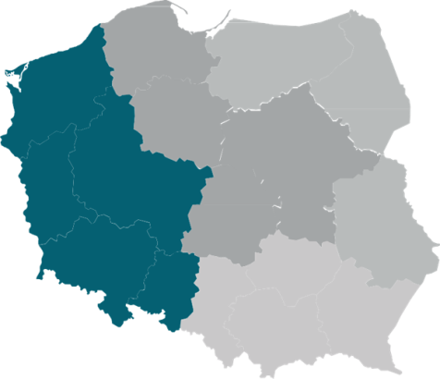

Enterprise Europe Network
+ 60 countries
+ 3000 experts
+ 600 organizations
WCTT’s role:
Consortium coordinator
Rola WCTT:

Slide 9
EEN services
Foreign partners searching
Legal support
IP Attorney support
Trade fairs and economic missions
Companies/Products preparation for internationalization
Market analysis

Slide 10
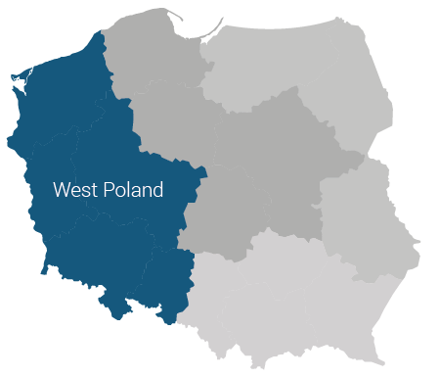
Support for enterpreneurs in the area of innovation and internalization
Commercial, technological or research cooperation profiles in the international offer database
Technological, marketing and design audits
Research of a selected foreign market
Broker meetings, trade fairs, economic missions
Contracts negotiation support
Thematic trainings
Searching for sources of financing
Coaching in the field of implementing innovations

Slide 11
EEN achievements 2018
6 broker events and foreign missions organized
8 thematic trainings organized for 222 participants
17 international commercial and technological agreements finalized
inquiries of 119 foreign enterprises and 92 national inquiries regarding cooperation were handled
47 advanced consulting services were provided (technological audits, market analysis, patent research and others)

Slide 12
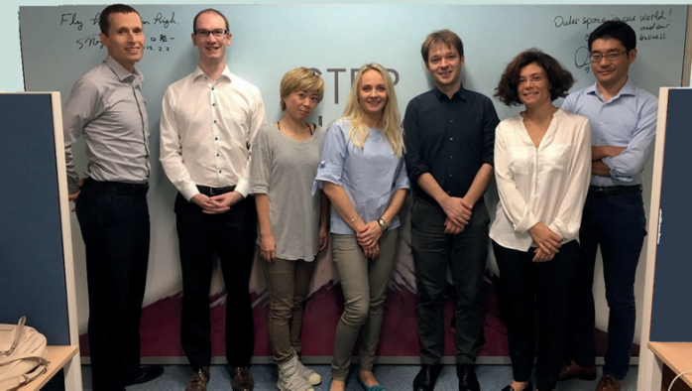
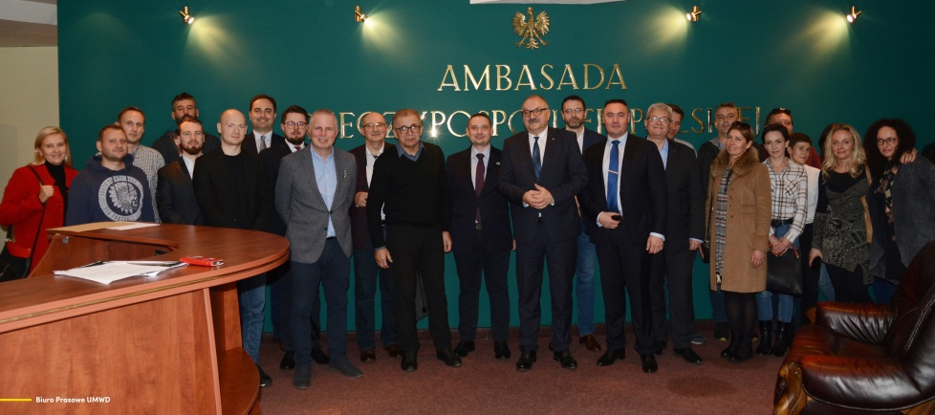
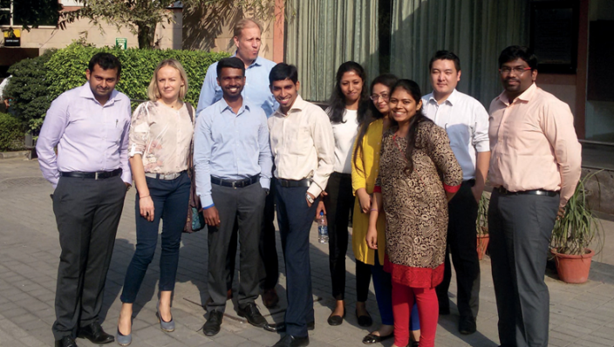
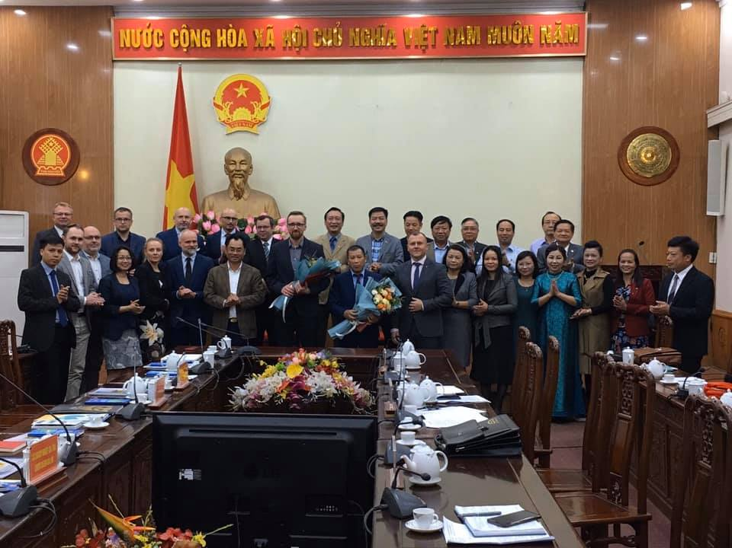
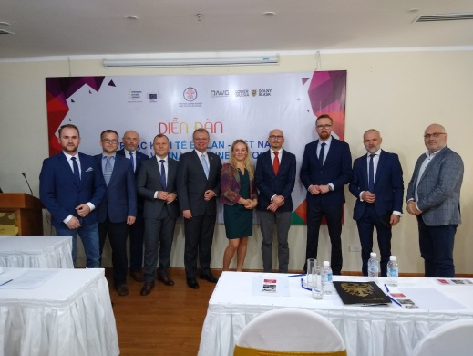
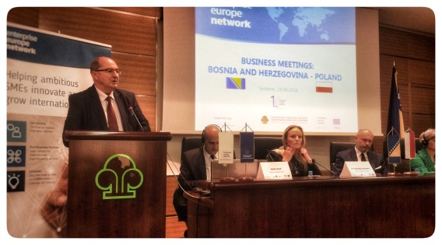
EEN events
EEN ostatnie wydarzenia
Moldova economic mission 13th-16th November 2019
Mentoring for Japanese i Indian IOB
Economy mission to Vietnam18th-22th November 2019
Mission to Bosnia and Herzegovina
August 26-28, 2018

Slide 13
THANK YOU FOR YOUR ATTENTION
Wroclaw Centre for Technology Transfer
Website: wctt.pwr.edu.pl
e-mail: wctt@pwr.edu.pl
Enterprise Europe Network
Agnieszka Turynska, PhD EEN West Poland Coordinator kontakt: 0048 695 360 096 email: agnieszka.turynska@pwr.edu.pl

