Slide 1
VR technology in business sphere

Slide 2
Virtual Reality – definition
Virtual Reality (VR) is the use of computer technology to generate simulation of a 3D image or environment. It can be experienced by a person using special electronic equipment, such as a helmet with a screen inside or gloves fitted with sensors.
VR literally makes it possible to experience anything, anywhere, anytime. It is the most immersive illusion and can convince the human brain that it is somewhere it is really not.

Slide 3
Uptake of VR in business is forecast to outpace leisure use of the technology in coming years, with spending reaching 9.2bn by 2021.*
*according to research from Tractica.

Slide 4
VR in business
The ways companies use Virtual Reality for business success

Slide 5
Why VR is powerful tool for business?
It’s UNIVERSAL - any business process from customer service to marketing, finance, HR can be simulated in VR
It’s IMMERSIVE – allows users to experience artificial environments as the real world.
It’s ENGAGING - opens new possibilities for showcasing products and services.

Slide 6
Examples of VR use in business
1

Slide 7

VR in production-driven business
The simulated digital spaces are used to design and test new features and models.
Thanks to them there is no need to build full-scale working prototypes.

Slide 8

VR in real estate industry
VR is used to present construction plans in 1:1 scale so that customers can freely explore architect’s designs before a single stone has been set in place.

Slide 9
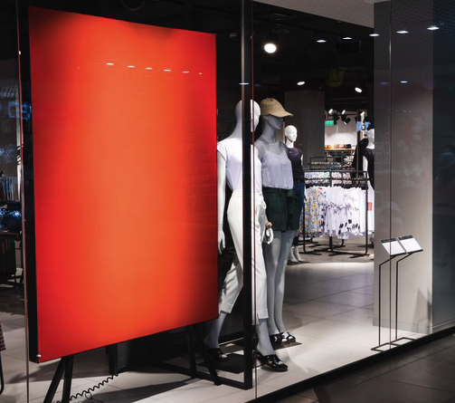
VR in retail
Virtual showrooms, like the one one offered by Swedish furniture giant Ikea, offer customers convenient alternative by letting them to try out new products without leaving their homes.

Slide 10

VR in healthcare
In safe simulated environment doctors and surgeons can test new tools and procedures. They can also use VR applications for training purposes before they get into the actual-reality complex operations.

Slide 11
Businesses of all size can take advantage of virtual reality for:
Marketing
e.x. virtual walk-throughs, 360-degree VR videos
Data Management
e.x. visualization of complex business data in an interactive way
Recruiting
e.x. interviews with remote job candidates,
Training
e.x. virtual-reality programs to train business skills.
Customer Experience
e.x. virtual showrooms with interactive shop assistances
Manufacturing
e.x. special VR zones designed to test new features and models.

Slide 12
Our projects
2

Slide 13
PowerUp Your Business in Małopolska
Program co-financed by European Union. As a part of the project we have launched:
Interactive VR application
AR App for Android and iOS

Slide 14
The aim of the project is to:
Create a modern information system for the enterpreneurs in Małopolska,
Promote the economic potential of Małopolska abroad during international trade fairs,
Improve the competitiveness of regional companies,
Support foreign investments in Małopolska.

Slide 15
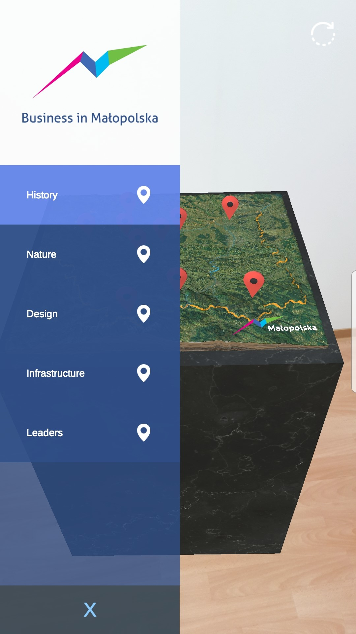
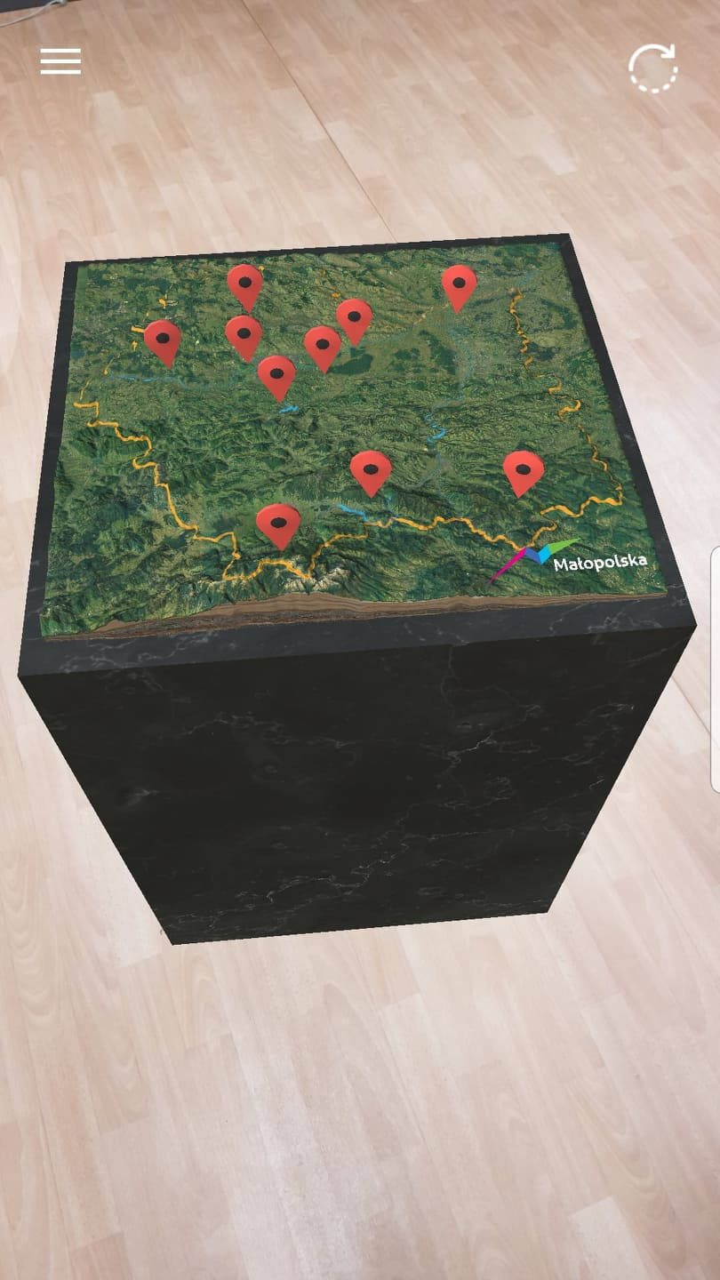
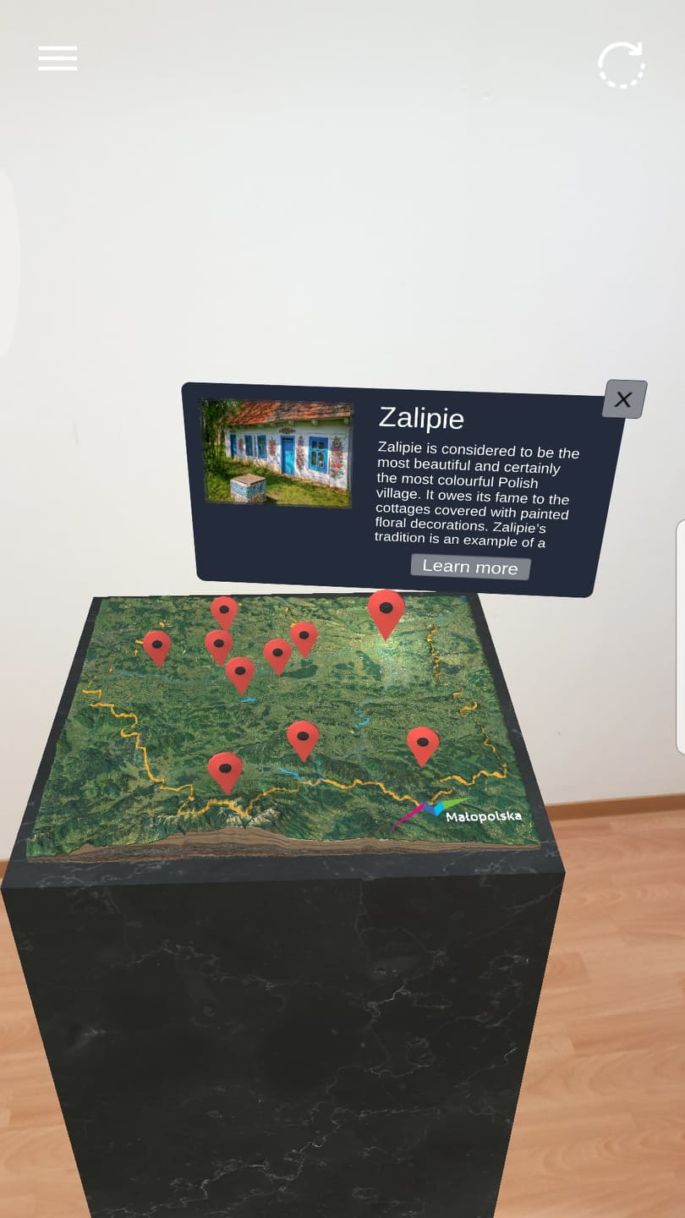

Slide 17
Virtual professionals
virtual reality simulation video game in which players participate in digital approximations of real-world jobs, like auto mechanic, welder, shop assistant etc.
By using the app players can interact with the virtual environment similarly to how they would in real life: performing tasks associated with particular occupation, interacting with people and objects.

Slide 18
The aim of the project is to:
Promote local labour market and show employment possibilities,
Increase employment of young people In traditional jobs,
Empower local enterpreneurs.

Slide 19
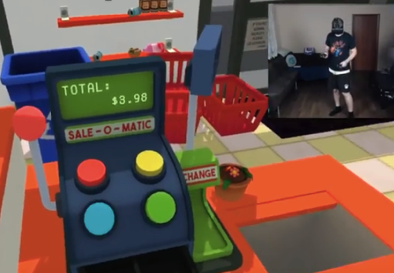

Slide 20
What does the future of VR in business look like?
Companies will be able to use VR in product design and prototyping process,
VR will be an important tool in training,
Conferences and meetings in VR will become popular,
Virtual tours of different locations will be commonly provided.

Slide 21
80%
That’s the % of the top tech companies which have already invested in VR and this number will only continue to grow

Slide 22
Thank you!
Any questions?
You can find us at @username & user@mail.me

