Slide 1

New investment projects’ support
offered by
Legnica Special Economic Zone
LEGNICA, 10.12.2019

Slide 2
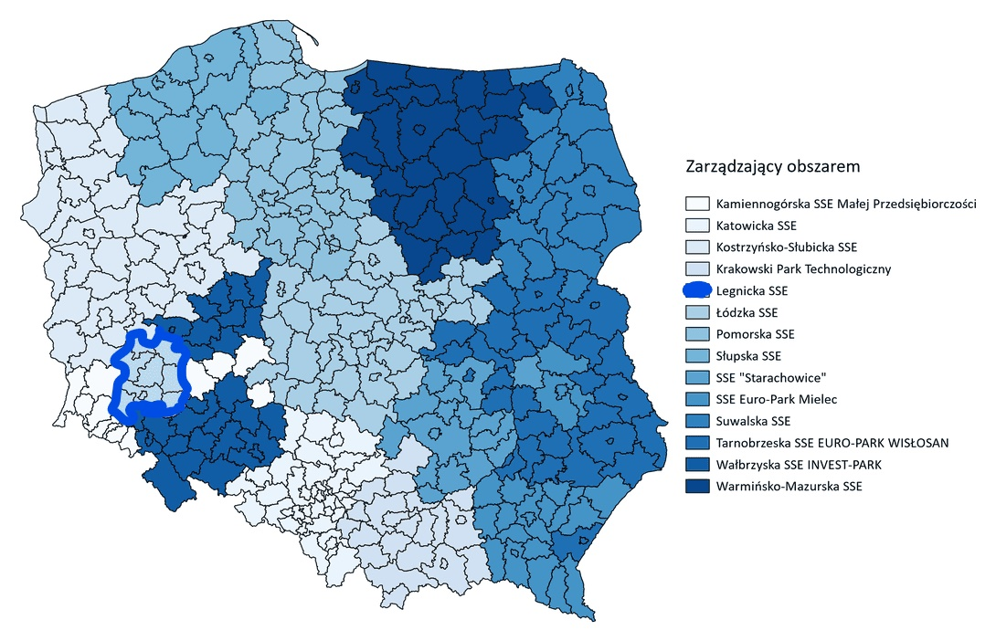

Slide 3
Maximum public aid intensity in Legnica SEZ:
45 % (small and micro-size entrepreneurs),
35 % (medium-size entrepreneurs),
25 % (big-size entrepreneurs)
of incurred capital expenditures or 2-year labour costs.
The formal decision on public aid to support the project is valid for the period of:
15 years – on land properties incorporated in a special economic zone
10 years – on land properties outside special economic zones

Slide 4
To benefit from a CIT exemption two criteria must be met:
1. Quantitative criterion – the enterpreneur must declare no less than the minimal capital expenses set for the given poviat. The minimal capital expenses depend on the unemployment rate: lower unemplyment rate in the poviat means higher value of investment required. There is a reduction of required Capex for medium, small and micro sized enterpreneurs by 80, 95 and 98 % respectively:
Legnica town, Polkowice, Sroda Slaska and Lubin poviats:
80mln PLN / 16mln PLN - medium / 4mln PLN – small / 1,6 mln PLN – micro
Legnica and Głogow Poviats:
20mln PLN / 4mln PLN / 1mln PLN / 0,4mln PLN
Wołów Poviat:
15mln PLN / 3mln PLN / 0,75mln PLN / 0,3 mln PLN
Złotoryja and Góra Poviats:
10mln PLN / 2mln PLN / 0,5mln PLN / 0,2 mln PLN

Slide 5
2. Qualitative criterion – entrepreneurs must meet at least 6 citeria out of the following:
investment in projects supporting branches being in line with current national
development policy, in which Poland may gain competitive advantage (inc. Aviation),
2) level of sales outside of Poland no less than the national average,
3) affiliation to the Key National Cluster,
4) conducting R&D activities,
5) entrepreneur qualifies for one of the categories: micro, small or medium enterprise,
6) creation of specialised work places for conducting of business activities and offering
stable employment,
7) conducting a business activity that reduces the negative impact on the environment,
8) investment project location:
a) in medium-sized cities losing socio-economic functions, or communes bordering such cities or
b) in the poviats or cities with poviat rights, where the unemployment rate is at least 160%
of the average unemployment rate in the country (poviats: legnicki, głogowski, górowski, wołowski,
złotoryjski),
9) supporting the acquisition of education and professional qualifications and cooperation with industry
schools,
10) undertaking activities in the field of employee care.

Slide 6
Please contact us when you need
any detailled explanation!
Wieslaw Sowinski Łukasz Maciejewski
sowinski@lsse.eu maciejewski@lsse.eu
+ 48 607 770 712 + 48 607 770 437

