Slide 1


CLARIN – a European Language Technology Infrastructure for Humanities and Social Sciences
Maciej Piasecki
CLARIN-PL & Wrocław University of Science and Technology
The Chair of National Coodinators Forums
CLARIN ERIC

Slide 2
Opportunities, Challenges & Problems
Opportunities
ubiquitous electronic records: documents, notes, interviews, news, literature, letters, social media, radio and TV broadcasting, …
portrays of: language, literature, society, culture, history …
Humanities and Social Sciences
Challenges
different media: text, speech, video, social media, …
hundreds of languages of research interests
standard language, but also unofficial language variants (jargon, slang), distorted communication
large volumes of data
Problems
Efficient and effective Language Technology
Its accessibility and usability for H&SS

Slide 3
CLARIN in eight bullets
CLARIN is the Common Language Resources and Technology Infrastructure
an European Research Infrastructure Consortium (ERIC, since 2012)
a part of ESFRI (the European Strategy Forum on Research Infrastructures)
Landmark status since 2016
Provides easy and sustainable access to digital language data (in written, spoken, video or multimodal form)
language resources (e.g. lexicons, language models, grammars)
advanced tools to discover, explore, exploit, annotate, analyse language data in many languages
an ecosystem for knowledge sharing

Slide 4
CLARIN ERIC in members and centres
A consortium of: 20 members, 4 observers, >40 centres
4

Slide 5
CLARIN centres
Distributed architecture: (http-accessible) files, web applications and web services spread all over Europe
Nodes in the network: centres
Currently:
20 certified B Centres
over 40 registered centres in total
Tools and data from different CLARIN centres are interoperable, so that data collections can be combined and tools from different sources can be chained to perform complex operations to support researchers in their work.

Slide 6
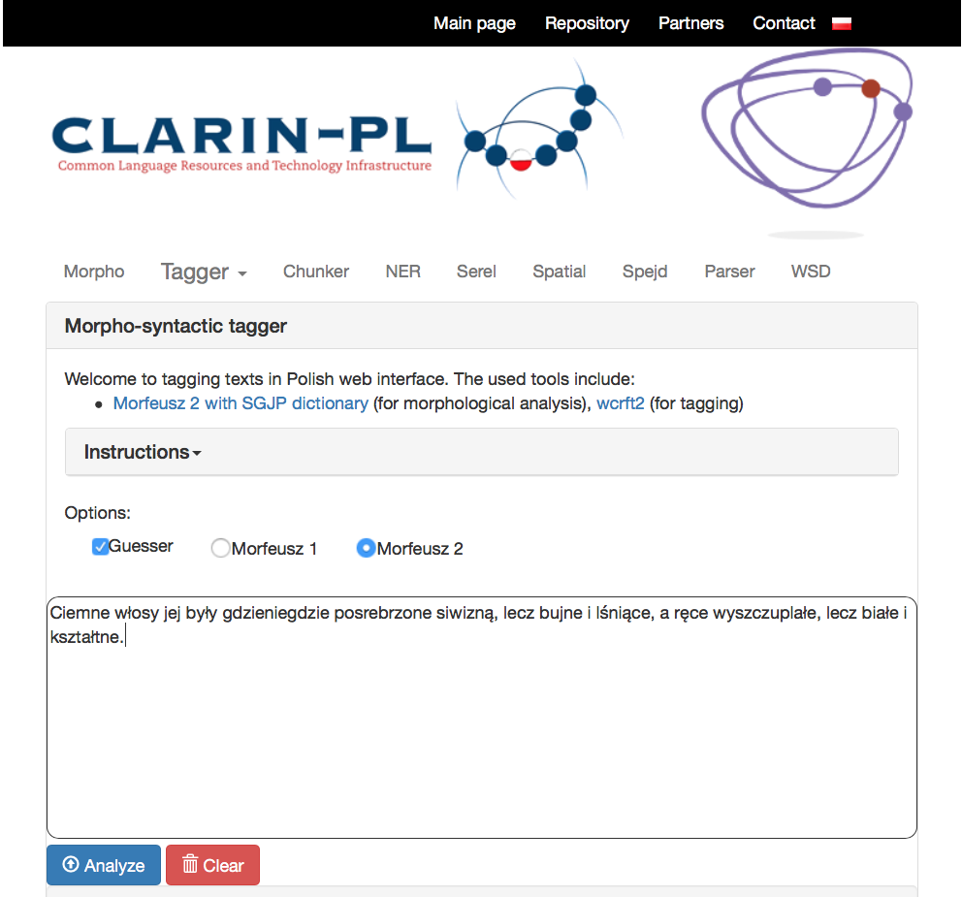
Simple Tools, … but Intelligent

Slide 7
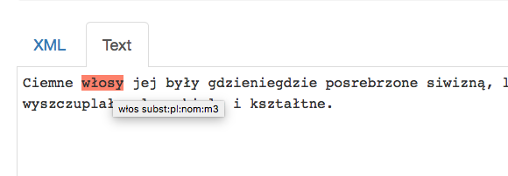
Simple Tools, … but Intelligent
e.g. most tools are based on Artificial Intelligence, Machine Learning, often Deep Neural Networks

Slide 8
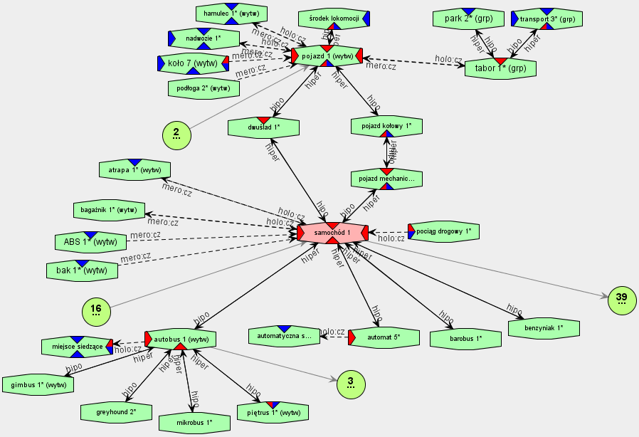
CLARIN-PL: Examples of Language Resources – Słowosieć (plWordNet) 4.1

Slide 9
WebSty: assumptions
WebSty - a web-based system for stylometry targeted at scholars in the Humanities
but also more and more often used in Social Sciences
No requirement of installing any software on local machines
Supports various research tasks for several languages:
authorship attribution, analysis of style, place of origin characteristic features of author
comparative analysis: similarities and differences between texts and collections
semantic analysis: topics, situations, keywords, …
Open architecture based on Web Services and run on a computing cluster – efficient parallel processing
http://ws.clarin-pl.eu/websty.shtml

Slide 10
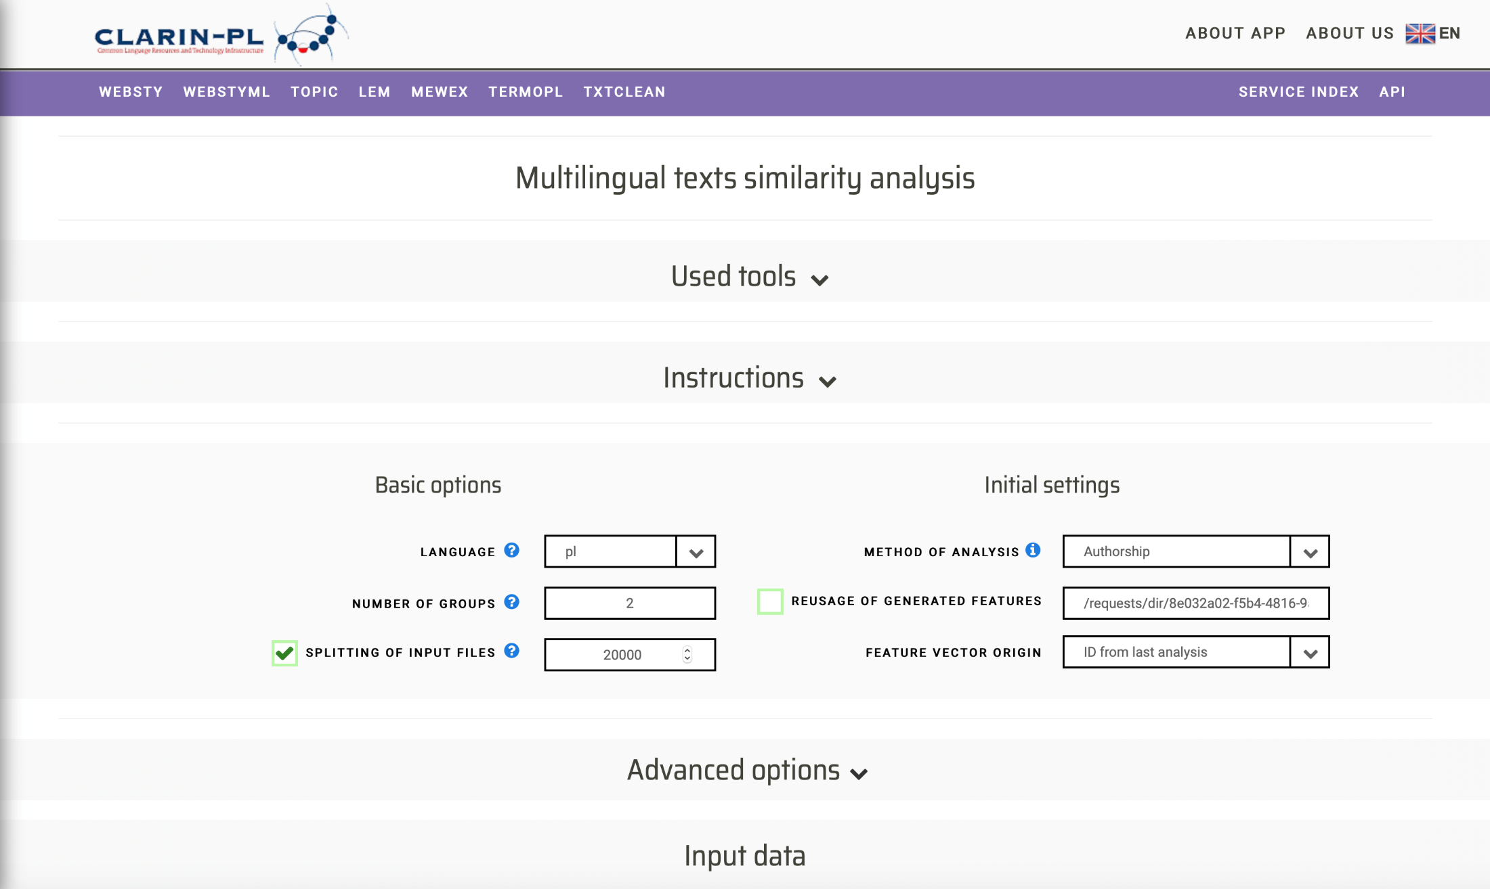
WebSty: data input and features http://ws.clarin-pl.eu/webstyml.shtml

Slide 11
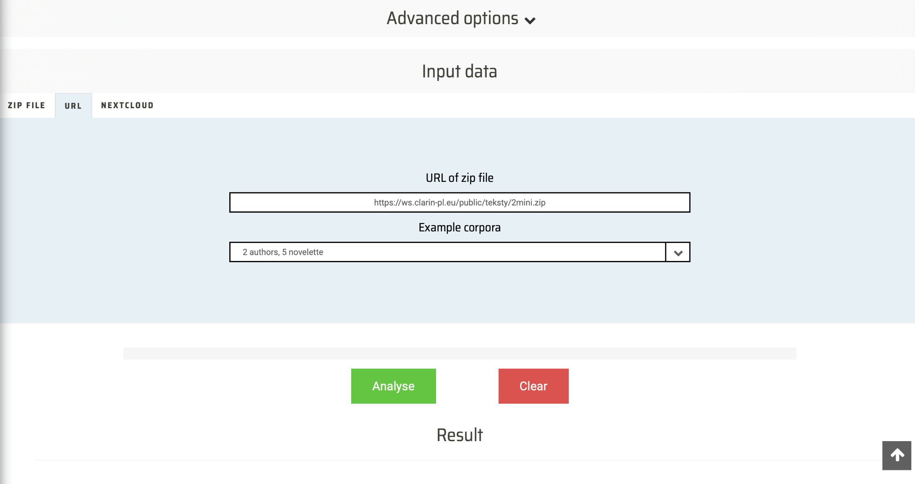
WebSty: data input and features http://ws.clarin-pl.eu/webstyml.shtml

Slide 12
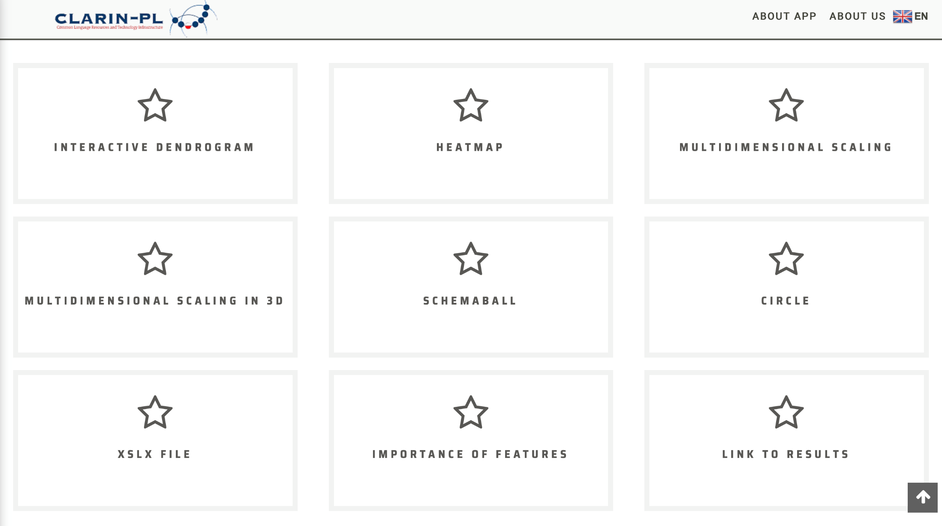
WebSty: data input and features http://ws.clarin-pl.eu/webstyml.shtml

Slide 13
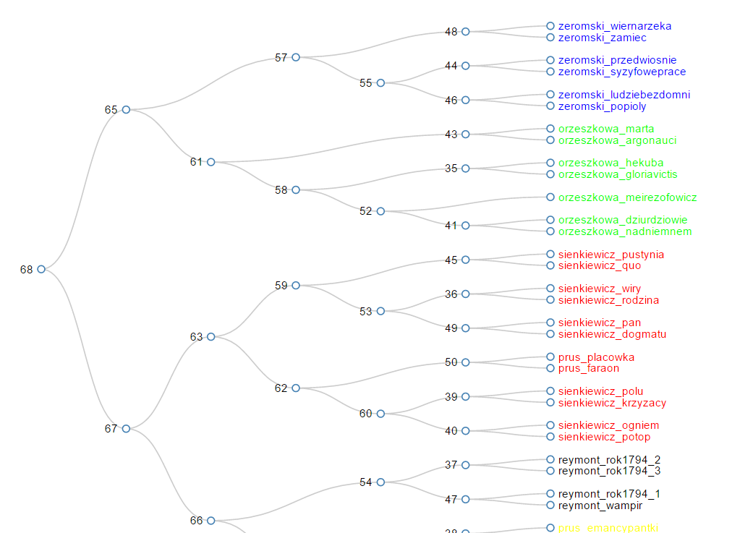
WebSty: Visualisation

Slide 14
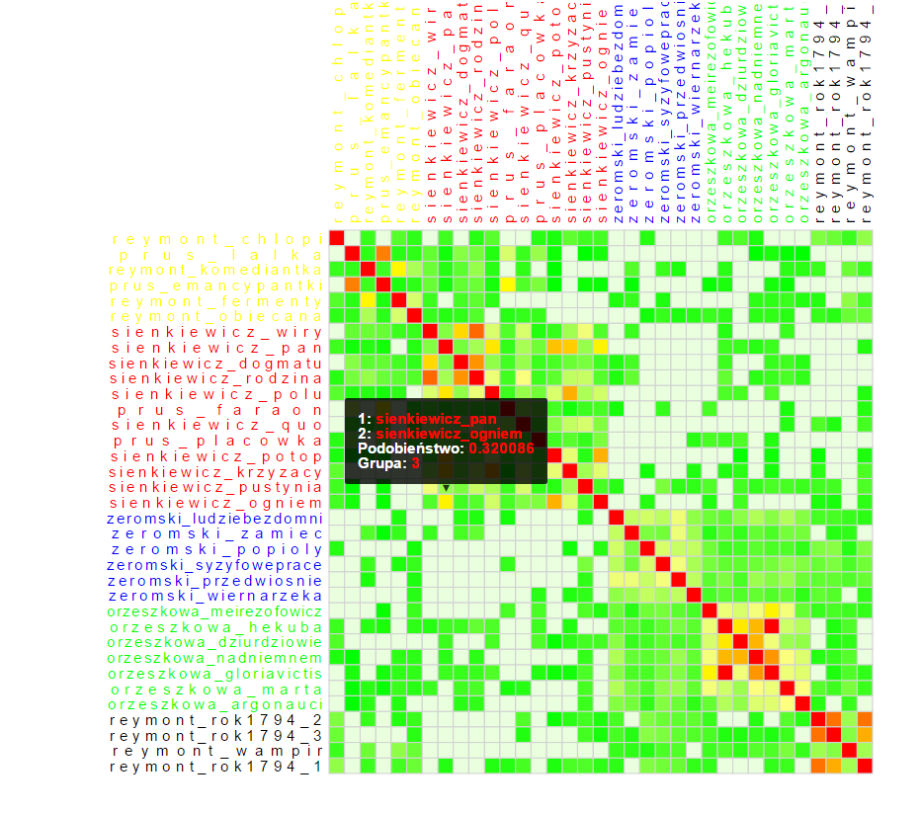
WebSty: Visualisation

Slide 15
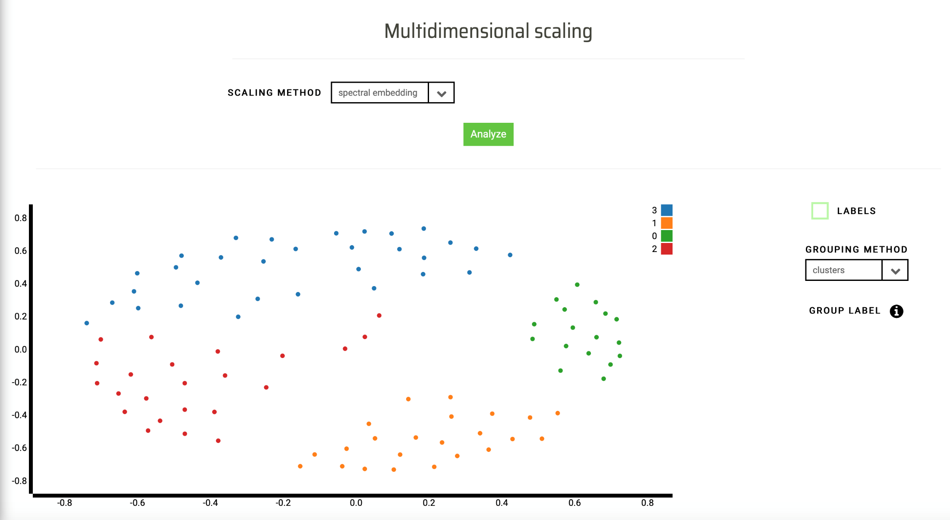
WebSty: visualisation

Slide 16
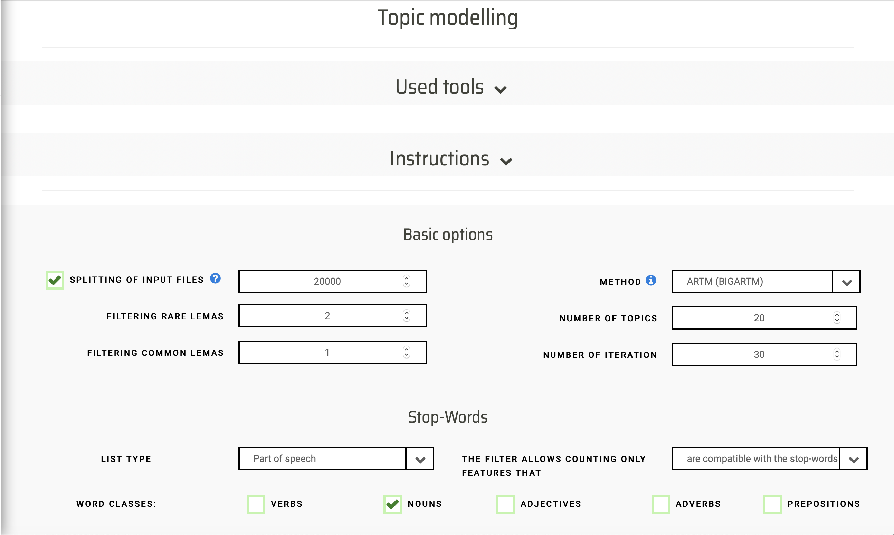
WebSty-Topic: thematic analysis

Slide 17
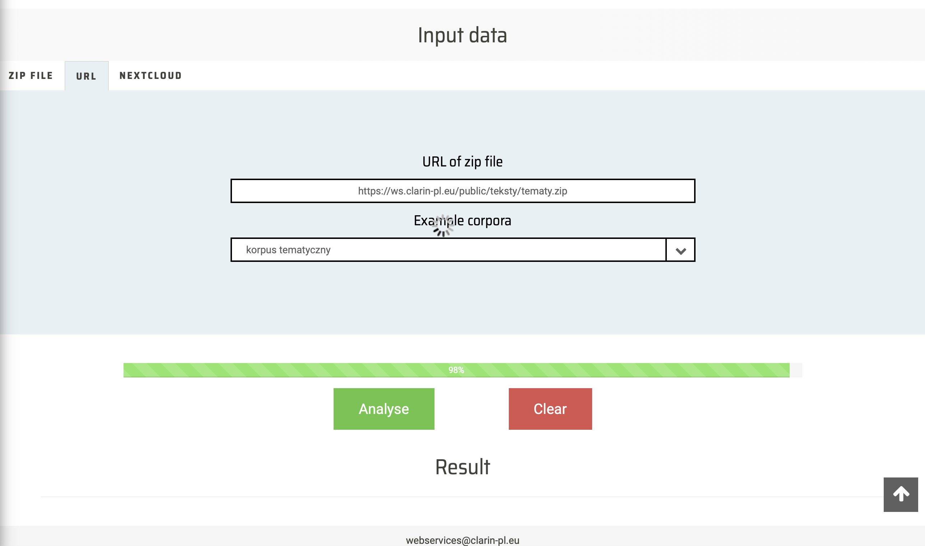
WebSty-Topic: thematic analysis

Slide 18
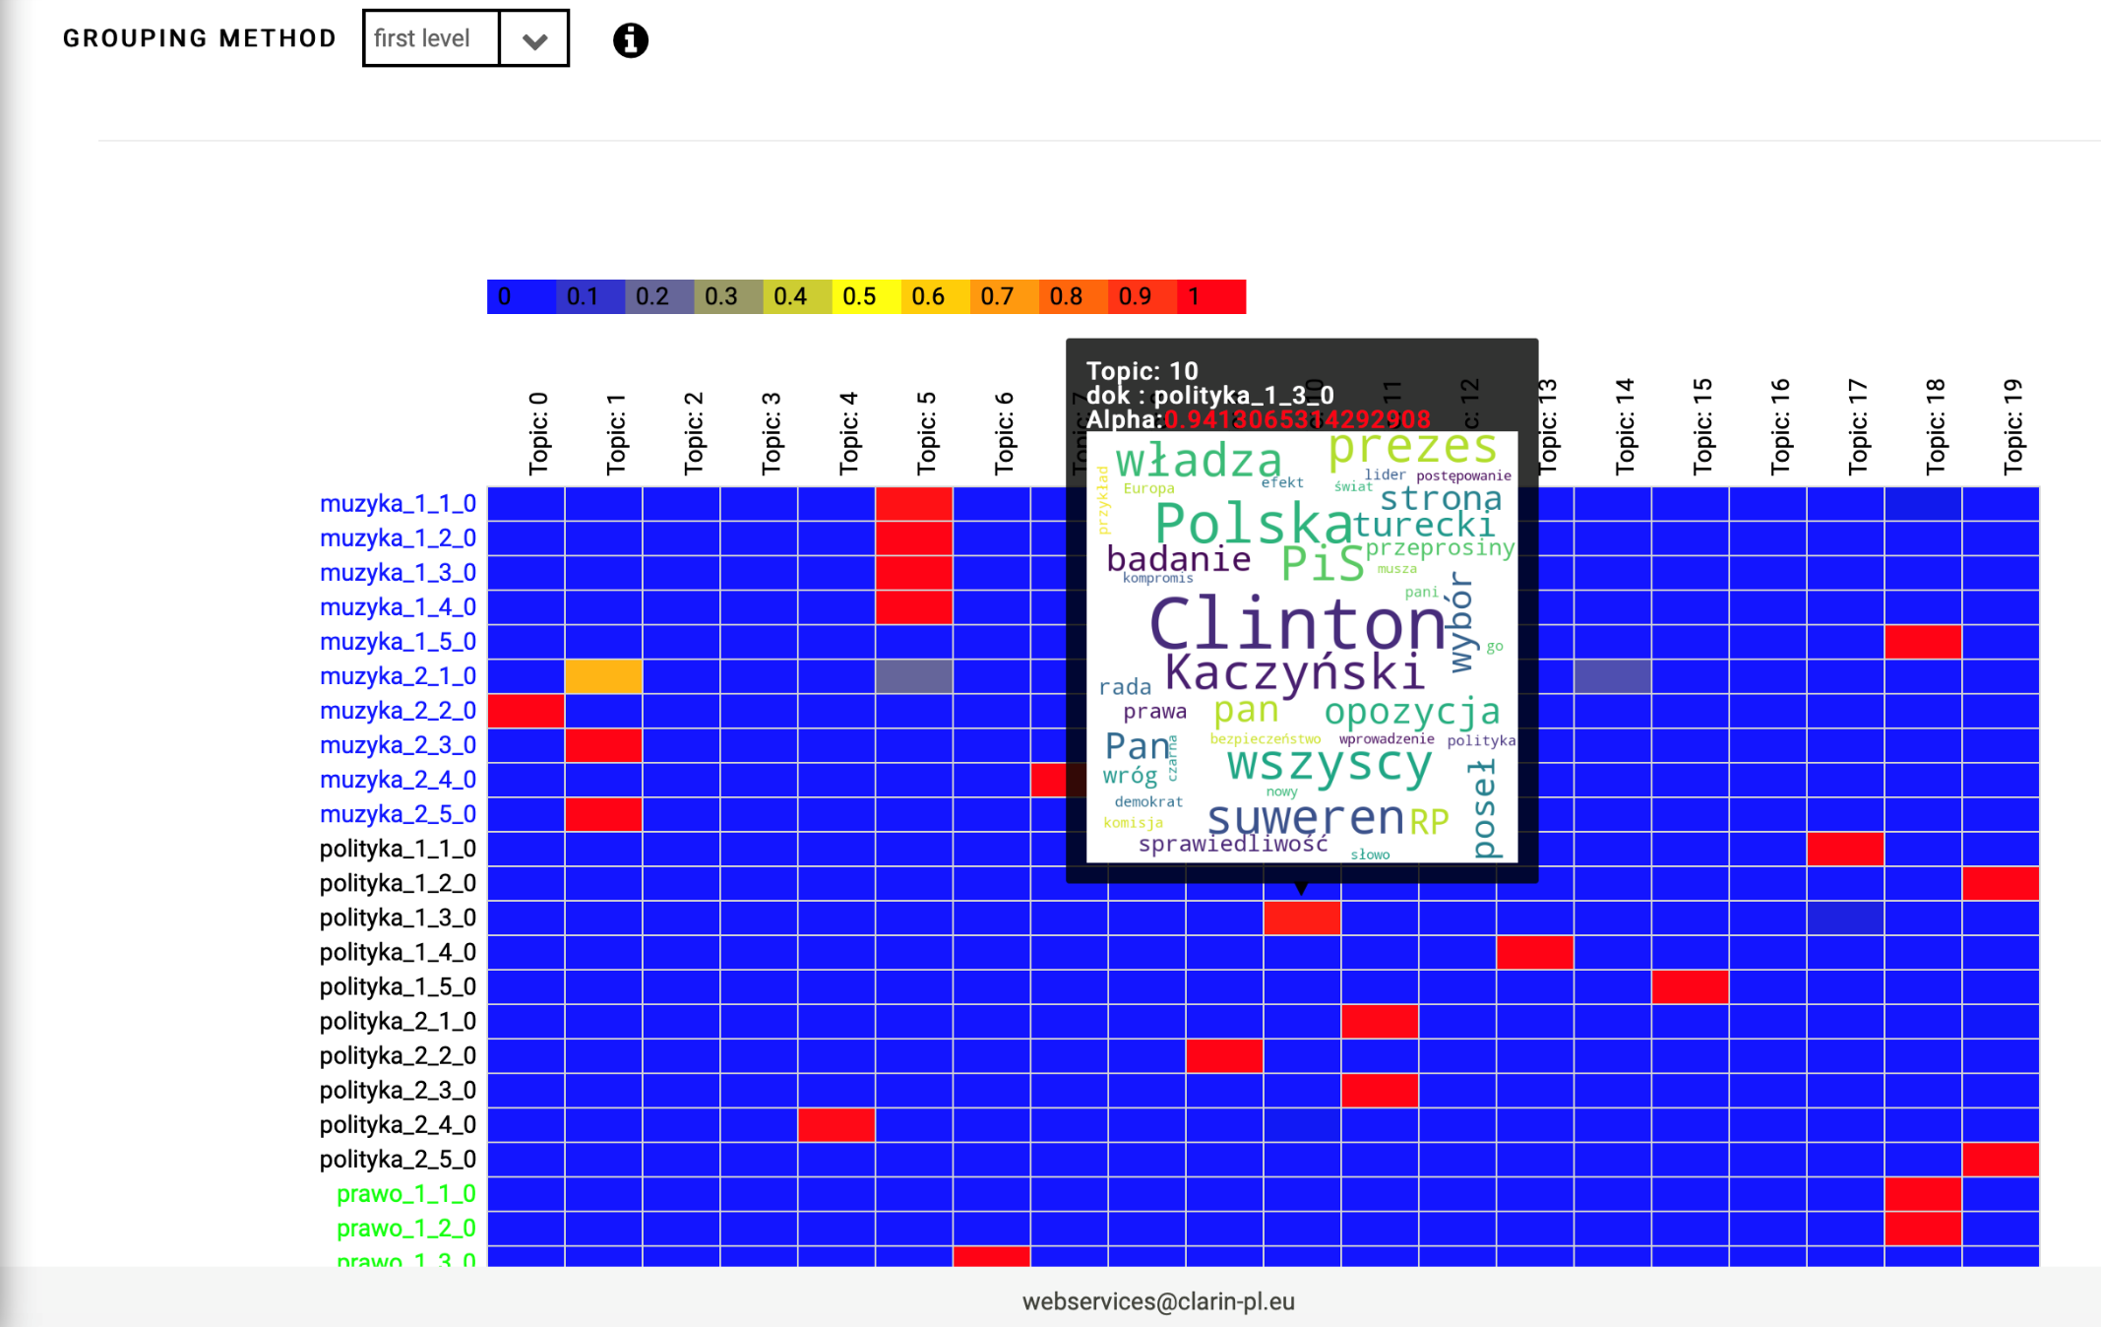
WebSty-Topic: thematic analysis

Slide 19
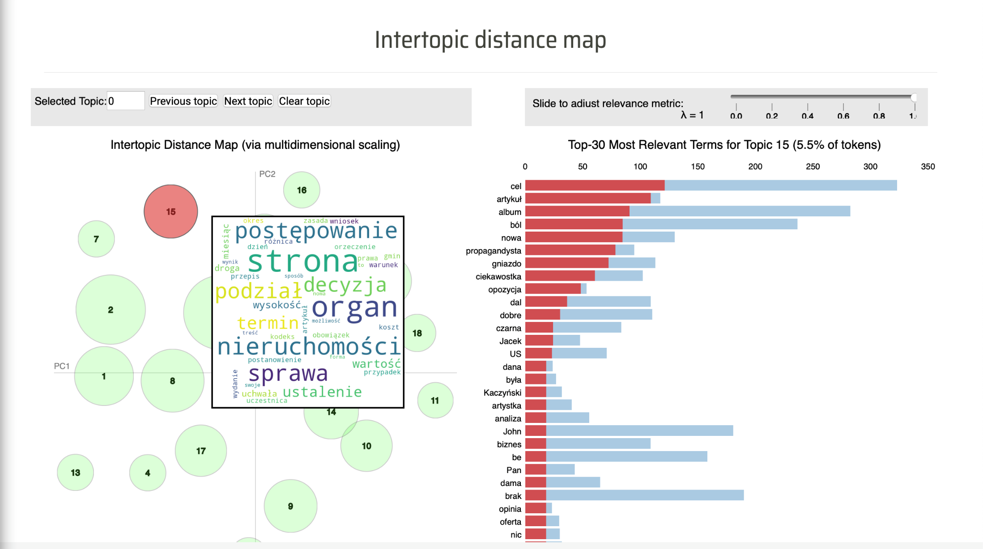
WebSty-Topic: thematic analysis

Slide 20
Take home message
CLARIN is a complex, working 24/7, system
CLARIN is open for users, especially researchers
supporting their work and listening to their needs
joint discovering of the meaning of „digital” in H&SS
CLARIN offers resources, tools, web applications for many languages, not only European
A steady growing research infrastructure firmly based on practical goals
CLARIN is open for cooperation
Centres: technological and knowledge sharing
Observers
Members

Slide 21
see you @ www.clarin.eu clarin-pl.eu or clarin@clarin.eu clarin-pl@pwr.edu.pl maciej.piasecki@pwr.edy.pl
http://clarin-pl.eu/
http://clarin.eu/

