Slide 1

The leader of polish economic rankings
In terms of investment attractiveness as also the quality of life.

Slide 2
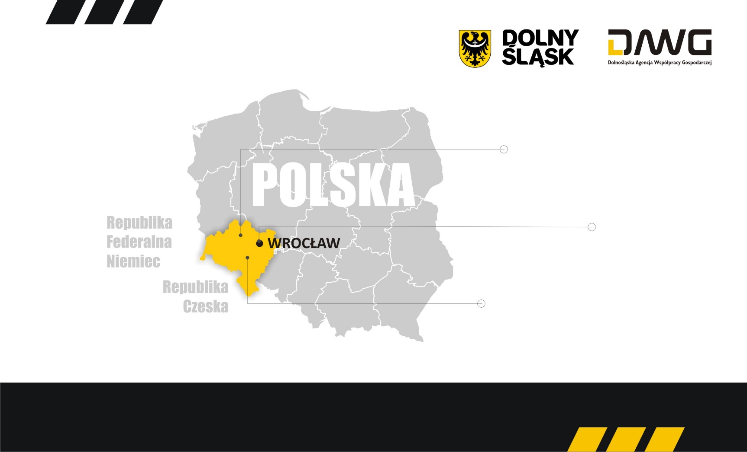
19 947 km²
SURFACE AREA
GERMANY
Wrocław
CAPITAL
OVER 2,901 MLN
NUMBER OF RESIDENTS
7,55% of POLISH POPULATION
CZECH REPUBLIC
Excellent location, infrastructure and human resources

Slide 3






5,1 %
2,6 %
4,1 %
3,7 %
33 800 mln USD
39 930 mln USD
41 005 mln USD
43 123 mln USD
2014
2015
2016
2017
Poland GDP growth in 2010-2017 19,8%
Lower Silesia GDP growth in 2010-2017 53,8%
GROSS DOMESTIC PRODUCT GROWTH

Slide 4
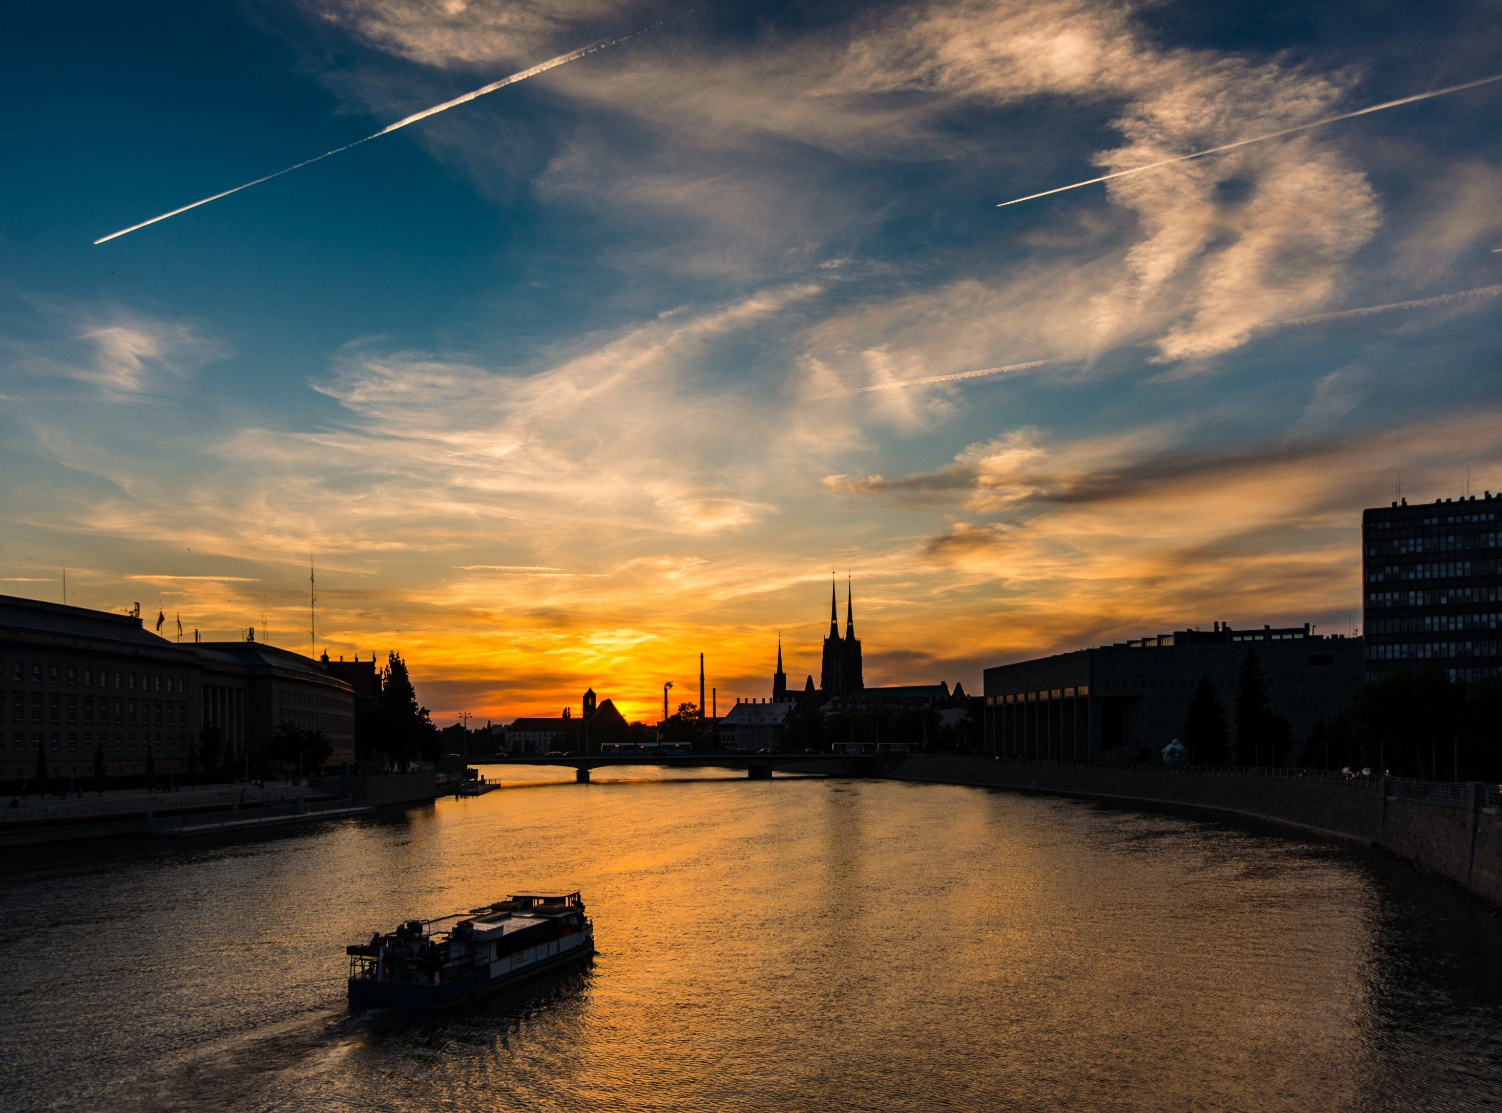

Chemical product
Machines
and
equipment
8,5 %
Poland GDP
Food products
Metal
products
10 %
Poland
export
Gum
synthetic
materials
Cars
other means of transport
Computers,
Electronic,
Optic products
ECONOMY STRUCTURE

Slide 5

UNEMPLOYMENT
5,1%
unemployment
rate
in Poland
around
1251 EUR
REMUNERATION
average gross remuneration in the enterprise sector
4,6%
unemployment
rate
in the region
POPULATION – 2 903 710
LABOUR MARKET

Slide 6

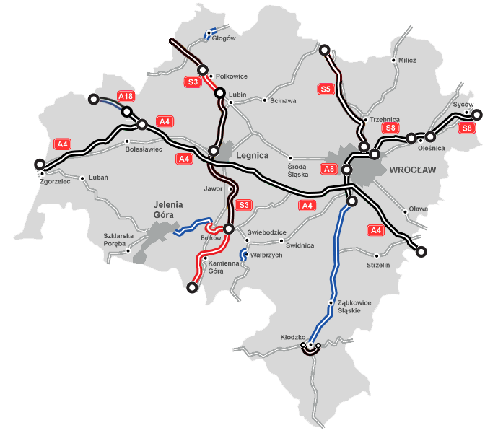
A4
Southern Germany via Wroclaw to Ukraine
A18
Northern Germany via Wroclaw to Ukraine
S8
Ekspressway Wroclaw to Warsaw
S5
Ekspressway Wroclaw to Poznan
S3
Ekspressway Northwest Poland via Wroclaw to Prague*
*end of construction in 2020
ROAD TRANSPORT

Slide 7
One of the main railway junctions of Poland
Wrocław - the largest cargo terminal
700 wagons per day
RAILWAY TRANSPORT
RAILWAY TRANSPORT

Slide 8
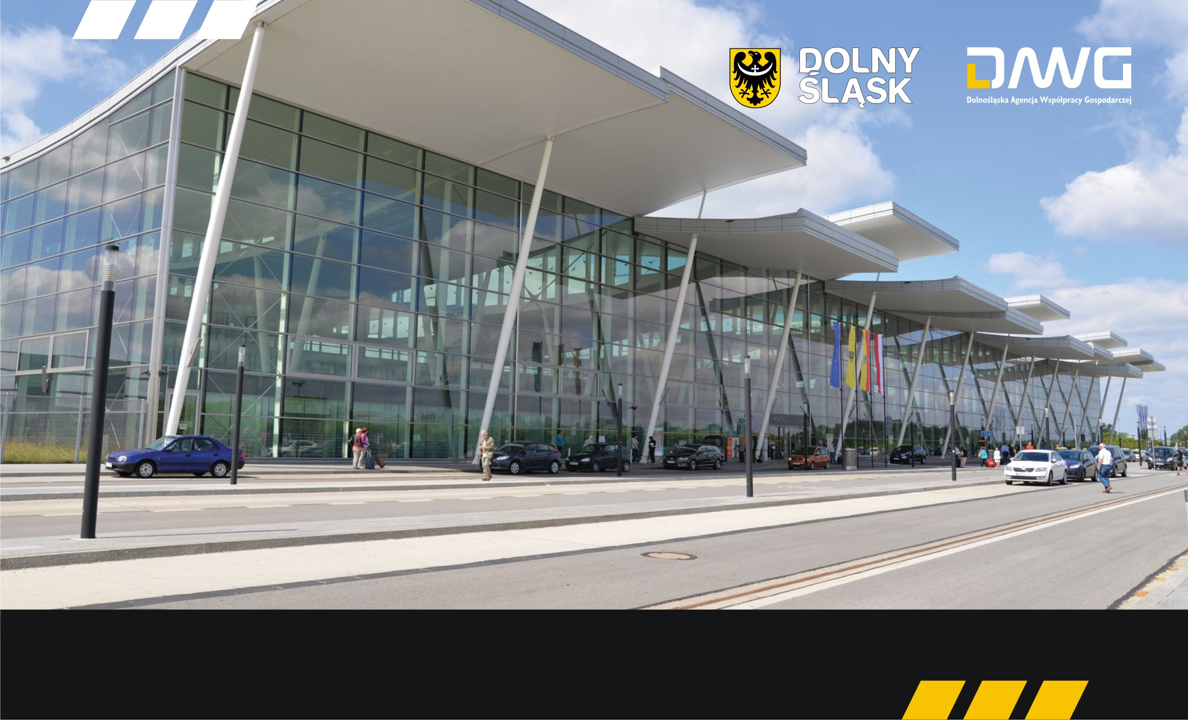
AIR TRANSPORT
FIFTH
airport
in Poland
in terms
of passenger
traffic volume
current
capacity approx
ok. 4 mln
passengers per year,
target - up to do
7 mln
traditional
and low-cost
services to
50 cities to 18
countries of Europe
24
charter
services
AIR TRANSPORT

Slide 9

automotive sector
MERCEDES - BENZ MANUFACTURING POLAND
VOLVO GROUP POLAND
WABCO POLSKA
TOYOTA MOTOR MANUFACTURING POLAND
AUTOLIV POLAND
SITECH
RONAL POLSKA
VOLKSWAGEN MOTOR POLSKA
FAURECIA WAŁBRZYCH
ROBERT BOSCH
BRIDGESTONE DIVERSIFIED PRODUCTS POLAND
BORGERS
LG CHEM
mechanical engineering sector
ABB
ALSTOM POWER
GE Power Controls Polska
Legrand Polska
BOMBARDIER TRANSPORTATION
Polska
SAUER-DANFOSS
XEOS (LUFTHANSA+GENERAL ELECTRIC)
FOREIGN INVESTORS

Slide 10

SELECTED FOREIGN INVESTORS
consumer electronics and household appliances sector
Heesung Electronics Poland
Whirlpool Polska
LG Display Poland
LG Chem Poland
LG Electronics Wrocław
LG Innotek Poland
Fagor Mastercook
LG Electronics Wrocław
Dong Yang Electronics
Electrolux Poland
Toshiba Television Central Europe
3M Wrocław
Technisat Digital
BPO, financial sector
Credit Suisse
Getin Holding
Credit Agricole
BZ WBK Grupa Santander
Google
IBM Polska
Nokia
Siemens
Amazone
HP
UPS
BNY Mellon
UBS
FOREIGN INVESTORS

Slide 11

chemical and pharmaceutical sector
PPG Deco Polska
Sca Hygiene Products
CeDo
Gerresheimer Boleslawiec
Colgate - Palmolive Manufacturing
US Pharmacia
Hirsch Porozell
BASF Polska
BORGHI CHEMICALS Poland
food products sector
Cadbury Polska
Mondelez Polska
Cargill Poland
AVO-Werke
Eisberg
ULDO Polska
FOREIGN INVESTORS

Slide 12

Polish Investments Zone is the program of Special Economic Zones expansion
– tax incentives are available for investment in any location in Poland.
Poland became the only economic zone.
POLISH INVESTMENTS ZONE

Slide 13

The Lower Silesian Voivodship is one of the largest education centres in Poland.
The number, type of schools and their location make the region an attractive
educational centre.
35 institutions of higher education
142 thousand of students
40 thousand graduates a year
international and bilingual schools, primary schools, gymnasium schools
and secondary schools, languages of instruction: English, German, Spanish,
French and Italian
EDUCATION
EDUCATION

Slide 14
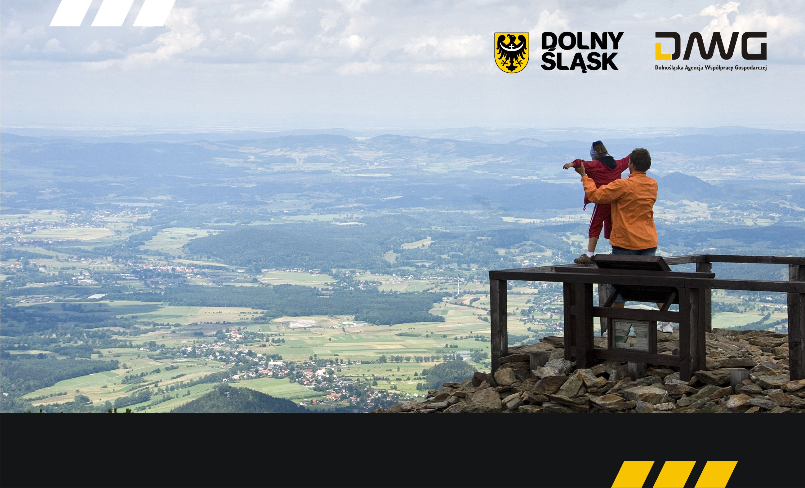
The uncommon
cultural richness
of the region is of huge
importance for tourism.
There are numerous
top-class monuments
that are listed as
UNESCO
World Heritage
TOURIST
ATTRACTIONS:
THE KARKONOSZE MOUNTAINS
LOWER SILESIAN SPAS
ACTIVE TOURISM
PALACES AND CASTLES
CISTERCIAN ROUTE
TOURISM AND CULTURE
TOURISM AND CULTURE

Slide 15
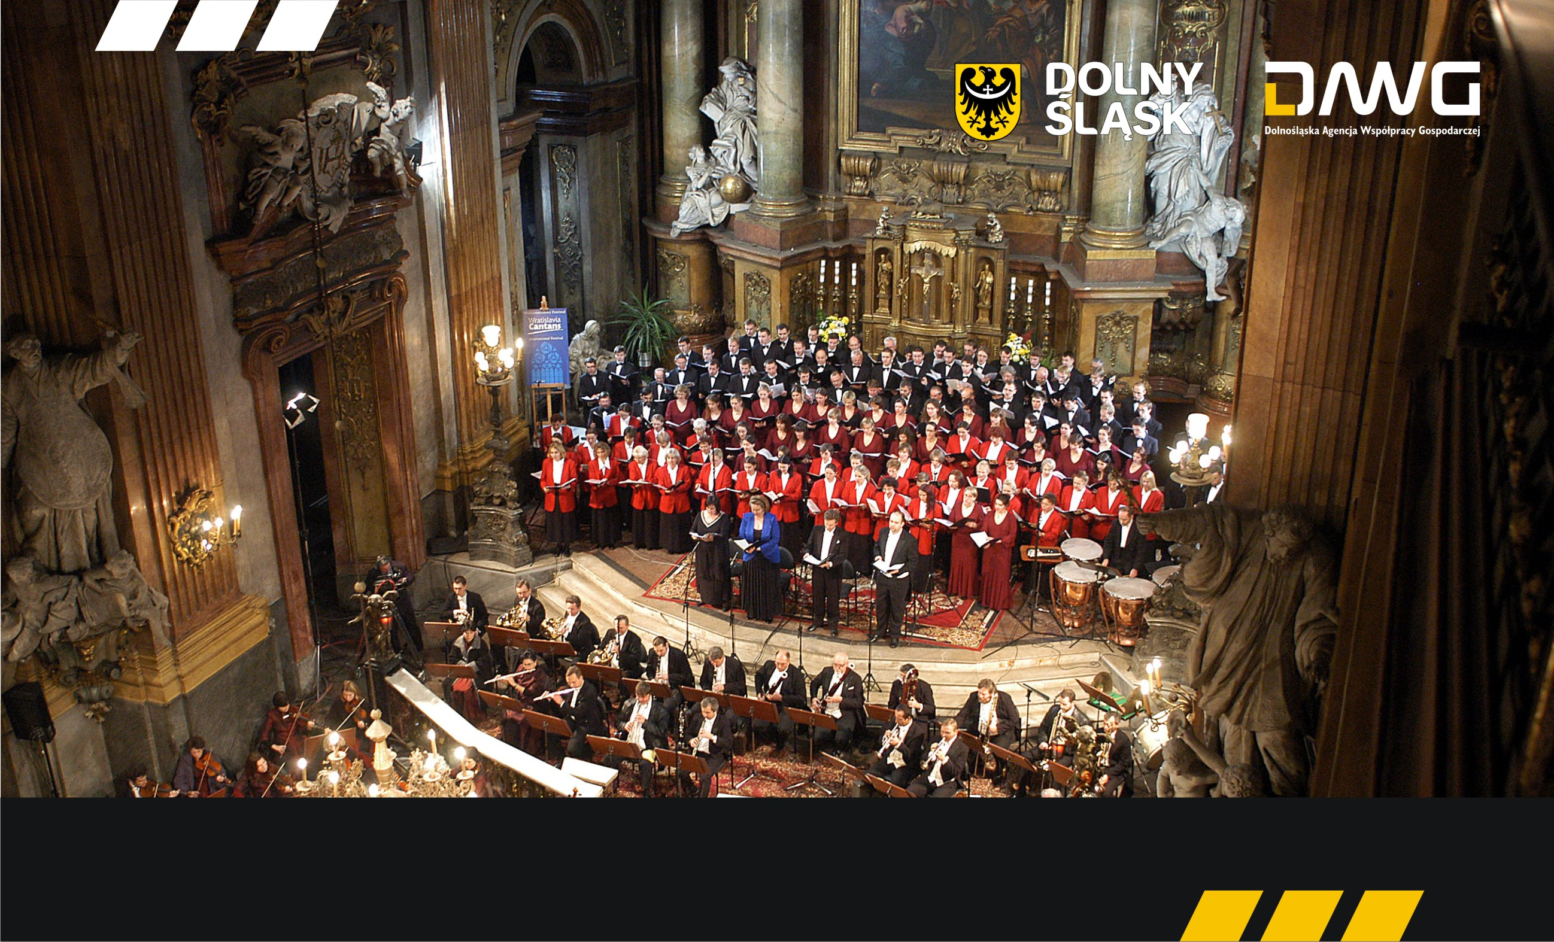
THEATRES, OPERA HOUSES, MUZEUMS, ART. GALERIES, CINEMAS, CULLTURAL CENTRES, PHILARMONIC
LOWER SILESIA - the place of numerous cultural ventures and events
of international importance
2016 – Wroclaw is THE EUROPIAN CAPITAL OF CULTURE
2017 – host city of WORLD GAMES 2017
TOURISM AND CULTURE
TOURISM AND CULTURE

Slide 16

Lower Silesia
THE SECRET OF YOUR SUCCESS
CONTACTS
Lower Silesian Agency of Economic Cooperation
al. Kasztanowa 3a-5, 53-125 Wrocław
tel. +48 71 736-63-03
mail: coie@dawg.pl
Working hours:
Monday-Friday, 8:00-16:00

