Slide 1
Models of co-operation of Faculty of Electronics with business
in the area of AI
– case studies
Henryk.Maciejewski@pwr.edu.pl

Slide 2
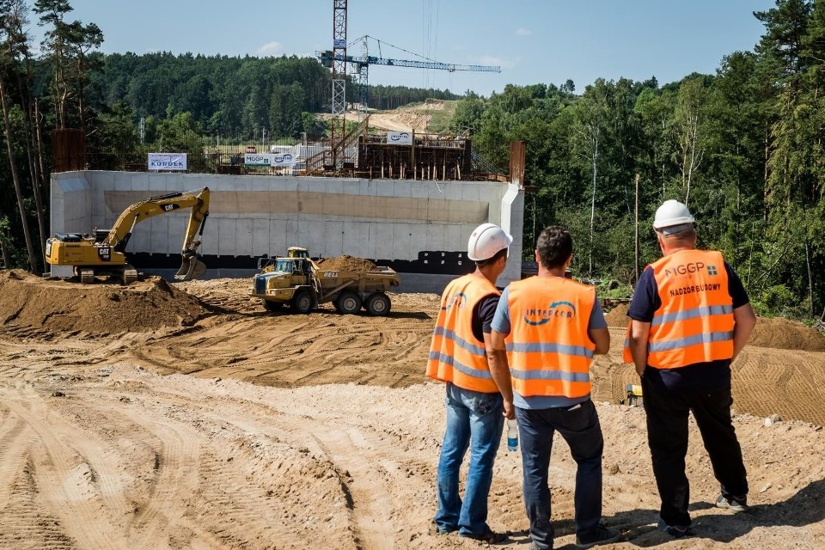
Case study 1
discover person with no helmet on his/her head
AI-based solution

Slide 3
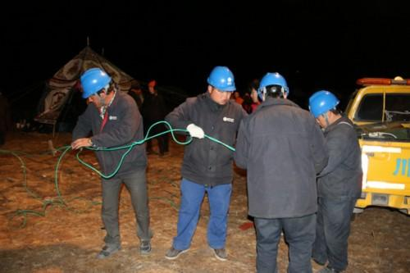
What is needed to build AI-based solution?
Data (train and test)
Deep learning model
GPU
Time
20K+ examples of helmets on 2500+ images
Split into train and test partitions

Slide 4
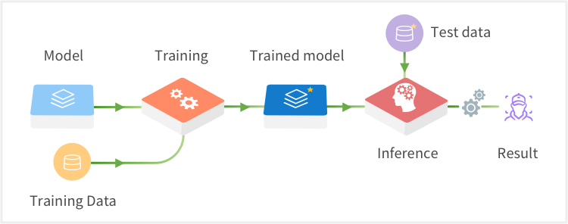
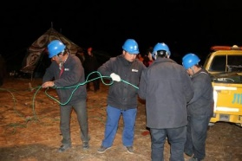
Deep learning model

Slide 5
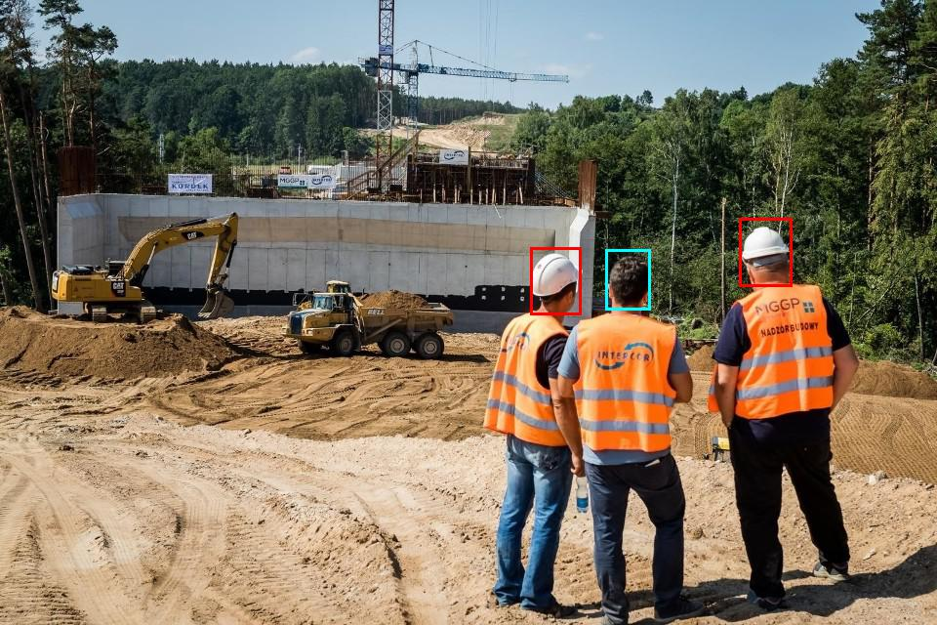
Results

Slide 6
Models of co-operation with business
What we can deliver:
POC -- Proof of Concept / Prototype
Training (AI-awareness courses)
Couching (remote-couching)

Slide 7
Models of co-operation with business
Commercial projects
Innovation projects (with public funding)
Student projects / group projects
(conference of student projects)
MSc, BSc projects
Research projects

Slide 8
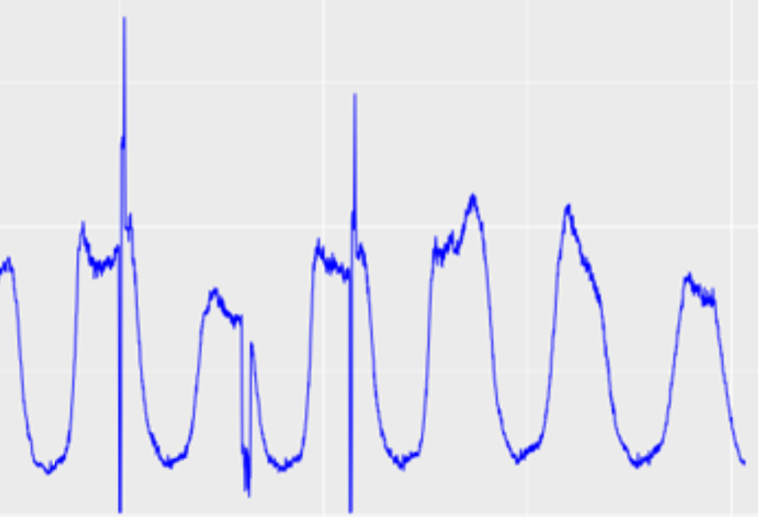

Case study: discovery of anomalies
Discover outliers / anomalies in monitoring data
Commercial project

Slide 9
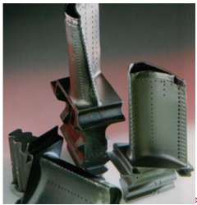
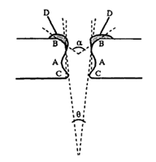
Case study: quality of laser drilling
Control quality / reproducibility of laser drilling in engine parts
MSc project

Slide 10
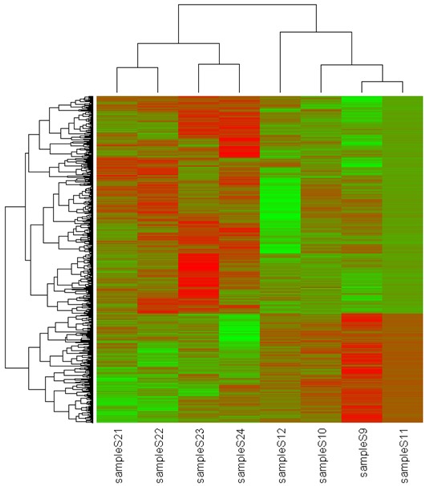
Case study: high-throughput data (life science)
? Relationship between gene expressions and diseases
Papers in: Briefings in Bioinformatics, PLOS One, Journal of Applied Genetics, Cancer Biology and Therapy, Leukemia Research, …
Co-operation with SGGW, Medical Univeristy of Łódź, PIW Puławy, …
MSc projects

Slide 11
Case studies
Monitoring of health / rutting (herds of breeding animals) POIR project
Airline:
  Use of social media to determine fare prices
  Weather impact on flight delays
  Text mining for customer service request
Nokia / NSN
  Traffic profiling in WCDMA packet networks for capacity planning
  Support request ticket dispatching
Autoresponder for processing large number of emails in recruitment campaigns
…
Group / student projects contributed by: DataArt, Comarch, Capgemini, Nokia, Ryanair, Samsung, Neurosoft, …

Slide 12
Summary
High expectations of AI in business
Shortage of AI competencies
Good time for AI-centred projects Business + Academia

Slide 13
Models of co-operation of Faculty of Electronics with business
in the area of AI
– case studies
Henryk.Maciejewski@pwr.edu.pl

