Slide 1




How to create system solutions which facilitate transfer of academic knowledge to business and administration
Damian Derlukiewicz Phd MEng
Vice-Director of Centre of Knowledge and Scientific and Technical Information
Specialist of Comercialistaion and Technology Transfer
Wrocław 2019

Slide 2


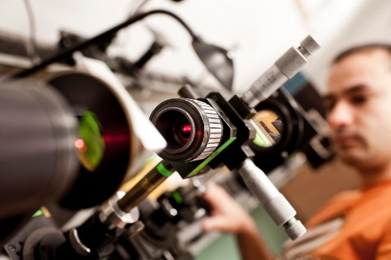
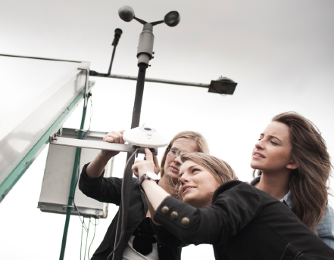
INNOVATIONS – THE STRATEGY FOR THE SUCCESS
– UNIVERSITY MISSION
CREATIVITY that changes the trajectories of the future
PROFESSIONALISM AND HARD SKILLS that condition the functioning of the technosphere
PARTNERSHIP - cooperation with the environment and external partners that facilitates the achievement of goals

Slide 3
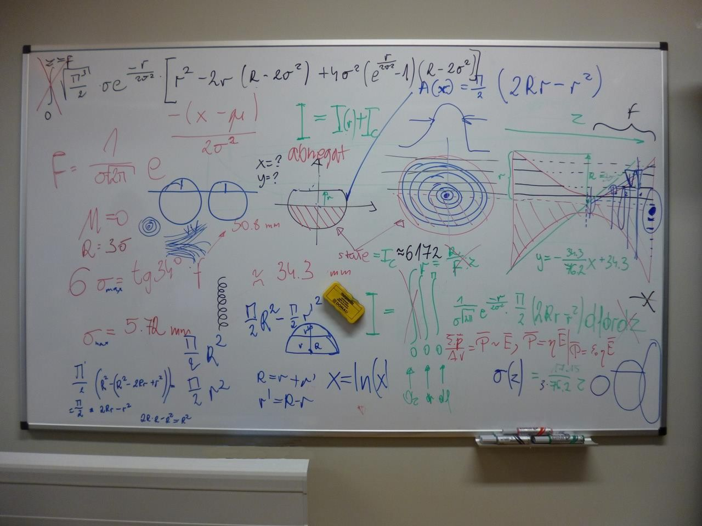
SO HERE COMES THE IDEAS OF OUR SCIENTISTS…

Slide 4
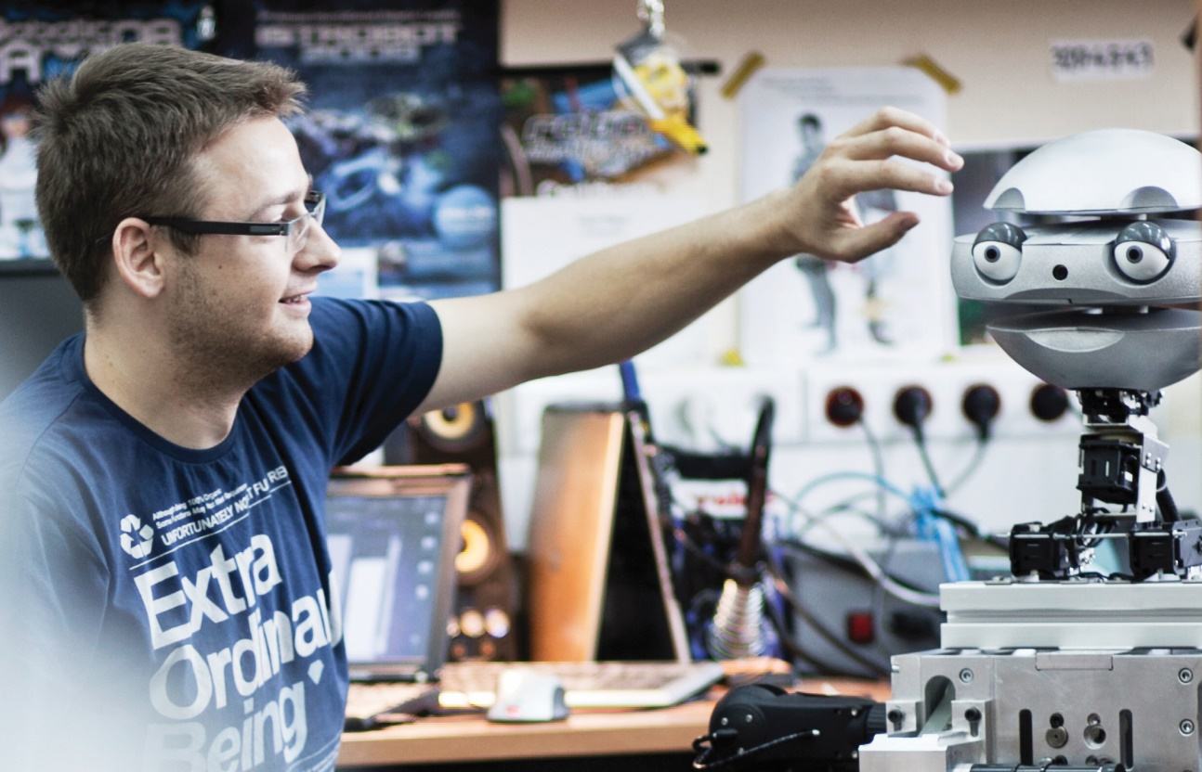




…THAT TRANSFORM INTO NEW SOLLUTION AND PRODUCT
PRODUCT
COMMER-
CIALISATION
PRODUCT
GOES
TO INDUSTRY
SOLLUTION
PRODUCT

Slide 5


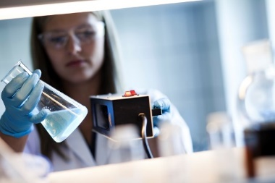


HOW IT'S WORKING - COOPERATION SCHEME
Company / External organisation
INQUIRY
Contact Point for Technology Transfer
Answer to the inquiry
WE SELECT THE RIGHT
RESEARCH TEAM
We complete formalities on behalf of entrepreneurs and scientists.
Formal and legal service also in the area of protection of intellectual property and patent protection.
UNIVERSITY RESEARCH UNITS

Slide 6
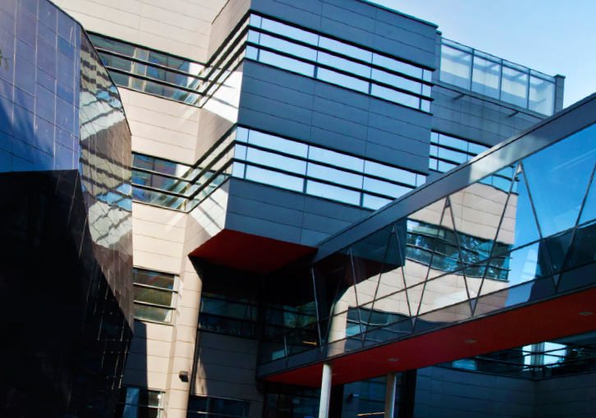

PROFIT
TECHNOLOGIES
COMPANY DEVELOPMENT
RESEARCH
PRICES & PRESTIGE
INNOVATIONS

Slide 7

Technology Transfer
Results of research and development work, created at the University
Sale
Apport
Free
Transfer
HOW
Licenses (exclusive/non-exclusive)
Intellectual property rights for technology (rights to know-how, patents, trademarks, etc.)
Ready solutions (equipment, apparatus, machinery)
WHAT

Slide 8
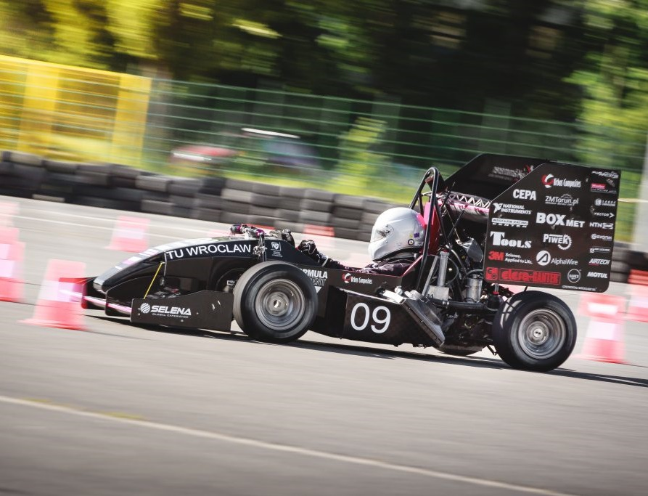






ORGANISED BUSINESS WITH SCIENCE MEETINGS
AT 16 FACULTIES MORE THAN 400 RESEARCH and TECHNOLOGIES
INNOVATION BROKERS
EXPERTISES
TRAININGS AND WORKSHOPS

Slide 9
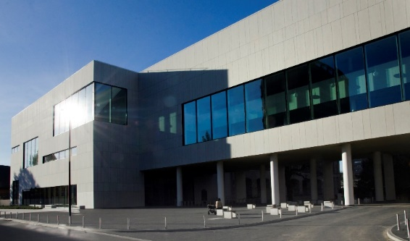






UNIVERSITY UNITS SUPPORTING THE TRANSFER
CENTRE OF SCIENTIFIC AND TECHNICAL INFORMATION
CENTER FOR SCIENCE AND ECONOMY COOPERATION
CAREER OFFICE
ACADEMIC ENTREPRENEURSHIP INCUBATOR
THE UNIVERSITY CONGRESS CENTRE
WROCŁAW CENTRE FOR TECHNOLOGY TRANSFER

Slide 10

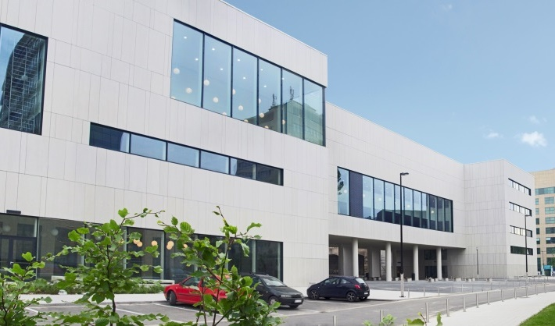
CENTRE OF SCIENTIFIC AND TECHNICAL INFORMATION
Center for Science and Economy Cooperation
Contact Point for Technology Transfer
Library – Repository of Knowledge
Research Laboratories

Slide 11


Slide 12





CAREER OFFICE
INDIVIDUAL CAREER PLANNING
MEETINGS WITH EMPLOYERS
TRAINNING AND WORKSHOPS
MONITORING CAREERS OF GRADUATES

Slide 13


TRANSFER OF RESEARCH RESULTS TO THE ECONOMY
PROMOTING AND SUPPORTING THE ENTERPRISE
FULL ASSISTANCE IN ESTABLISHING THEIR MICRO-BUSINESSES
INCUBATION
EFFECTIVE USE OF THE INTELLECTUAL AND TECHNOLOGICAL POTENTIAL OF WUST

Slide 14
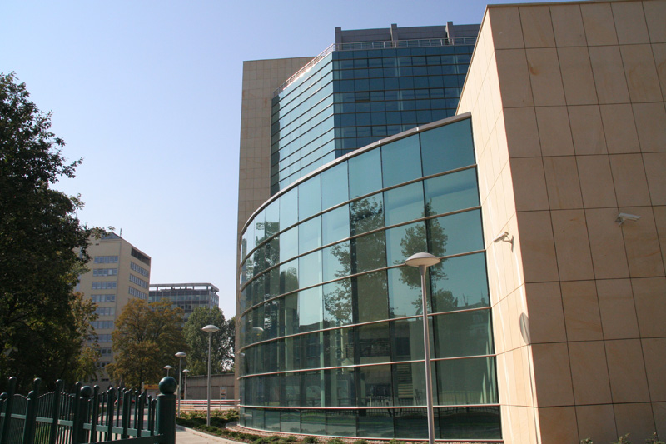
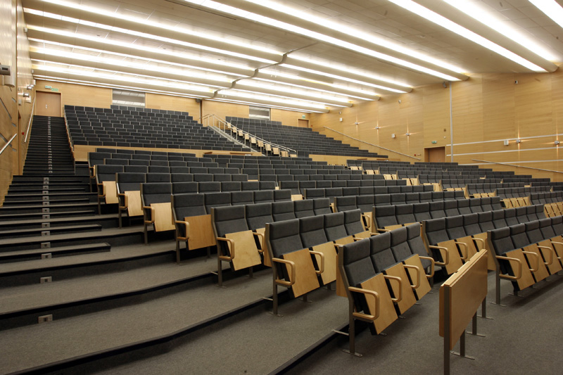
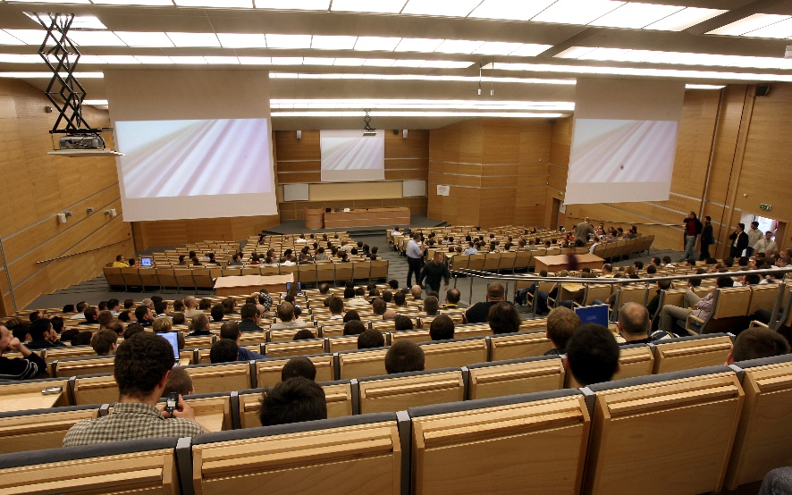
The Congress Centre
CONFERENCES, EXHIBITIONS
Congress Hall
with an area of over 700 square metres (620 seats) – one of the largest halls of its kind in Wrocław and the region

Slide 15
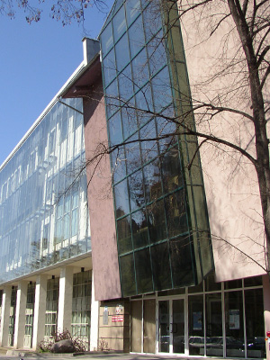

The mission of the
Wrocław Center for Technology Transfer
commercialization of the results of scientific research obtained at the Wrocław University of Science and Technology,
animation of research and technological cooperation
support for the innovative activity of enterprises.

Slide 16
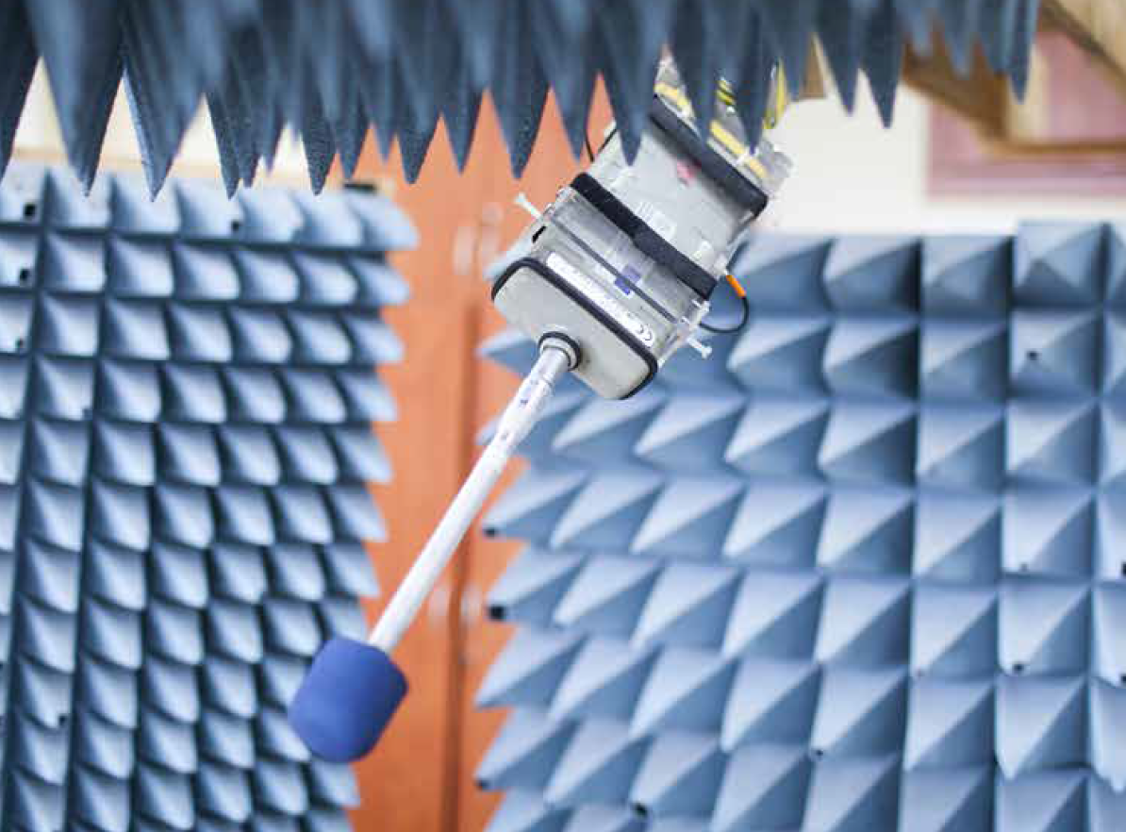
RESEARCH POTENTIAL
12
ACCREDITED LABORATORIES
17
CENTERS OF THE WUST
13
CLASTERS
144
RESEARCH LABORATORIES
10
CONSORTIA

Slide 17

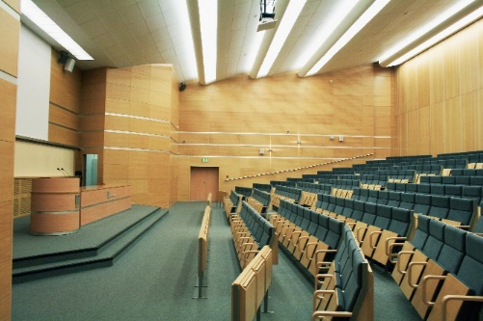
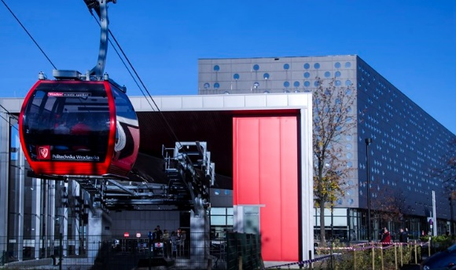
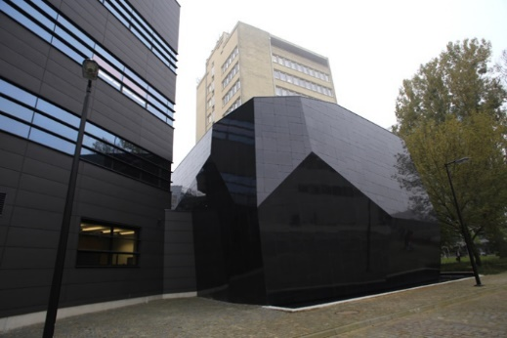

SCIENTIFIC AND DIDACTIC BASE
over 220 buildings with modern laboratories, libraries, teaching rooms equipped with multimedia
383 rooms and lecture-and-training labs
451 teaching laboratories
118 computer laboratories
wireless internet access on campus
free access to knowledge bases, lab bases and equipment base
free access to specific software

Slide 18


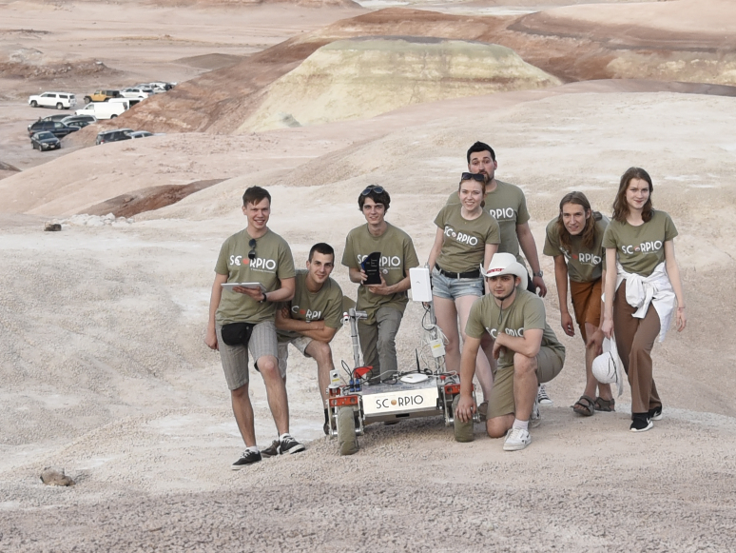
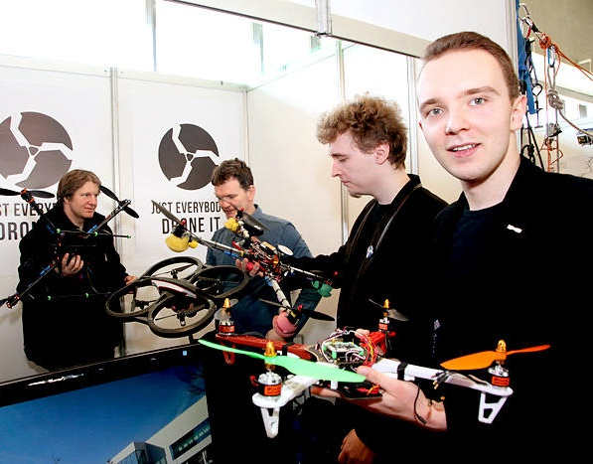
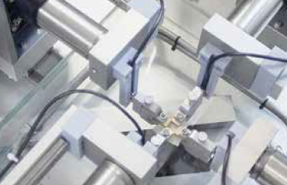
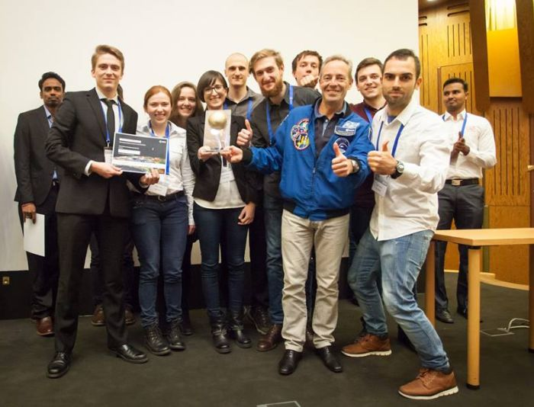
PEOPLE
HIGH QUALITY RESEARCH

Slide 19

INTERNATIONAL UNIVERSITY
INTERNATIONAL RESEARCH PROJECTS
INTERNATIONAL TRADE FAIR FOR INNOVATION AND NEW TECHNOLOGIES
INTERNSHIPS
SCIENTIFIC PROGRAMS:
Erasmus +, Erasmus-Mundus, VII Program Ramowy, Leonardo da Vinci
LEARNING OUTSIDE THE COUNTRY
GLOBAL LEVEL OF RESEARCH AND LABORATORIES

Slide 20


Centre for Scientific and Technical Information
plac Grunwaldzki 11 (building D-21, entrance C) www.biznes.pwr.edu.pl/laboratoria, centrum.lab@pwr.edu.pl
phone 71 320 47 13, 71 320 47 59

