Slide 1
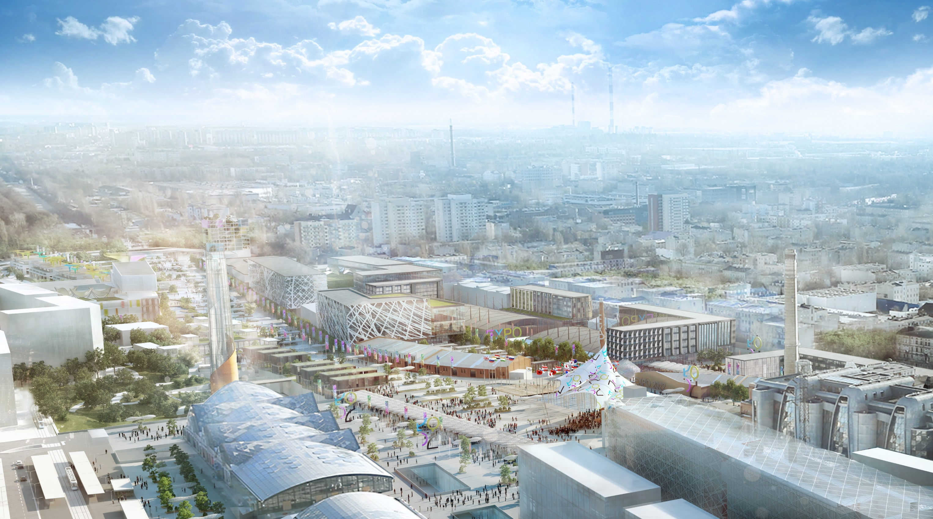

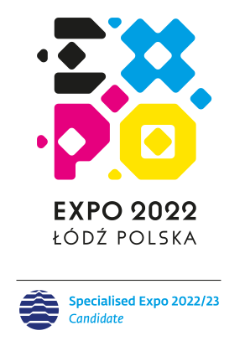

Slide 2
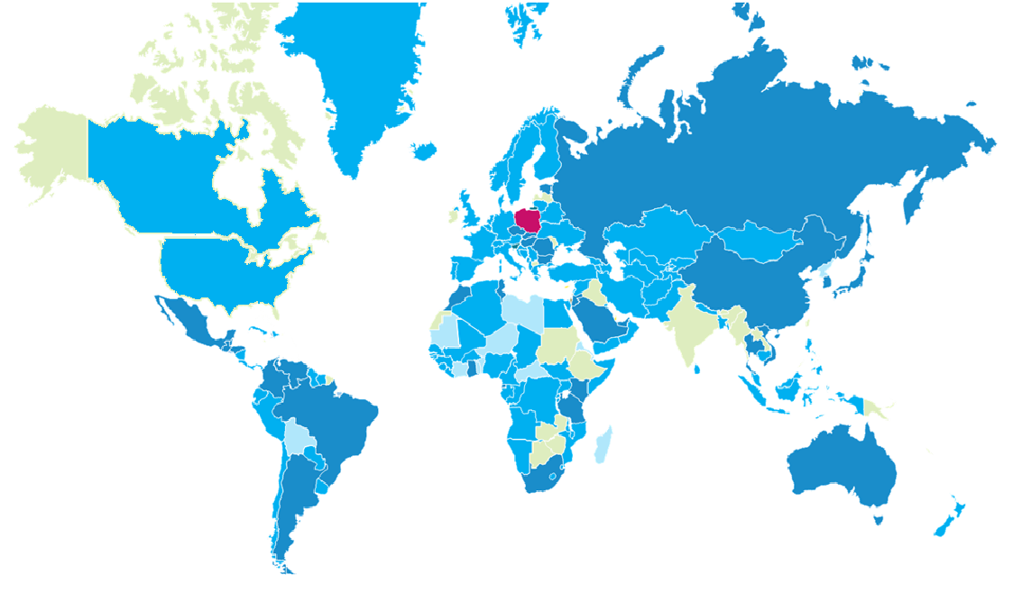
In its essence, regeneration supplements the global debate about the development of societies
Countries which have carried out urban renewal processes (that have urban renewal strategies, plans, or programmes in place): Austria, Belgium, Denmark, Finland, France, Spain, Netherlands, Germany, Iceland, Portugal, Switzerland, Sweden, United Kingdom, Egypt, Saudi Arabia, Israel, United Arab Emirates, USA
Countries very interested in urban renewal include: Ghana, Guinea, Kenya, Morocco, South Africa, Tanzania, Tunisia, Bulgaria, Croatia, Czech Republic, Estonia, Russia, Hungary, Slovenia, Romania, Slovakia, China, Australia, Japan, Thailand, Vietnam, South Korea, Argentina, Bahamas, Belize, Brazil, Honduras, Guatemala, Mexico, Panama, Columbia, Venezuela,
Countries with low interest in urban renewal: Uganda, Swaziland, South Sudan, Rwanda, Burundi, Lesotho, Kuwait, Syria, Mongolia, Sri Lanka, Fiji, Kyrgyzstan, Dominican Republic, Grenada

Slide 3
CITY RE:INVENTED
THE MOTTO CITY RE:INVENTED IS UNIVERSAL, ORIGINAL AND HAS A MULTIDIMENSIONAL CHARACTER. MOREOVER, IN A SIMPLE WAY IT REFLECTS THE MESSAGE OF EXPO 2022, WHICH IS URBAN REGENERATION
“Re:” is the essence of renewal, the process of transformation, is a symbol of the life cycle of the city
”Re:” is a response to human needs and natural social and community behaviors, as well as the processes taking place in the urban space
„Re:” is also a symbol of modern communication via the use of new technologies
„Invented” shows the assumptions of modern urban regeneration and creativity

Slide 4
A UNIQUE APPROACH STRENGTHS OF EXPO 2022
Central location - EXPO returns to the original format of the Exhibition
EXPO 2022 in Łódź will be incorporated into the city landscape
Smart and sustainable EXPO
Rather than an isolated event, the Exhibition will be an integral part of its environment
Polish effective EXPO formula
Development of innovative companies
EXPO 2022 will be a place of experiencing emotions
EXPO as the next grand celebration in Poland and as a symbol of Polish transformation

Slide 5


Number of EXPO 2022 participants
Basic projections concerning the number and structure of participants of the International EXPO 2022 Exhibition in Łódź.
105
16
13
30
STATES
Cities, Regions, Provinces
International organisations
Sponsors

Slide 6
Number of visitors at EXPO 2022
Main projections concerning the number of visitors
8,21 million number of visits
7,28 milllion number of visits by domestic visitors
925,2 THousand number of visits
by foreign visitors
The largest group of visitors
Families with children

Slide 7
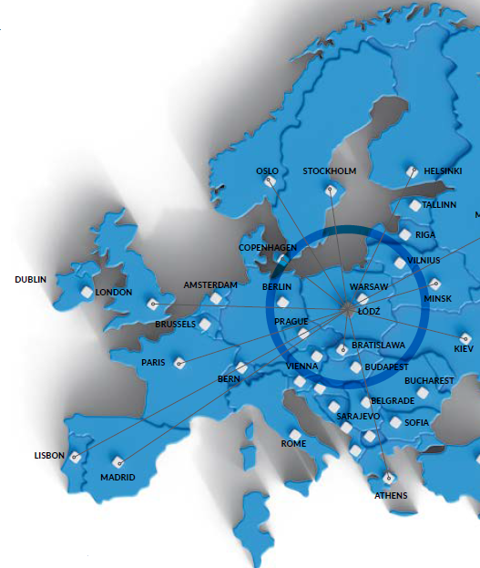
Location of Łódź
By any measure, Łódź is an extraordinary town, grown out of the need to create.
Located in the very heart of Poland, at the intersection of routes used now and in the past for the exchange of trading goods, people and ideas, Łódź is a cosmopolitan and multicultural city.
The whole Łódź agglomeration with over 1,1 million inhabitants is one of Poland’s most important economic centres and a prominent culture and academic hub.

Slide 8
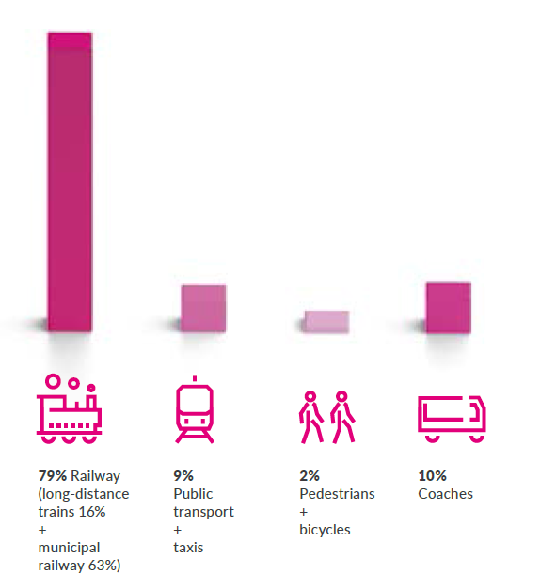
EXPO 2022 Transport structure of visitors

Slide 9
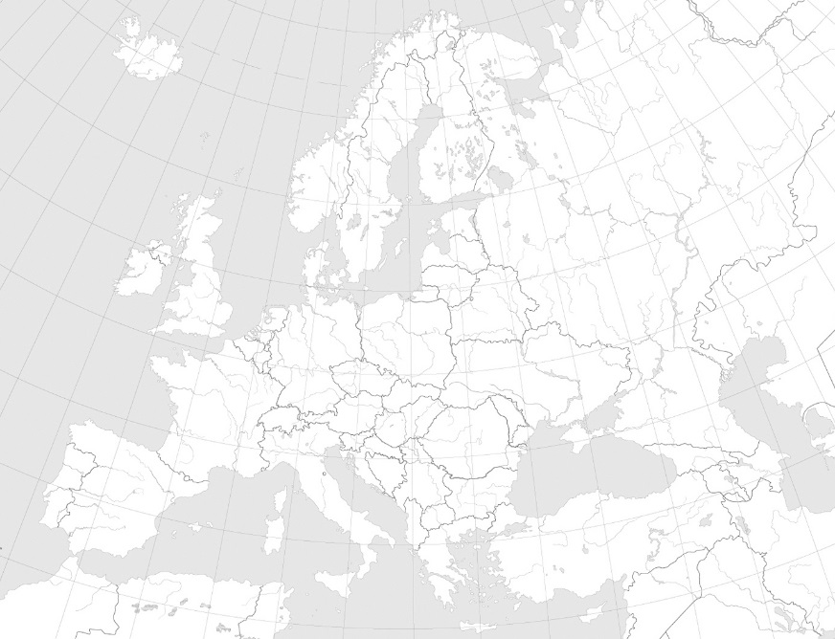
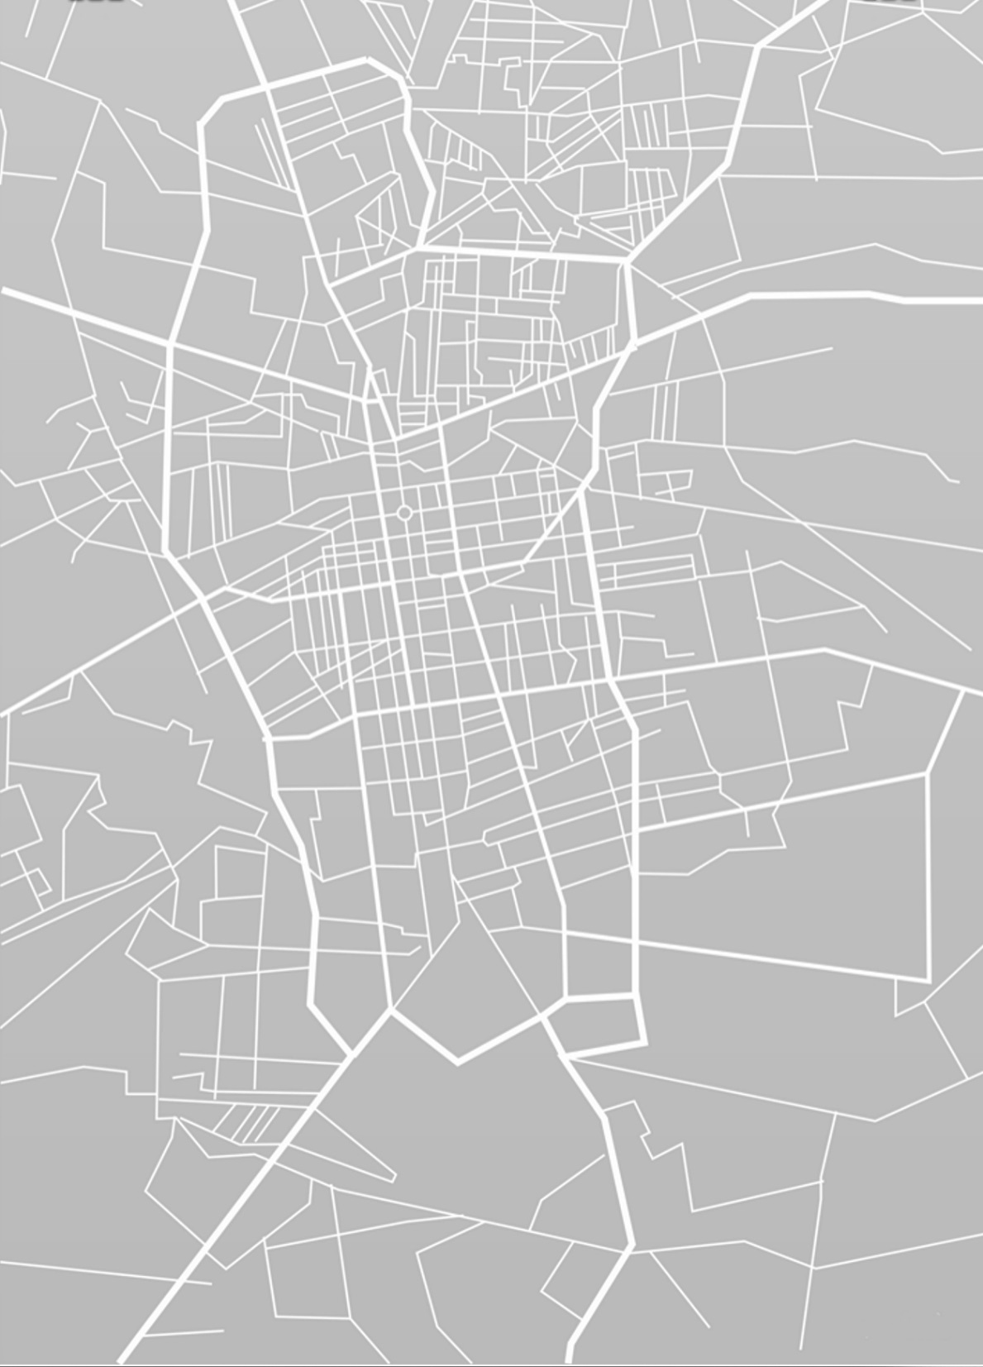
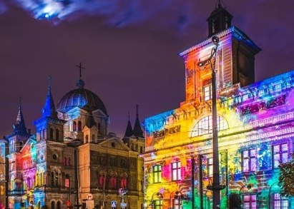
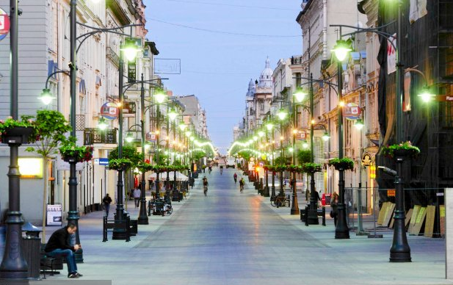
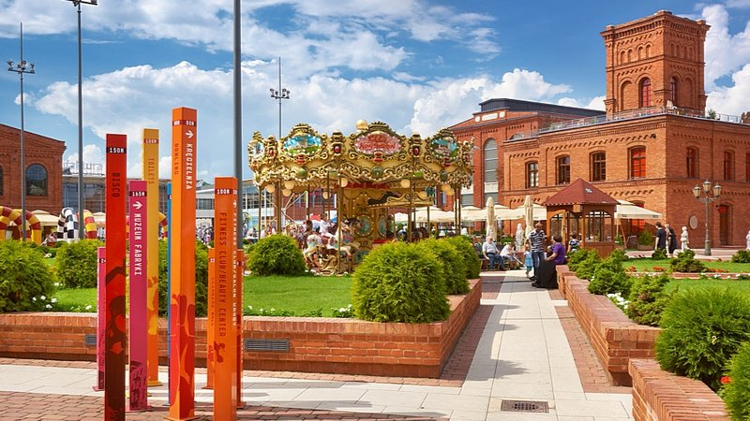
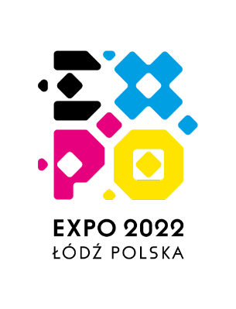
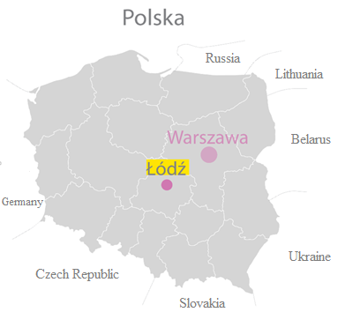
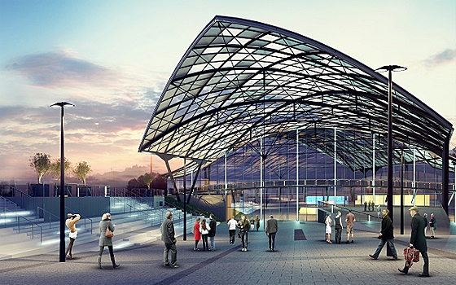
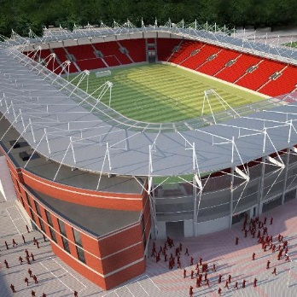
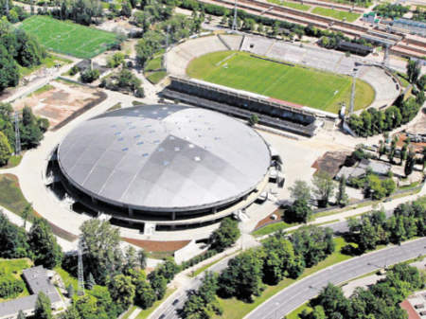
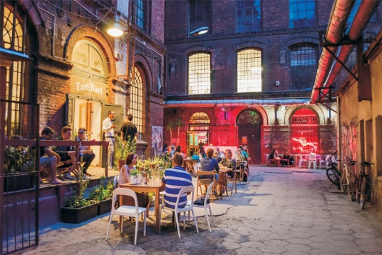
Exposition localisation: CENTER of…
Piotrkowska
MANUFAKTURA- Market
Europe
FABRYCZNA
WIDZEW
Off piotrkowska
Poland
Łódź
ATLAS ARENA

Slide 10
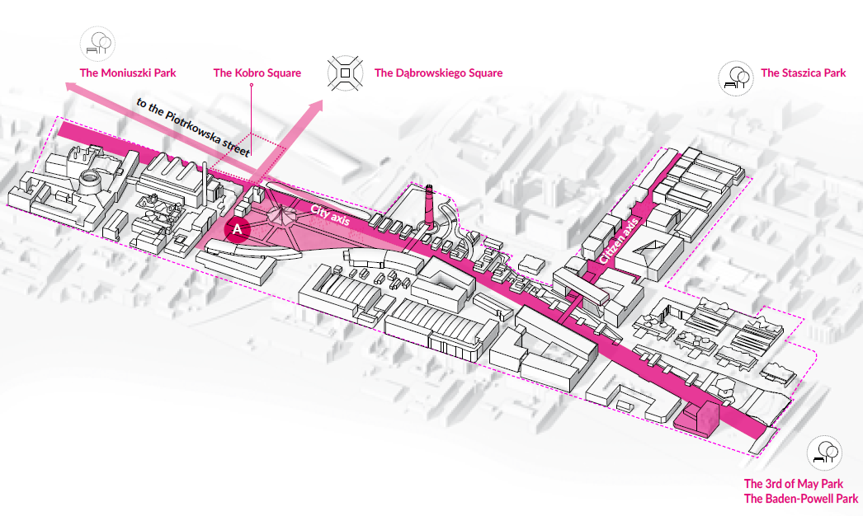
EXPO 2022- Composition

Slide 11
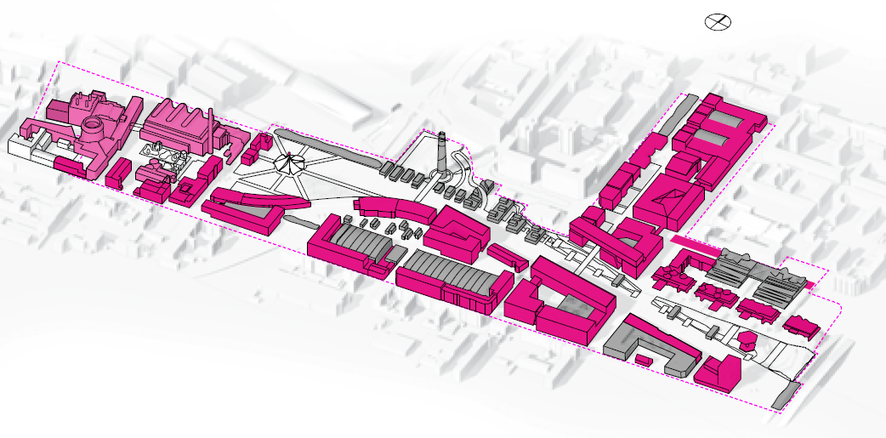
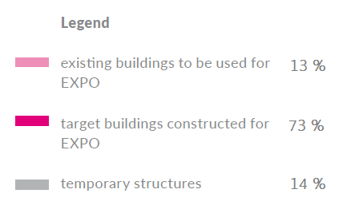
BUILDINGS OF EXPO

Slide 12
THE TRANSFORMATION OF THE CITY AFTER EXPO

