Slide 1


WIELKOPOLSKA REGION DEVELOPMENT FUND
SELF-GOVERNMENT COMPANY
New support instruments for MSE
and urban areas

Slide 2
MISSION AND PURPOSE
Wielkopolska Region Development Fund as a Self-Government Company was set up by the founding act signed on
5 October 2016
MISSION: Financial management of the funds returned from the financial engineering instruments of the Wielkopolska Regional Operational Program for the years 2007-2013 and 2014-2020 (JEREMIE - Joint European Resources for Micro to Medium Enterprises and JESSICA - Joint European Support for sustainable Investment in City Areas)
PURPOSE: Using financial instruments to support development of micro, small and medium enterprises and promote the Wielkopolska Region as an attractive region for investors and conducting economic activity

Slide 3


ACTIONS OF THE SELF-GOVERNMENT OF THE WIELKOPOLSKA REGION
TO BUILD A SUSTAINABLE FINANCING MECHANISM
FOR DEVEOPMENT PURPOSES
2009
Start implementing JEREMIE and JESSICA
April - June 2016
Ending of projects JEREMIE and JESSICA
September 2016
Termination of contracts
JEREMIE and JESSICA
2017
Returning funds
to the Wielkopolska Region
February - March 2017
Assignment of tasks to WFR Ltd.
October 2016
Establishment
of the company
WFR Ltd.
The agreement entrusting implementation public tasks in the field of financial management was signed on March 17, 2017 between the Wielkopolska Region Development Fund and the Wielkopolska Region (an in-house model)

Slide 4
ORGANIZATIONAL FRAMEWORK
Actions conducted for the acquisition by the Wielkopolska Development Fund full operating capacity (i.a. organizational, technical, human resources)
Implementation of the statutory tasks
Handling the 1st level operational agreements
within JEREMIE and JESSICA initiatives
Actions leading to involvement of entrusted funds into financial instruments
Currently in parallel with the implementation of the First Level Operational Agreements activities are being carried out leading to the involvement of funds returned from the JEREMIE and JESSICA initiatives into financial instruments

Slide 5

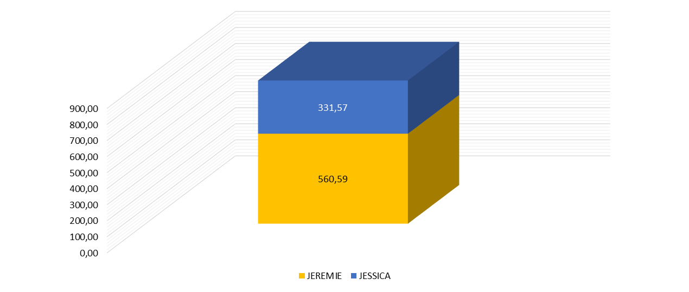
THE STRUCTURE OF FUNDS DECLARED TO ENTRUST THE MANAGMENT TO THE WIELKOPOLSKA REGION DEVELOPMENT FUND
(as for 31.01.2017/ in mln PLN)
Total pool of declared funds transferred to WFR
within WRPO 2007-2013
= 892.16 million PLN
(207,48 mln EUR)

Slide 6

INVESTMENT STRATEGY
Investment Strategy of the Wielkopolska Region Development Fund relates to regional knowledge and experience in implementing financial instruments. Based on program assumptions, conclusions from the diagnosis of investment needs and additional analysis to take proper focused actions and adequately adressed development support.

Slide 7
FINANCIAL PRODUCTS debt & capital financing
Financial products implemented at the regional level targeted to support development projects, MSE sector, including startups in terms of preferences for smart specializations
Financial products tailor-made for local needs ensuring sustainable development of the region

Slide 8
FINANCIAL INTERMEDIARIES /
JEREMIE and JESSICA as for 30.09.2017
Wielkopolska Agencja Rozwoju Przedsiębiorczości Sp. z o.o.
Fundusz Rozwoju i Promocji Województwa Wielkopolskiego S.A.
Stowarzyszenie Ostrowskie Centrum Wspierania Przedsiębiorczości
Jarociński Fundusz Poręczeń Kredytowych Sp. z o.o.
Stowarzyszenie Ostrzeszowskie Centrum Przedsiębiorczości
Samorządowy Fundusz Poręczeń Kredytowych Sp. z o.o.
Poznański Fundusz Poręczeń Kredytowych Sp. z o.o.
Polska Fundacja Przedsiębiorczości
Fundacja Kaliski Inkubator Przedsiębiorczości
Nest Bank S.A.
Agencja Rozwoju Regionalnego S.A. w Koninie
IKB Leasing Polska Sp. z o.o.
Consortium: Unia Gospodarcza Regionu Śremskiego - Śremski Ośrodek Wspierania Małej Przedsiębiorczości, Cech Rzemiosł Różnych
Consortium: ECDF S.A.,Towarzystwo Inwestycji Społeczno-Ekonomicznych S.A.
Towarzystwo Inwestycji Społeczno-Ekonomicznych S.A.
Unia Gospodarcza Regionu Śremskiego - Śremski Ośrodek Wspierania Małej Przedsiębiorczości
POLFUND Fundusz Poręczeń Kredytowych S.A.
ECDF S.A.
Fundusz Regionu Wałbrzyskiego
Agencja Rozwoju Regionalnego „AGROREG” S.A.
Bank Gospodarstwa Krajowego
21
FINANCIAL INTERMEDIARIES
78 agreements
total contract value:
1 672 034 392,23 PLN

Slide 9
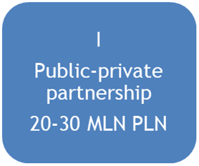
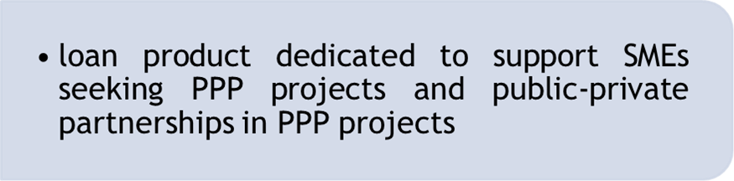
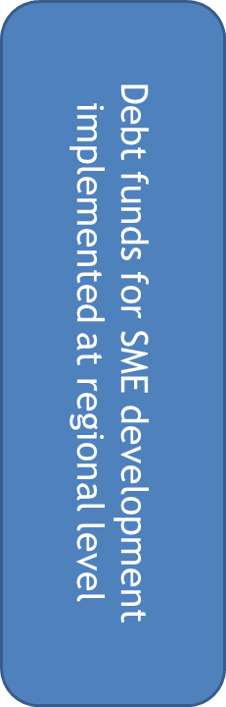
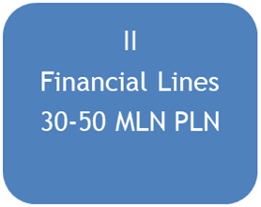
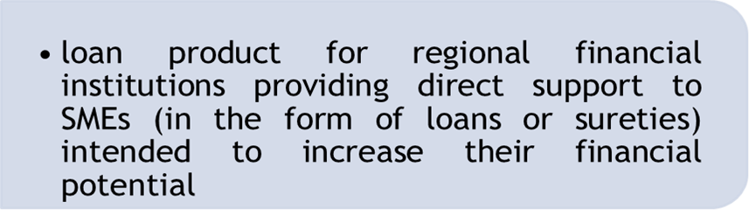
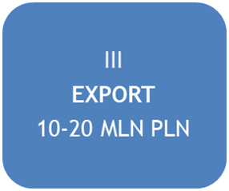
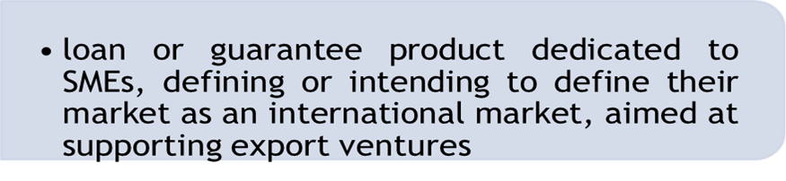
PLANNED USE OF RESOURCES - JEREMIE initiative - support for micro, small and medium enterprises
Declared funds under the JEREMIE Initiative: 560.6 million PLN
Currently resources available: 90.2 million PLN

Slide 10

COMPANY ACTIVITY
Wielkopolska Region Development Fund
provides back support in the form of:
    low–interest loans
    sureties/ guarantees
    capital entry
    other repayable forms of financing

Slide 11

COMPANY ACTIVITY
The company in the framework of promotion and development of the Wielkopolska Region takes action in the field of foreign expansion
The foreign expansion is aimed at recognizing the opportunities offered by multinational markets in the context of launching support for investments for entrepreneurs from the Wielkopolska Region

Slide 12


WIELKOPOLSKA REGION DEVELOPMENT FUND
Expansion & Development Department
analysis of market development, market trends and potential
diagnose of new areas for development
current cooperation with business partners, searching for new business opportunities
cooperation with institutions in international projects
complex organization of meetings and business travel, selecting the most appropriate international markets
cooperation with regional authorities to promote the region and support foreign contractors
publishing activities connected with the expansion of the company
creating business development strategy of the Wielkopolska Region
coordinating and executing marketing campaigns, events

Slide 13

SUPPORT OF SME’s INTERNATIONALIZATION
Searching for opportunities in the emerging markets
for investors from the Wielkopolska Region
Visit to Angola 7-14.08.2017
One of the top 10 fastest growing economies in the world, some say it will be the future powerhouse of Africa. Vast natural resources and a quickly growing population make Angola highly attractive.
meetings with ministries and provincial governors
participation in fairs: Expo-Huíla 2017 (Huíla province is a partner region of the Wielkopolska Region)
B2B meetings
Creating INVESTOR’S GUIDE
tips for doing business in Angola

Slide 14
NEXT VISIT TO ANGOLA 4-12.11.2017
Continuing political and economic relationships after the election in Angola
Visiting 3 ministries: Ministry of Health, Ministry of Agriculture, Ministry of Industry
Collecting additional data to the investor’s guide
Making 3 investments from Wielkopolska Region
Visiting 3 provinces: Luanda, Malanje and Huila
Meetings with 2 organisations: APIEX and SODEPAC

Slide 15
SEARCHING FOR OPPORTUNITIES IN THE EMERGING MARKETS FOR INVESTORS FROM THE WIELKOPOLSKA REGION
Plans for the third quarter 2017 of visits and market recognition:
  Africa:
    Namibia
    Angola
    Ghana
    Tanzania
  South America
    Argentina
    Uruguay

Slide 16
PLANS FOR VISITS AND MARKET RECOGNITION IN 2018
Africa
  Angola
  Ghana
  Tanzania
  South America
      Cuba
      Argentina
      Columbia
Asia
  Kazakhstan
  Vietnam
  China

Slide 17

WIELKOPOLSKA REGION AN ATTRACTIVE REGION FOR INVESTORS
Our next target: searching for cooperation with international institutions:
SMEs, universities/research centres, trade associations, Chambers of Commerce, local/regional government)
to help develop entrepreneurial projects in the Wielkopolska Region
Internationalization initiatives will promote
a cooperation with foreign partners with the use of our financial products

Slide 18

We look forward to future cooperation…
Thank you!
Hubert Zobel
President of the Board
Wielkopolska region development fund
Szyperska 14, 61-754 Poznań
wfr@wfr.org.pl
+48 61 671 71 71

