Slide 1


.

Slide 2
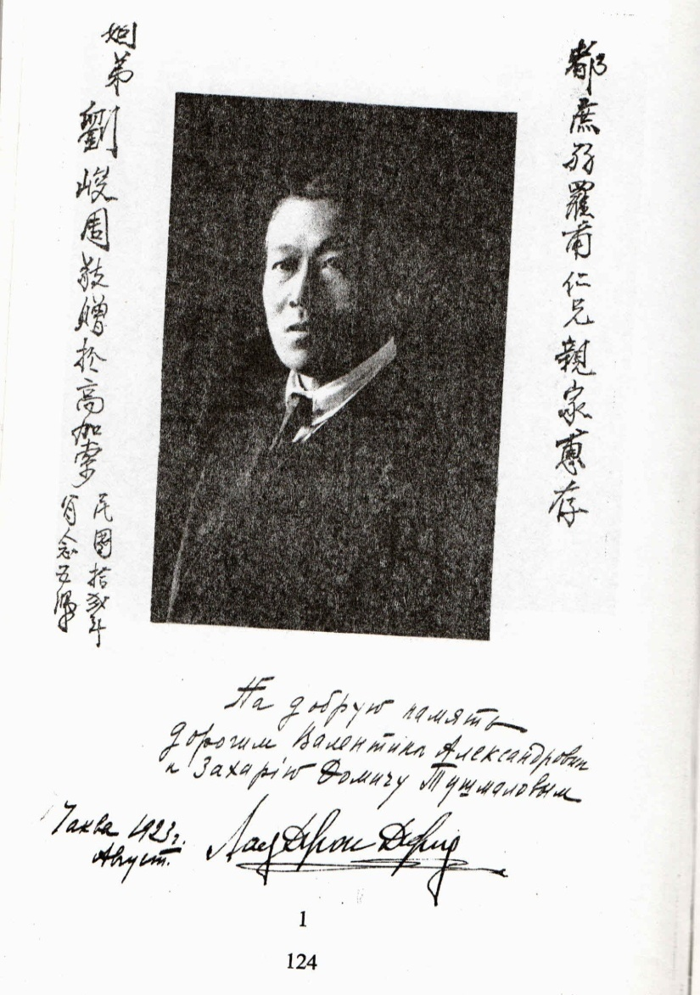
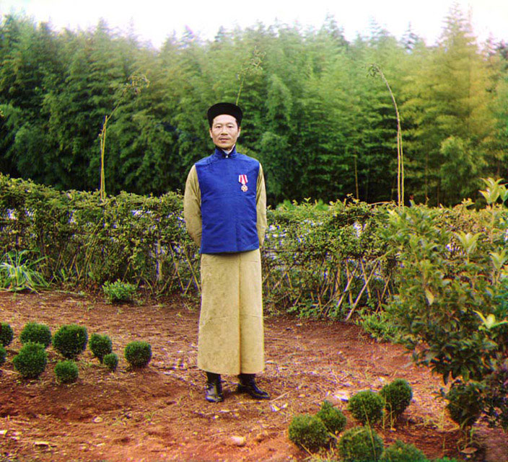
1893-The Production of Georgian Tea Commences under the Leadership of Chinese Tea-grower Lao Zhan Zhou(1870-1939).
The first international recognition of the Georgian Tea received in 1899 at an exhibition in Paris, where it was awarded a gold medal.

Slide 3
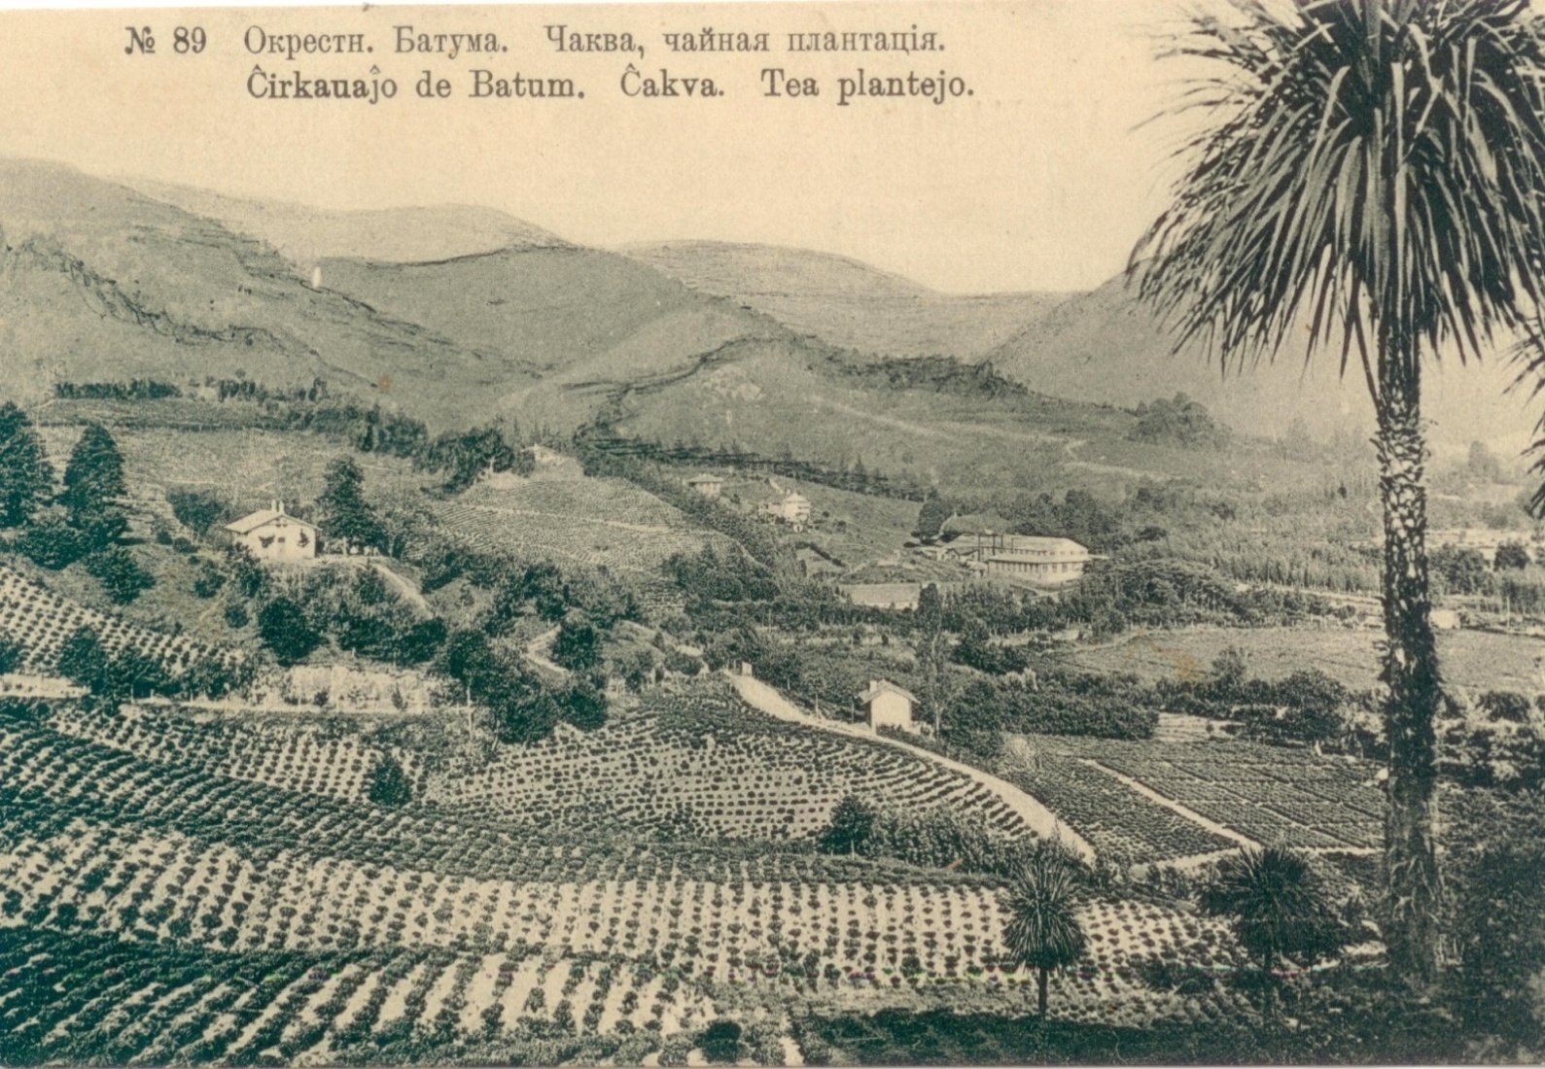
The industry was growing and during the Soviet Union we supplied Tea for the whole Soviet Union. Georgia became 4th largest producer of tea in the world.
.

Slide 4
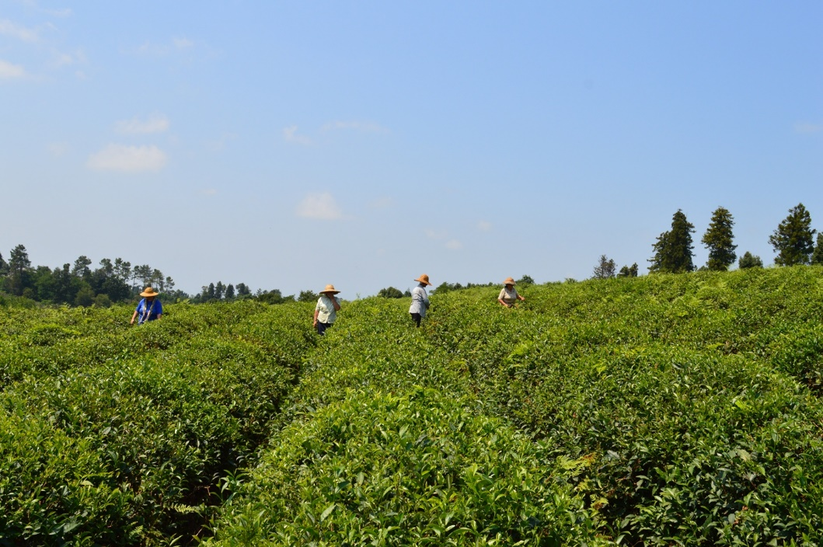

Nowadays Tea growing industry is developing intensively. Tea plantations are spread over 3000 hectares and 2 tons are picked per hectare.

Slide 5
Georgian Tea Characteristics
Georgian tea is well known for its authentic and exclusive touch and a variety of taste nuances.
Sub-tropical climate zone along the coast line, perfect matching of soil and moist air from the Black Sea, temperatures that vary drastically between summer and winter determine the unique character of Georgian tea.
Strong contrast between day and nighttime temperatures during the period when the tea shoots start to appear, produces aromatic substances in the delicate sprouts of the plant creating a complex bouquet of aroma unique to Georgian tea. Specially selected varieties allow the bushes to grow well despite the very cold winters.
However, a benefit of the extreme winter cold is that pests and diseases typical on tea grown in the tropics do not occur here. Thus Georgian teas are completely free from any pesticides.

Slide 6


Natura Tea Company
Natura Tea Company was founded in 2013 in Guria region.
Natura Tea Company has its own tea plantations spread over 41 hectare land. 40 tons of fresh tea leaves is picked in a season out of which we produce 10 tons of product - tea.
Picking process is only handmade process, that makes our Tea of the highest quality.
“Natura Tea Company” produces high quality natural and ecologically pure products.
“Natura Tea Company” produces 7 types of tea: “Natura Taiguli”, “Natura Mtsvane”, “Natura Imperatori”, “Natura Marjani”, “Natura Khaverdi”, Green Iodized Tea and Black Iodized Tea.

Slide 7
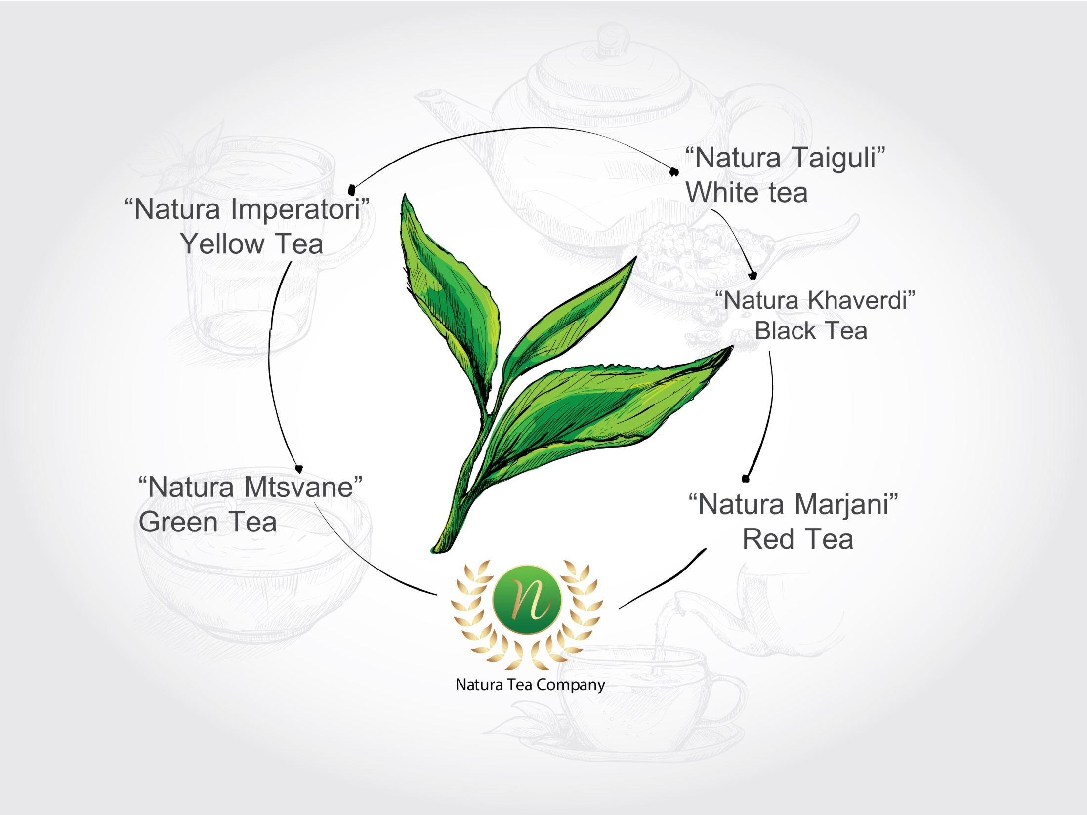

Slide 8

“Natura Khaverdi”
Black Tea
Black tea belongs to the camellia sinensis the mere tea bush petals that are preceded with specific methodology. Black tea petals fermentation process undergoes till it is totally rusted. Black tea is the most popular among others. Black tea tincture has light aroma and pleasant astringent taste.
Black tea contains more caffeine compared to other tea types and least antioxidants. Black tea useful features: it blocks cancer cells growing, reduces the stomach, gastrointestinal and breast cancer risks, regulates the cardiovascular system, destroys the germs that cause diarrhea, pneumonia, cystitis and herpes, and lowers blood cholesterol.

Slide 9
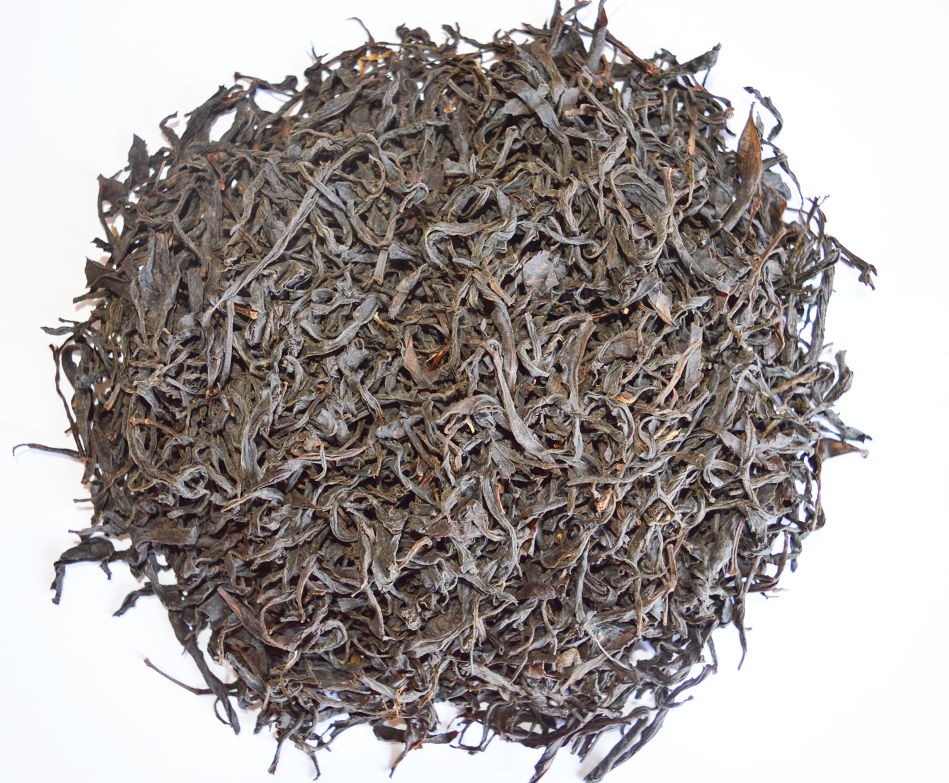

Slide 10
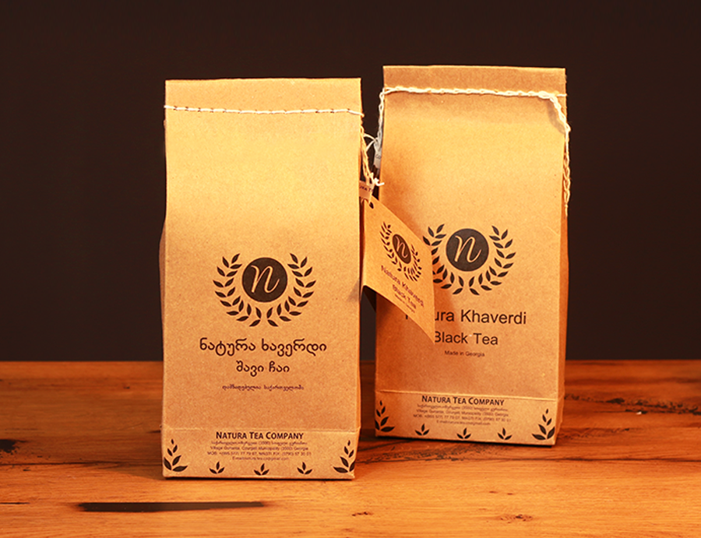

Slide 11

“Natura Mtsvane”
Green Tea
Green tea bush petals are collected on early spring and prepared immediately. By warming, steaming or roasting technique petals fermentation is terminated. Petals go through wind procedure before they are finally dried out. Green tea tincture has yellow color.
Green tea has useful features: rich in antioxidants, anti-stress effect, metabolism and bowels normalization, helps to sweat, strengthens heart and blood vessels, prevents caries, improves vessels tightness, and absorbs ascorbic acid.

Slide 12
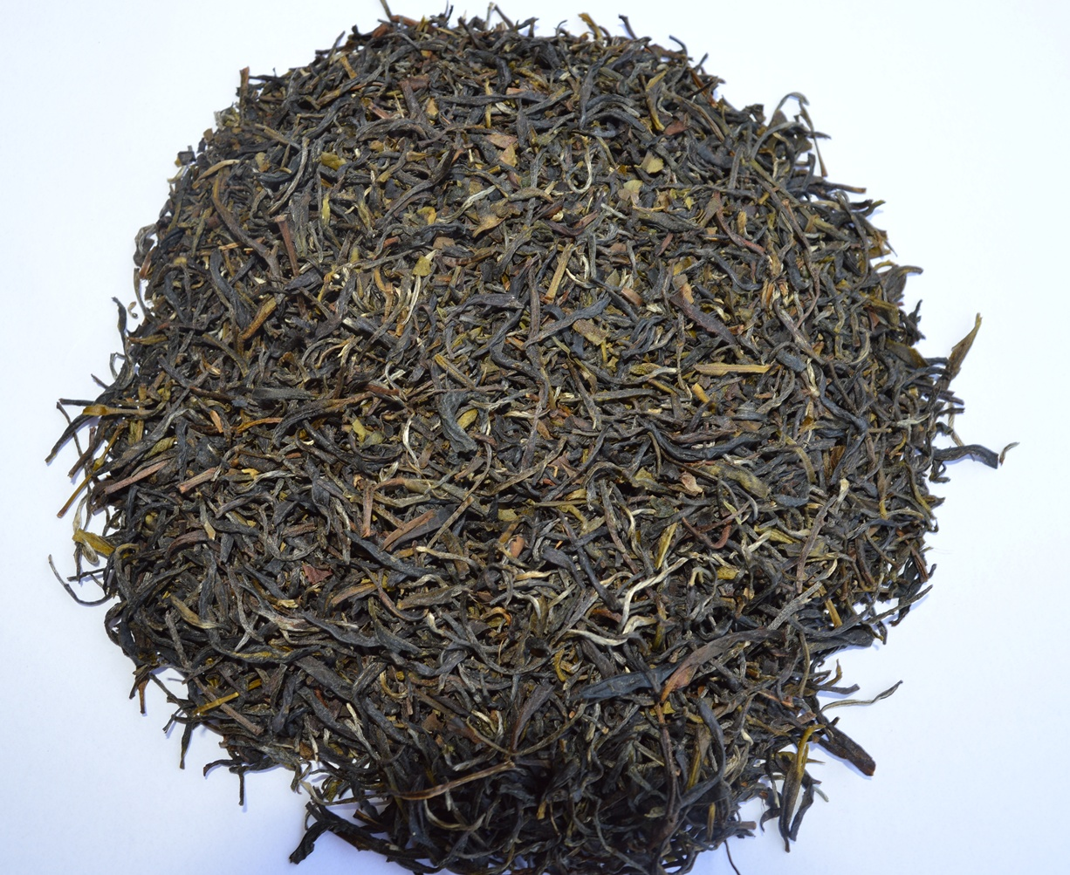

Slide 13


Slide 14

“Natura Imperatori”
Yellow Tea
Yellow tea preparation starts when tea bush buds are not opened yet. Yellow tea undergoes light fermentation and petals are stewed. Yellow tea tincture has transparent yellow color.
Yellow tea useful features are close to Green tea characteristics: it regulates blood pressure, strengthens heart and blood vessels, and activate brain cells.

Slide 15
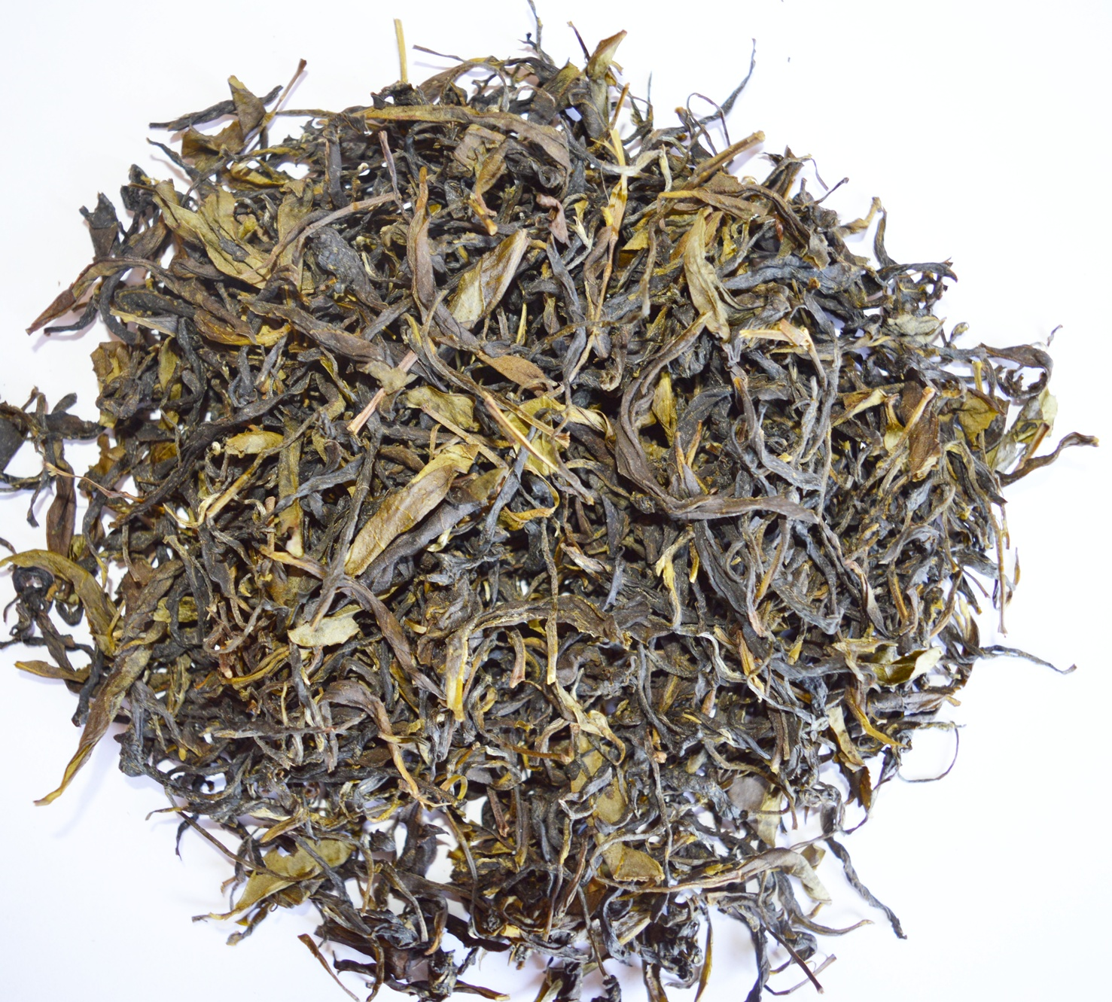

Slide 16


Slide 17

“Natura Marjani”
Red Tea
Red tea petals undergo fermentation process from 1 to up to 2 hours. Red tea is half-fermented as it rusts on behalf. Red tea tincture has beautiful red color and pleasant taste.
Red tea useful features fix immune system lowers artery blood pressure and cholesterol level in blood.

Slide 18
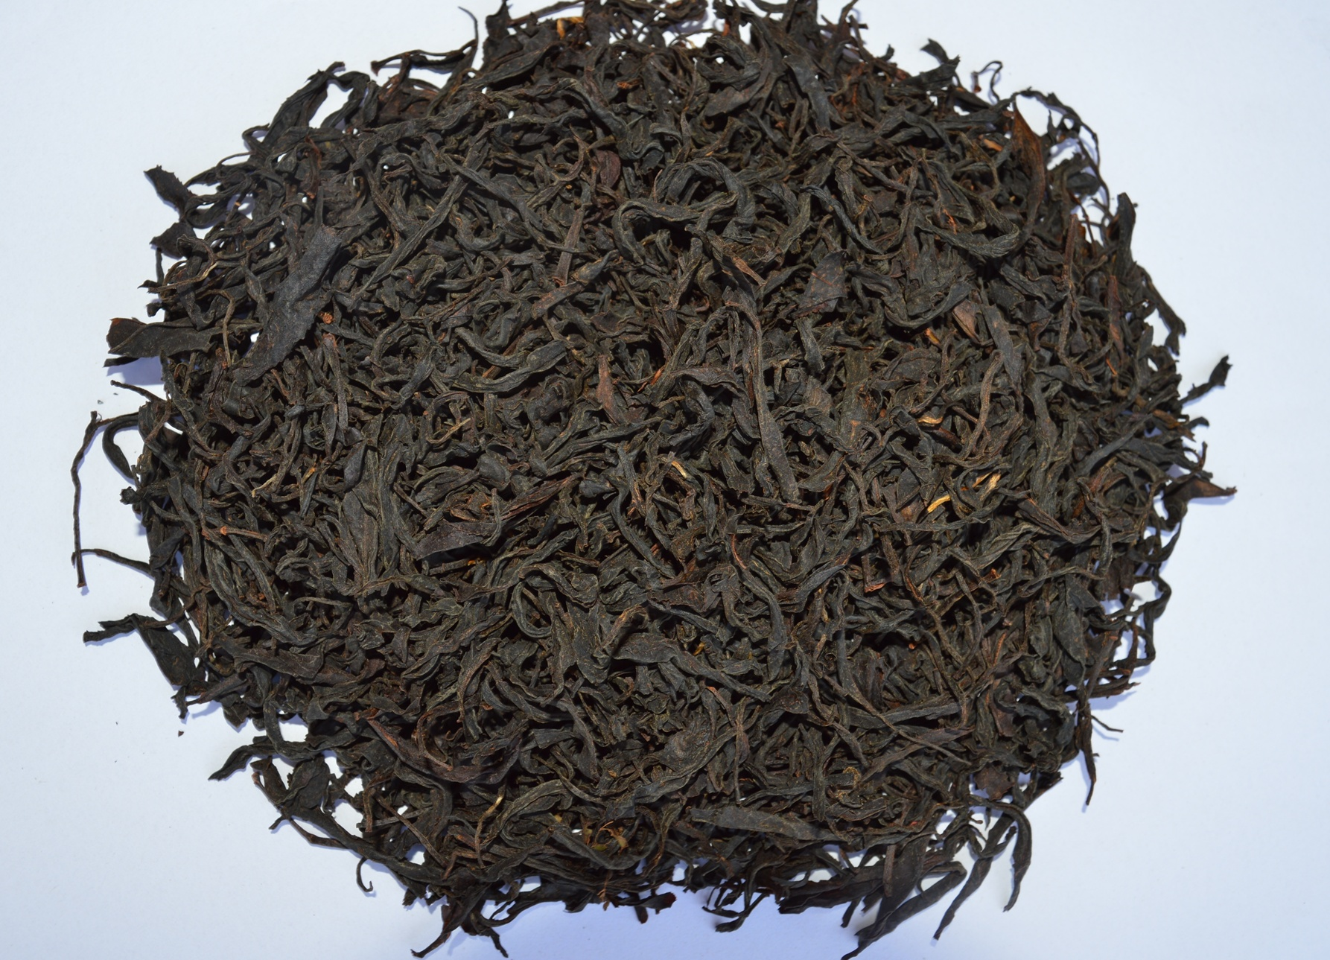

Slide 19


Slide 20

Iodized teas
In addition, the company produces Iodized black and green tea, is prepared on the base of newly picked, high-quality leaves and subtropical plant actinidia (kiwi) leaves of first vegetation.
The Iodized teas contain all biologically active substances found in green and black tea and actinidia leaves, including the iodine found in kiwi leaves. Iodine content is 5.3 mkg/%. As the product contains iodine, together with the properties of the consumed tea it is characterized with the preventive features for the persons diseased or having inclination to become diseased with goitre.

Slide 21


High
Quality Georgian
Tea

Slide 22
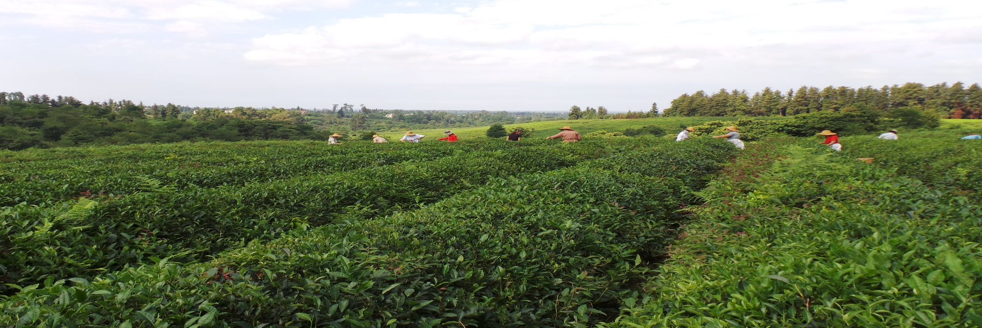
Natura Tea Company
Managing Director: Berdia Elgujauri
37D Chavchavadze St. Tbilisi, Georgia
email: natura.tea.co@gmail.com
fb: Natura Tea Company

